Slide 1



Slide 2

ADB Project
Logistic Center Pirot
FREE ZONE PIROT
content
content

Slide 3
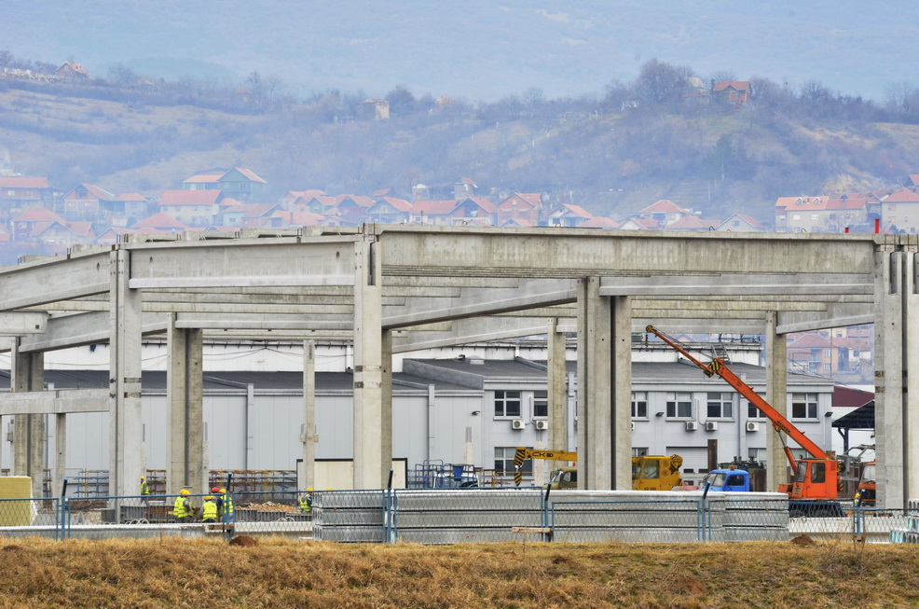
FREE ZONE PIROT

Slide 4

NATURAL LOGISTIC CENTER
CORRIDOR 4
CORRIDOR 10
FZ PIROT
CONSTANTZA
VARNA
BURGAS
BAR
ISTANBUL
CORRIDOR 8
THESSALONIKI

Slide 5
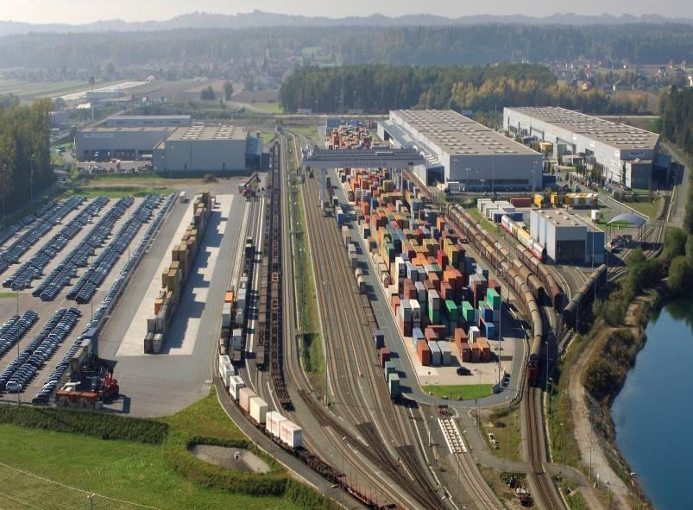
Regional Intermodal Logistic Center
Notes:
5

Slide 6

LOGISTIC CENTER PIROT
EU model
Regional Intermodal Logistic Center

Slide 7
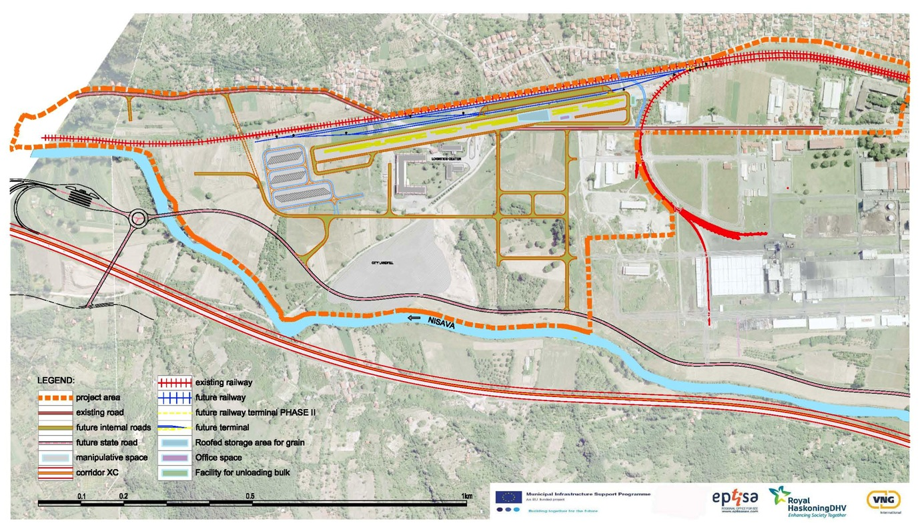

LOGISTIC CENTER PIROT
Good connections to Pan European corridors
Fast loading/unloading trucks - railway
TIGAR TYRES
3 Railway lanes

Slide 8
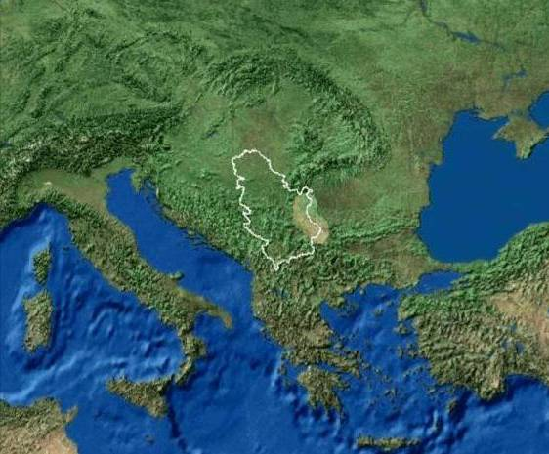
LOGISTIC CENTER PIROT
The
SHORTEST
ROUTE
EAST&
WEST
2154 KM
1928 KM
2016 KM
2350+530 KM

Slide 9
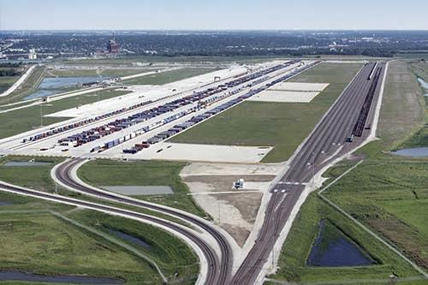
LOGISTIC CENTER PIROT
6.8 ha intermodal terminal and corridors
38 ha land for investors
12,8 M € Investment
4.200 new jobs

Slide 10

LOGISTIC CENTER PIROT
Connection to other intermodal nodes
All logistic services at one place including customs
Free Zone Incentives

Slide 11
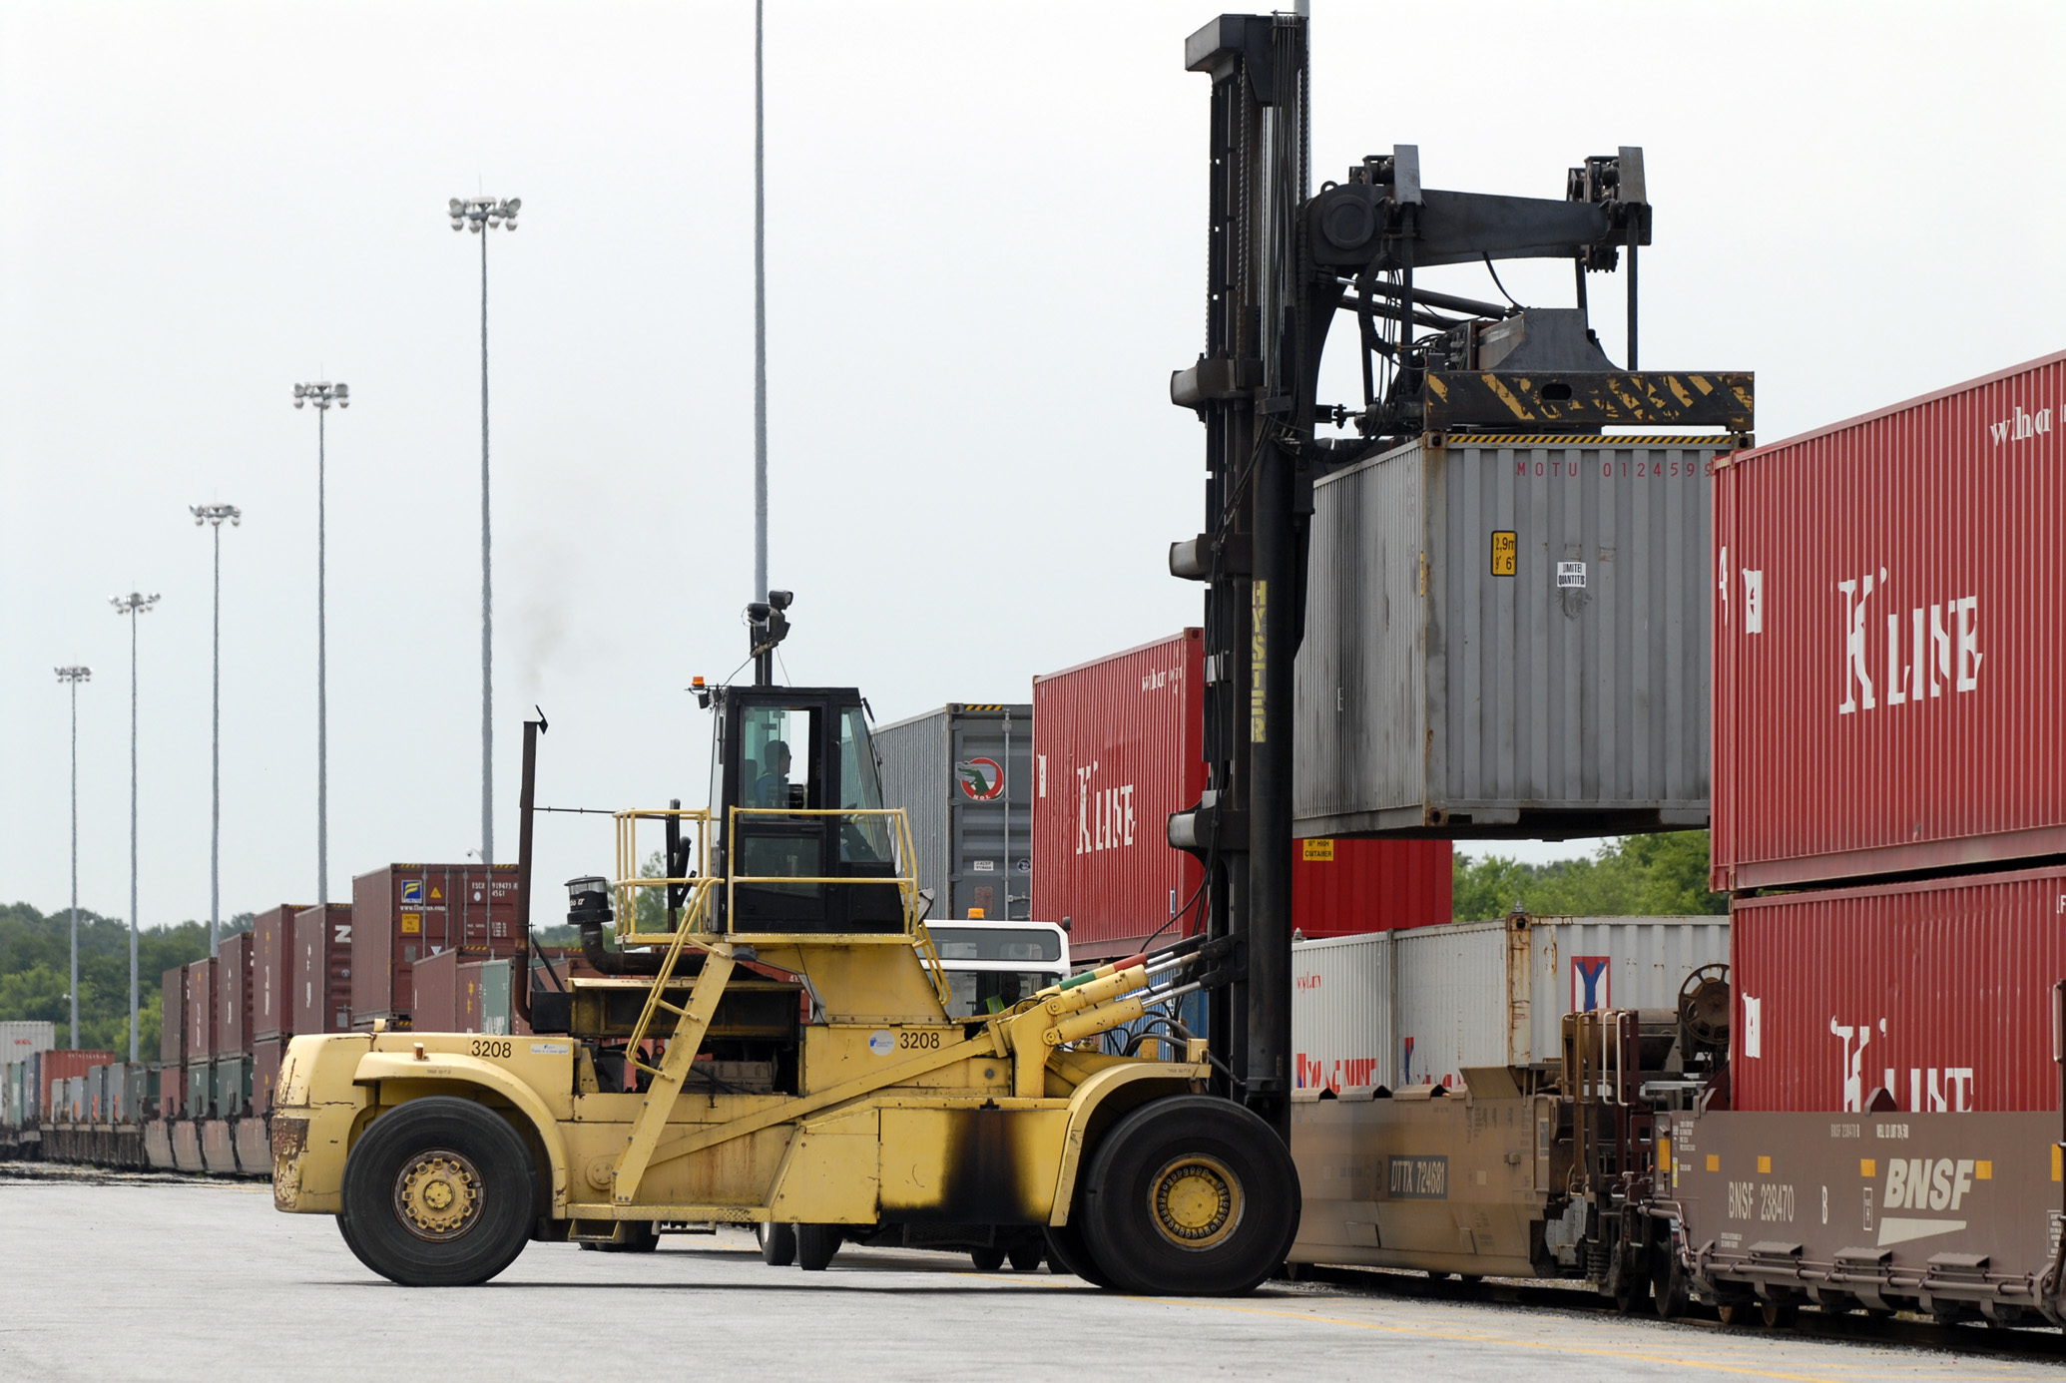
LOGISTIC CENTER PIROT
Total capacity 25.000 TEU/year
2020 Start operation

Slide 12
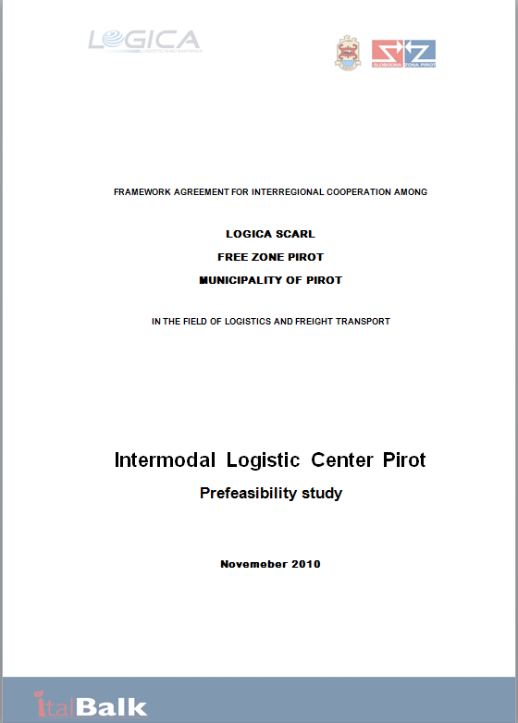
PREFEASIBILITY STUDY
2011 Compleated
Total value: 174.000 EUR

Slide 13
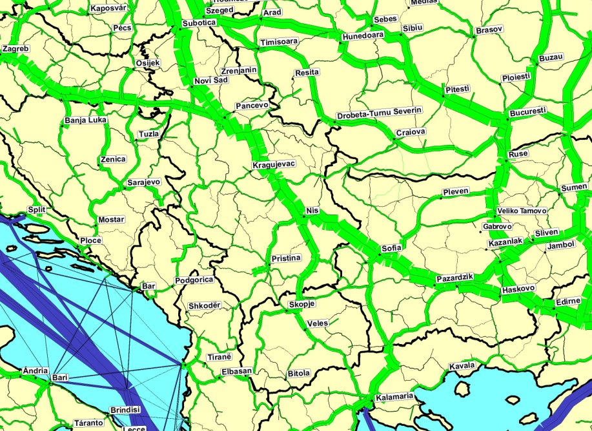
PREFEASIBILITY STUDY
Provides overview of the transport demand and supply contexts

Slide 14
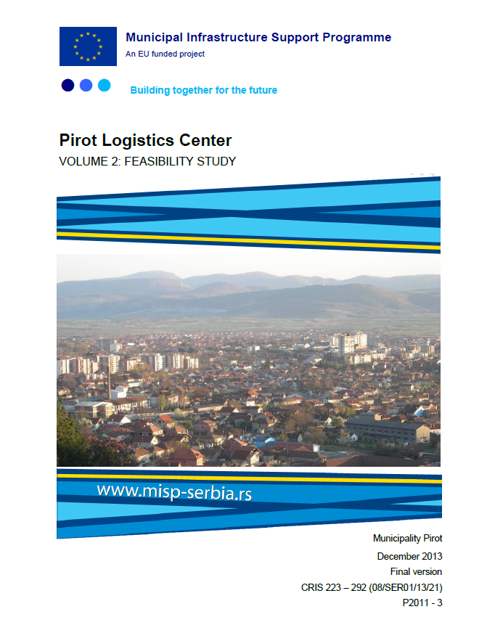
FEASIBILITY STUDY
Compleated 31/01/2014
Total value 800.000 EUR
Financed by MISP
Main beneficiary Municipality Pirot

Slide 15
FEASIBILITY STUDY
Logistic Center Pirot
Financial
sources
Funding source | Value € | %
EU grant | 7.623.101 | 59,61%
State contribution | 2.891.230 | 22,61%
Credit | 2.000.163 | 15,64%
Municipal Budget | 274.270 | 2,14%
Total | 12.788.764 | 100,00%

Slide 16
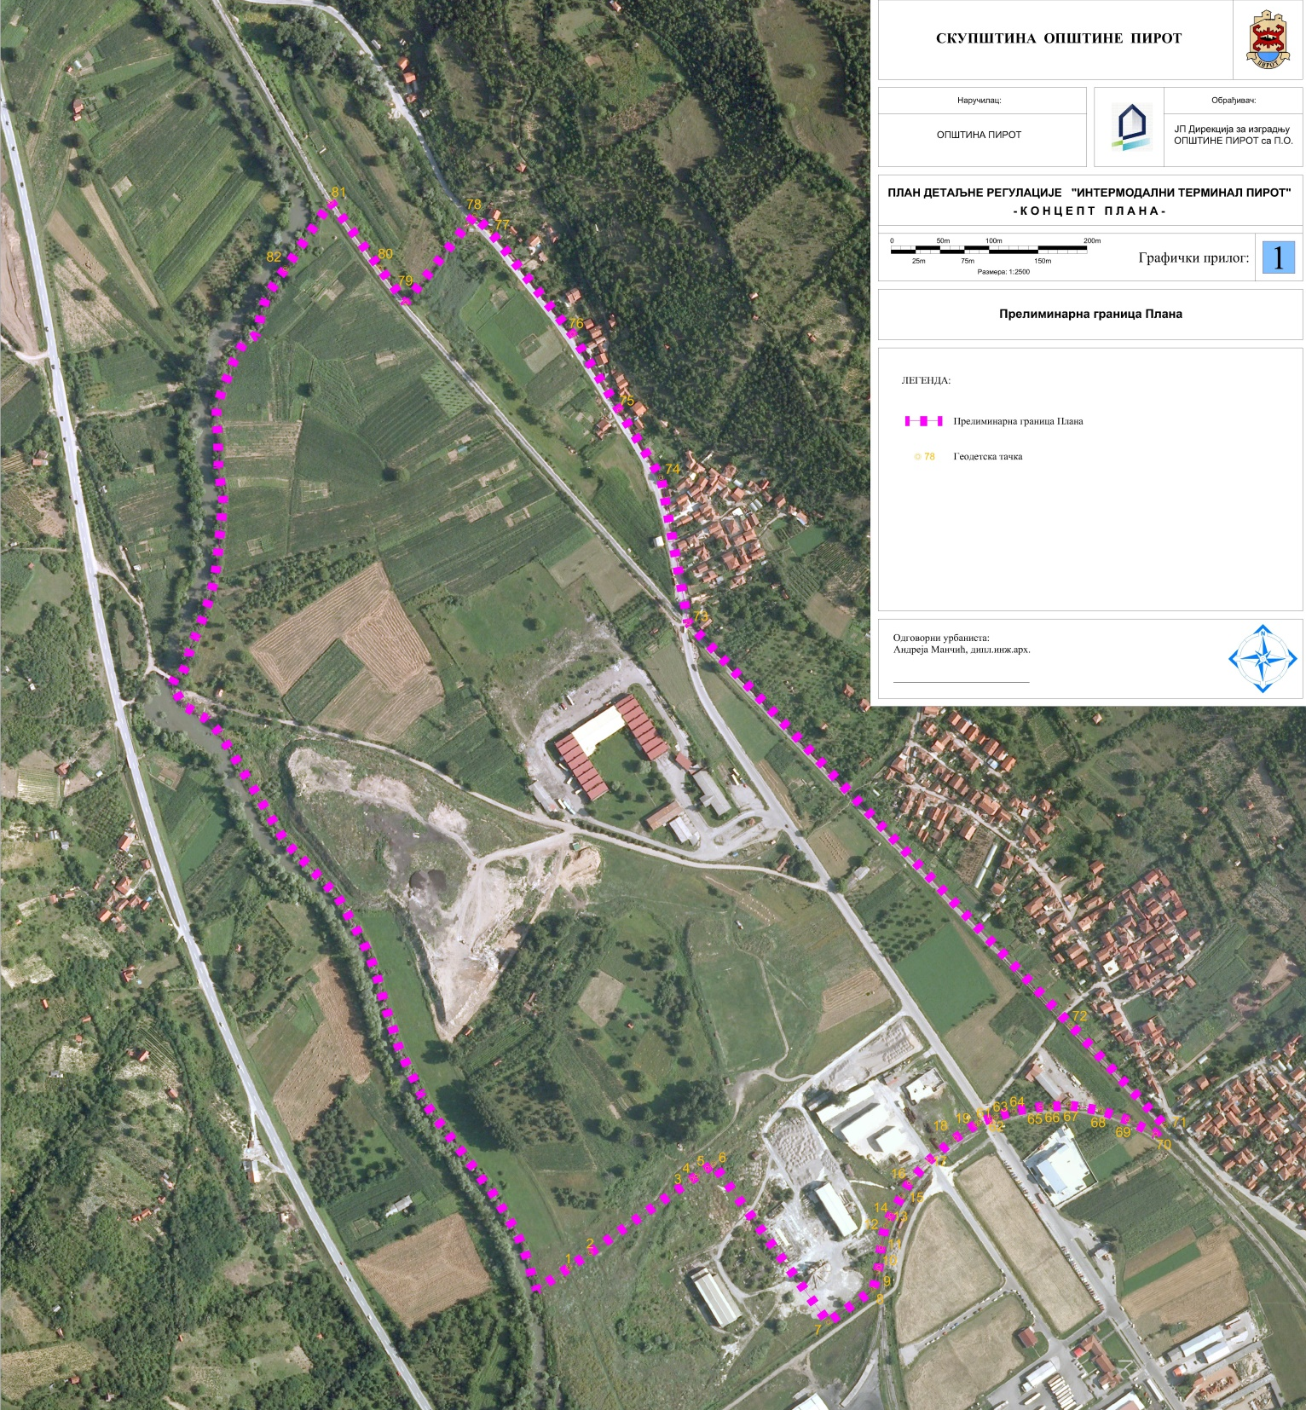
DETAILED REGULATION PLAN
Logistic Center Pirot
Total area
52ha 89a 24m2
Adopted in 2013 by Municipal Assembly Pirot

Slide 17
LOGISTIC CENTER PIROT
Compliance with local and national doc.
1. National strategy for sustainable development
2. Strategy and policy of development of industry of the Republic of Serbia from 2011 to 2020
3. Law on spatial plan of the republic of Serbia
4. Development strategy of railway, road, water, air and intermodal transport in the Republic of Serbia from 2008 until 2015

Slide 18
LOGISTIC CENTER PIROT
Compliance with local and national doc.
5. General Master plan of traffic of Serbia
6. White paper
7. Development strategy Nis, Pirot and Toplica
8. Local economic development strategy of the municipality of Pirot
9. EU project - Adriatic Danube Black Sea Multimodal Platform

Slide 19



STRATEGIC SUPPORT TO LOGISTIC CENTER PIROT
ADRIATIC-DANUBE BLACK SEA
MULTIMODAL TRANSPORT

Slide 20
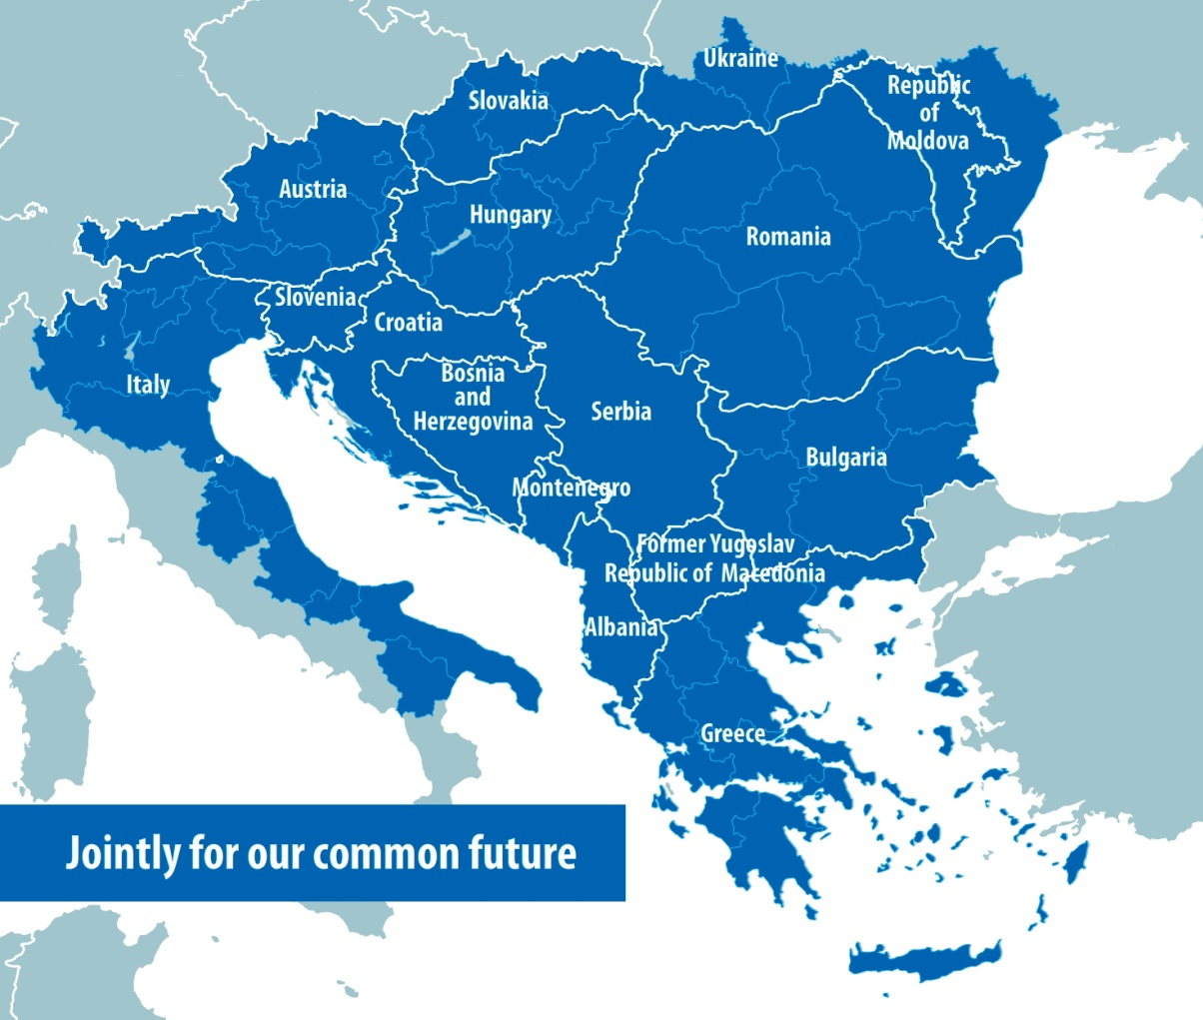
ADB MULTIPLATFORM
PROJECT PARTNERS: 42
15 ERDF partners
7 IPA partners
17 ASP & 3 Observers
Duration:
30 months (04/2012-09/2014)

Slide 21
ADB MULTIPLATFORM
Results
Signature of „Green Transport MoU“
Overview of the existing transport infrastructure and forecast of future transport supply
Identification of main transport rutes
Establishment of Multimodal Development Centers (MDC)

Slide 22
ADB MULTIPLATFORM
Results
ICT tool for tracking and tracing of freight trains
Thorough survey on the common needs for
harmonization of customs procedures
...

Slide 23
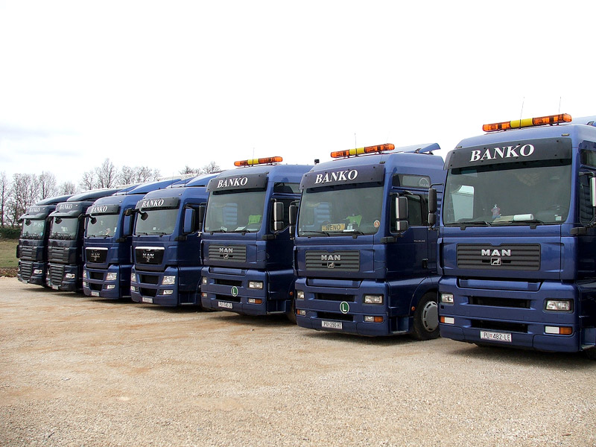
NOW
15.000 trucks per year

Slide 24

OVERSEA
1.100 CONTAINERS PER YEAR

Slide 25
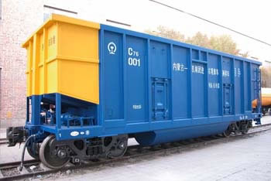
YEARLY 1500 WAGONS WITH CONTAINERS OR COAL

Slide 26
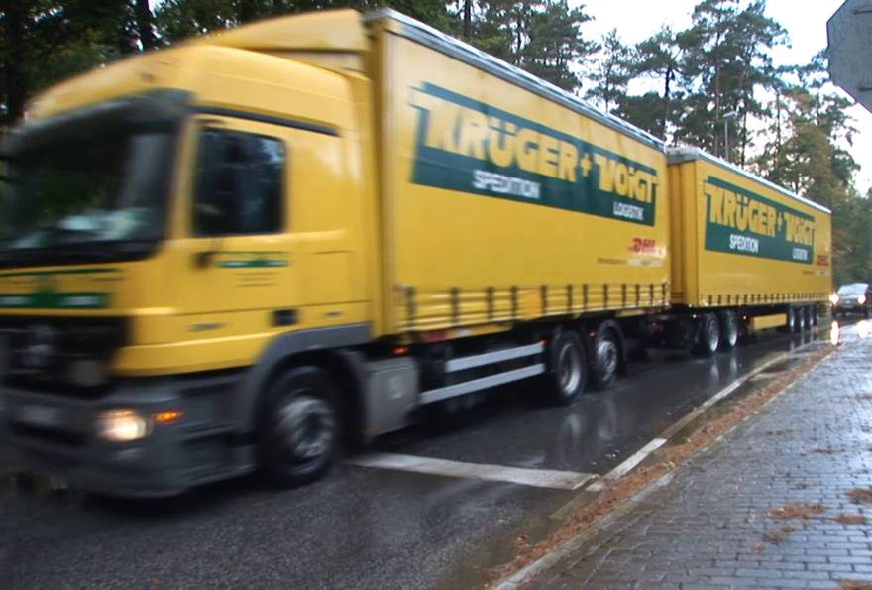
MINIMUM 50 TRUCK START TO EU DAILY

Slide 27
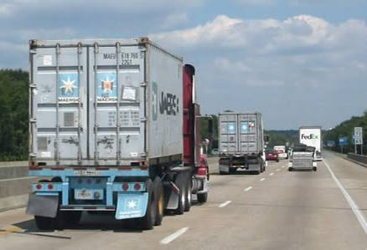
1400 TRUCKS
DAILY TRANSIT THROUGHT PIROT

Slide 28
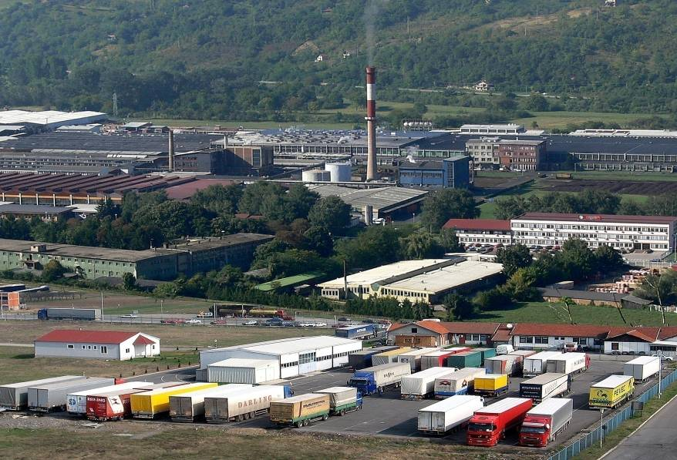
Free Zone Pirot
Notes:
28

Slide 29





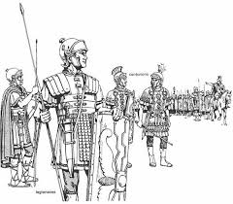
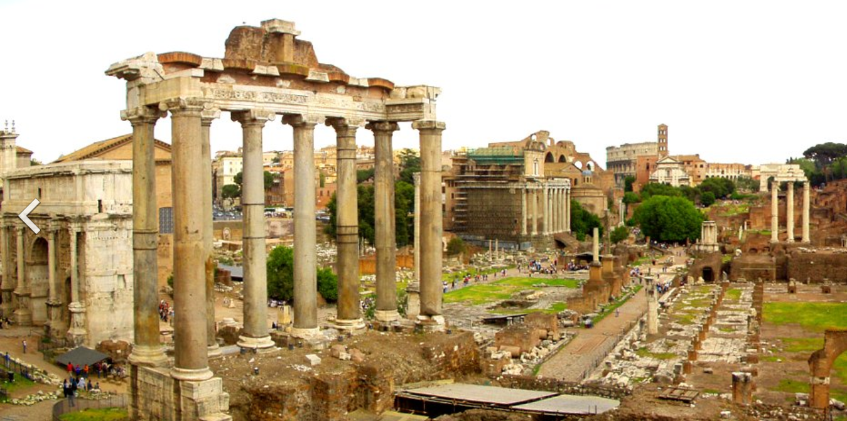
LOCATION ON THE VIA MILITARIS

Slide 30
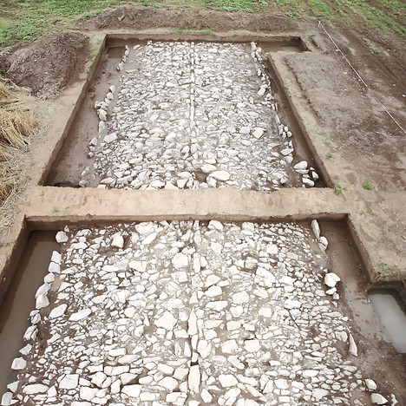
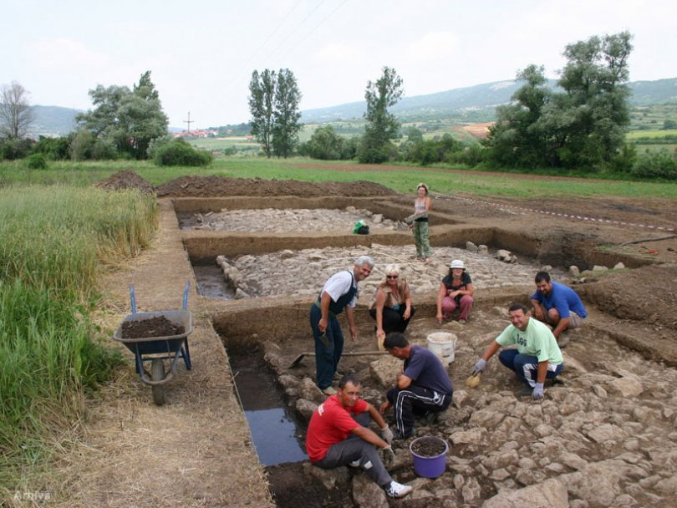
OLD ROMAN ROAD

Slide 31
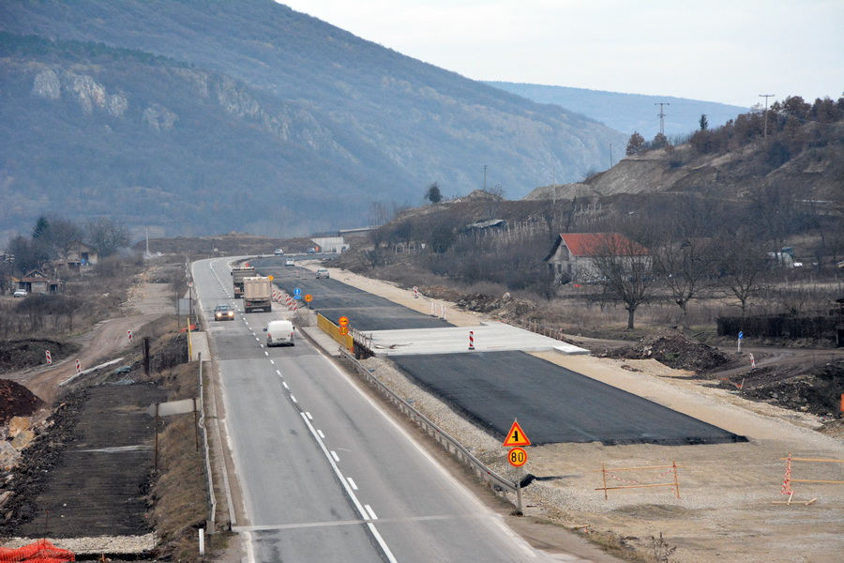
NOW PAN EUROPEAN Corridor X
UNDER CONSTRUCTION THIS DAYS

Slide 32
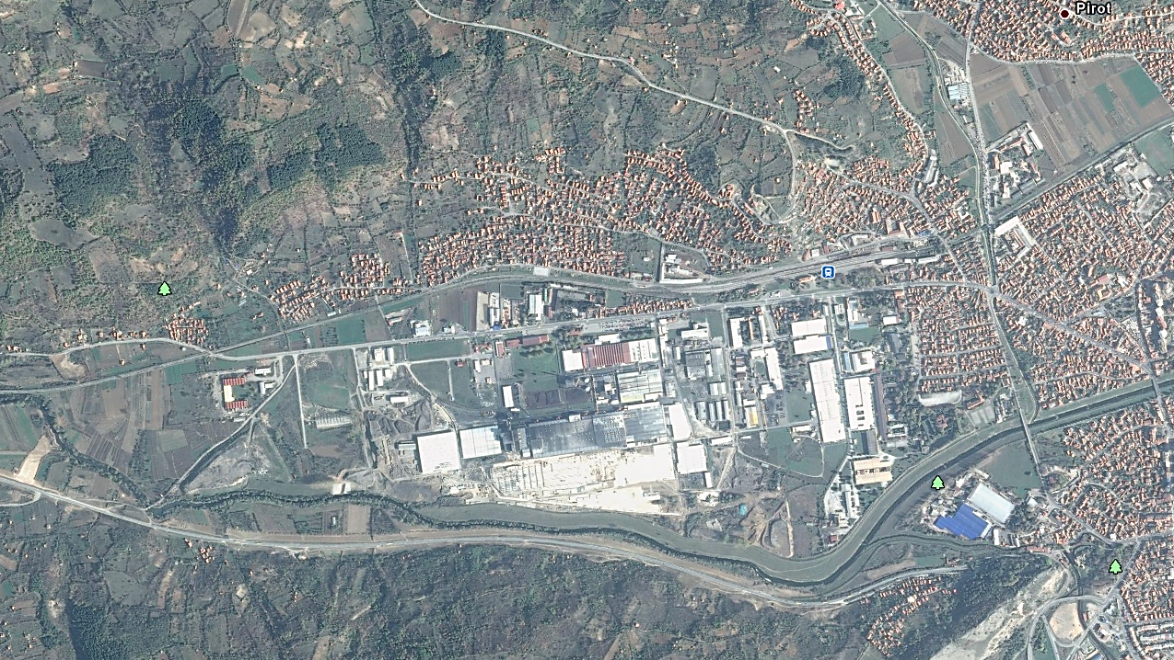
116 ha FREE ZONE PIROT

Slide 33
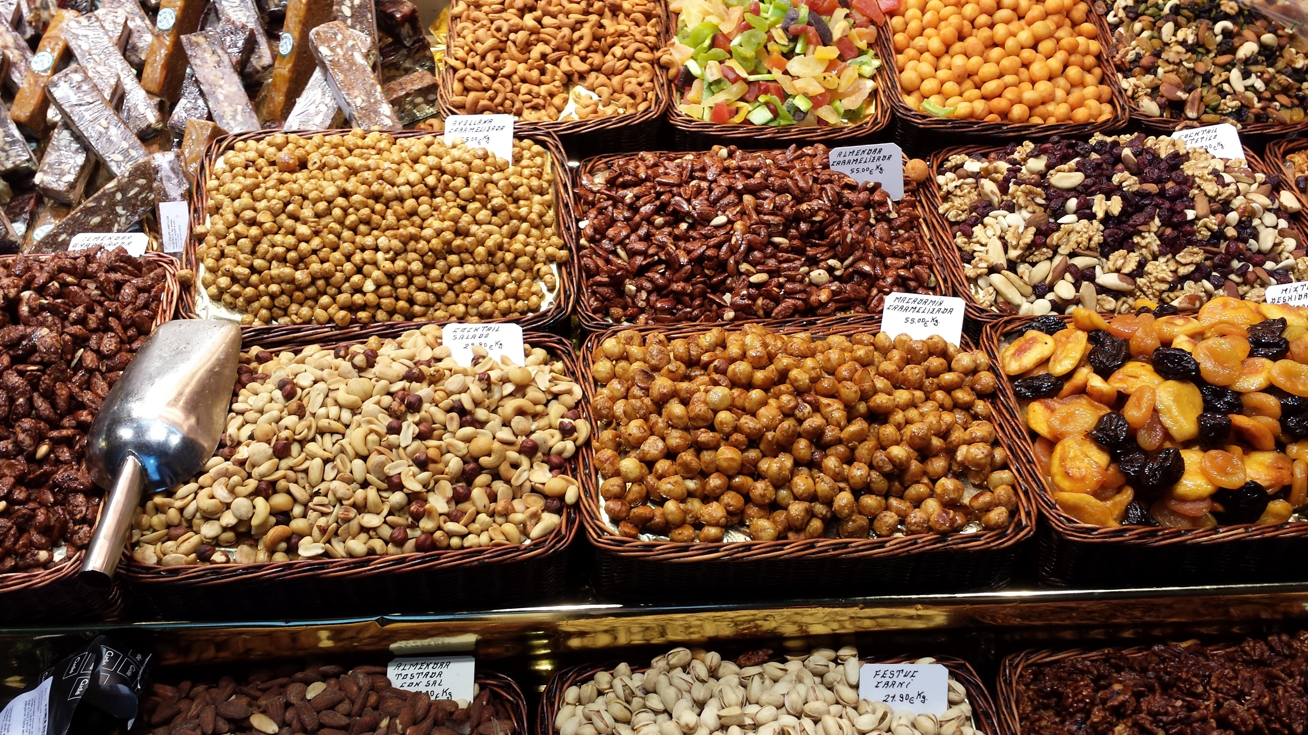
Your
Free Zone Pirot
Business

Slide 34
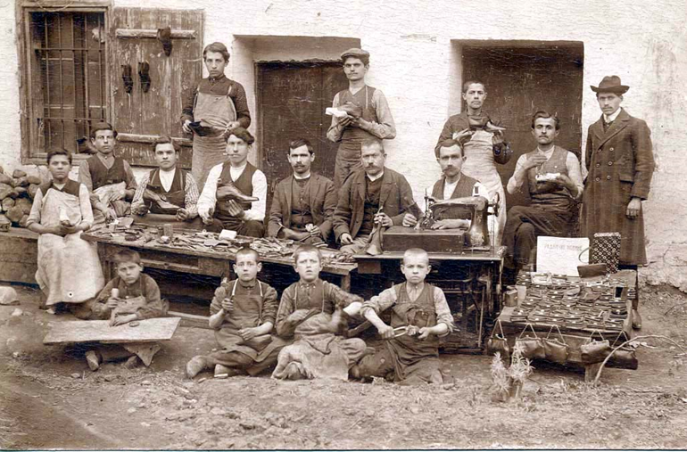
Production FREE

Slide 35
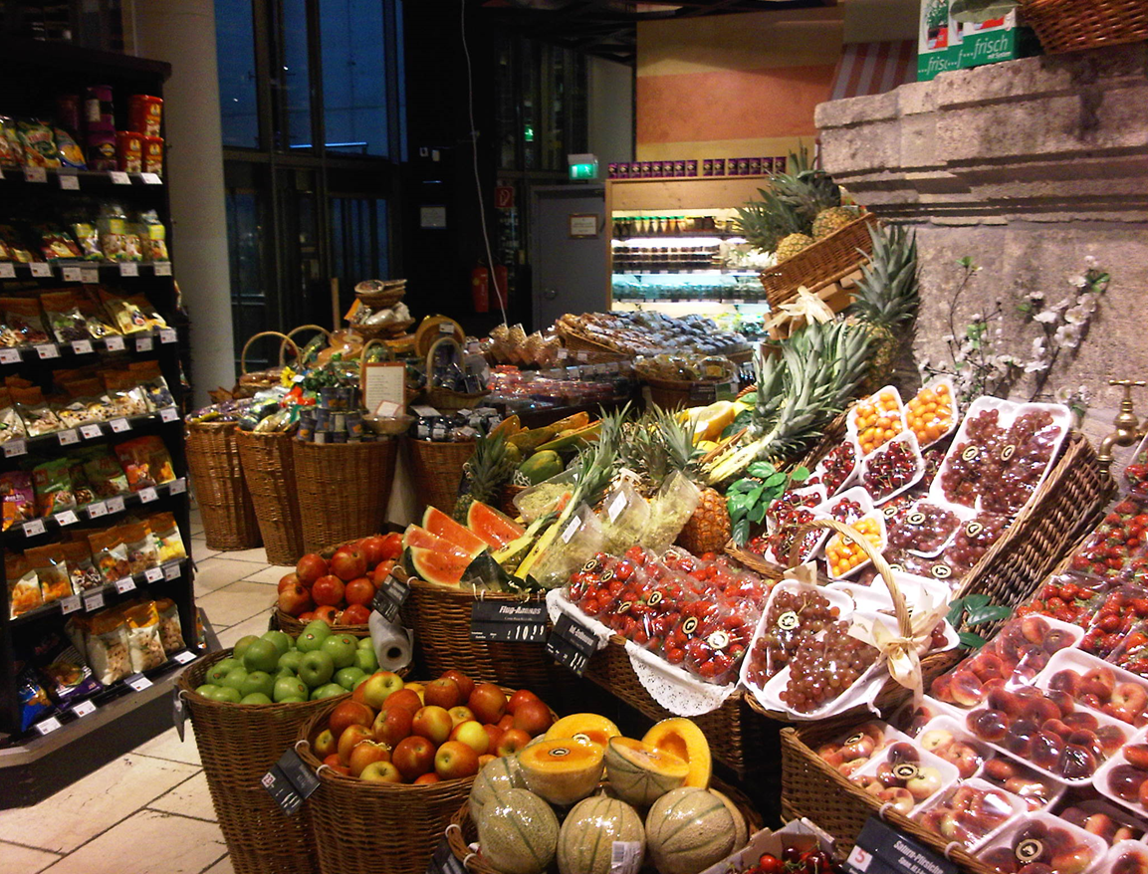
Trade FREE

Slide 36
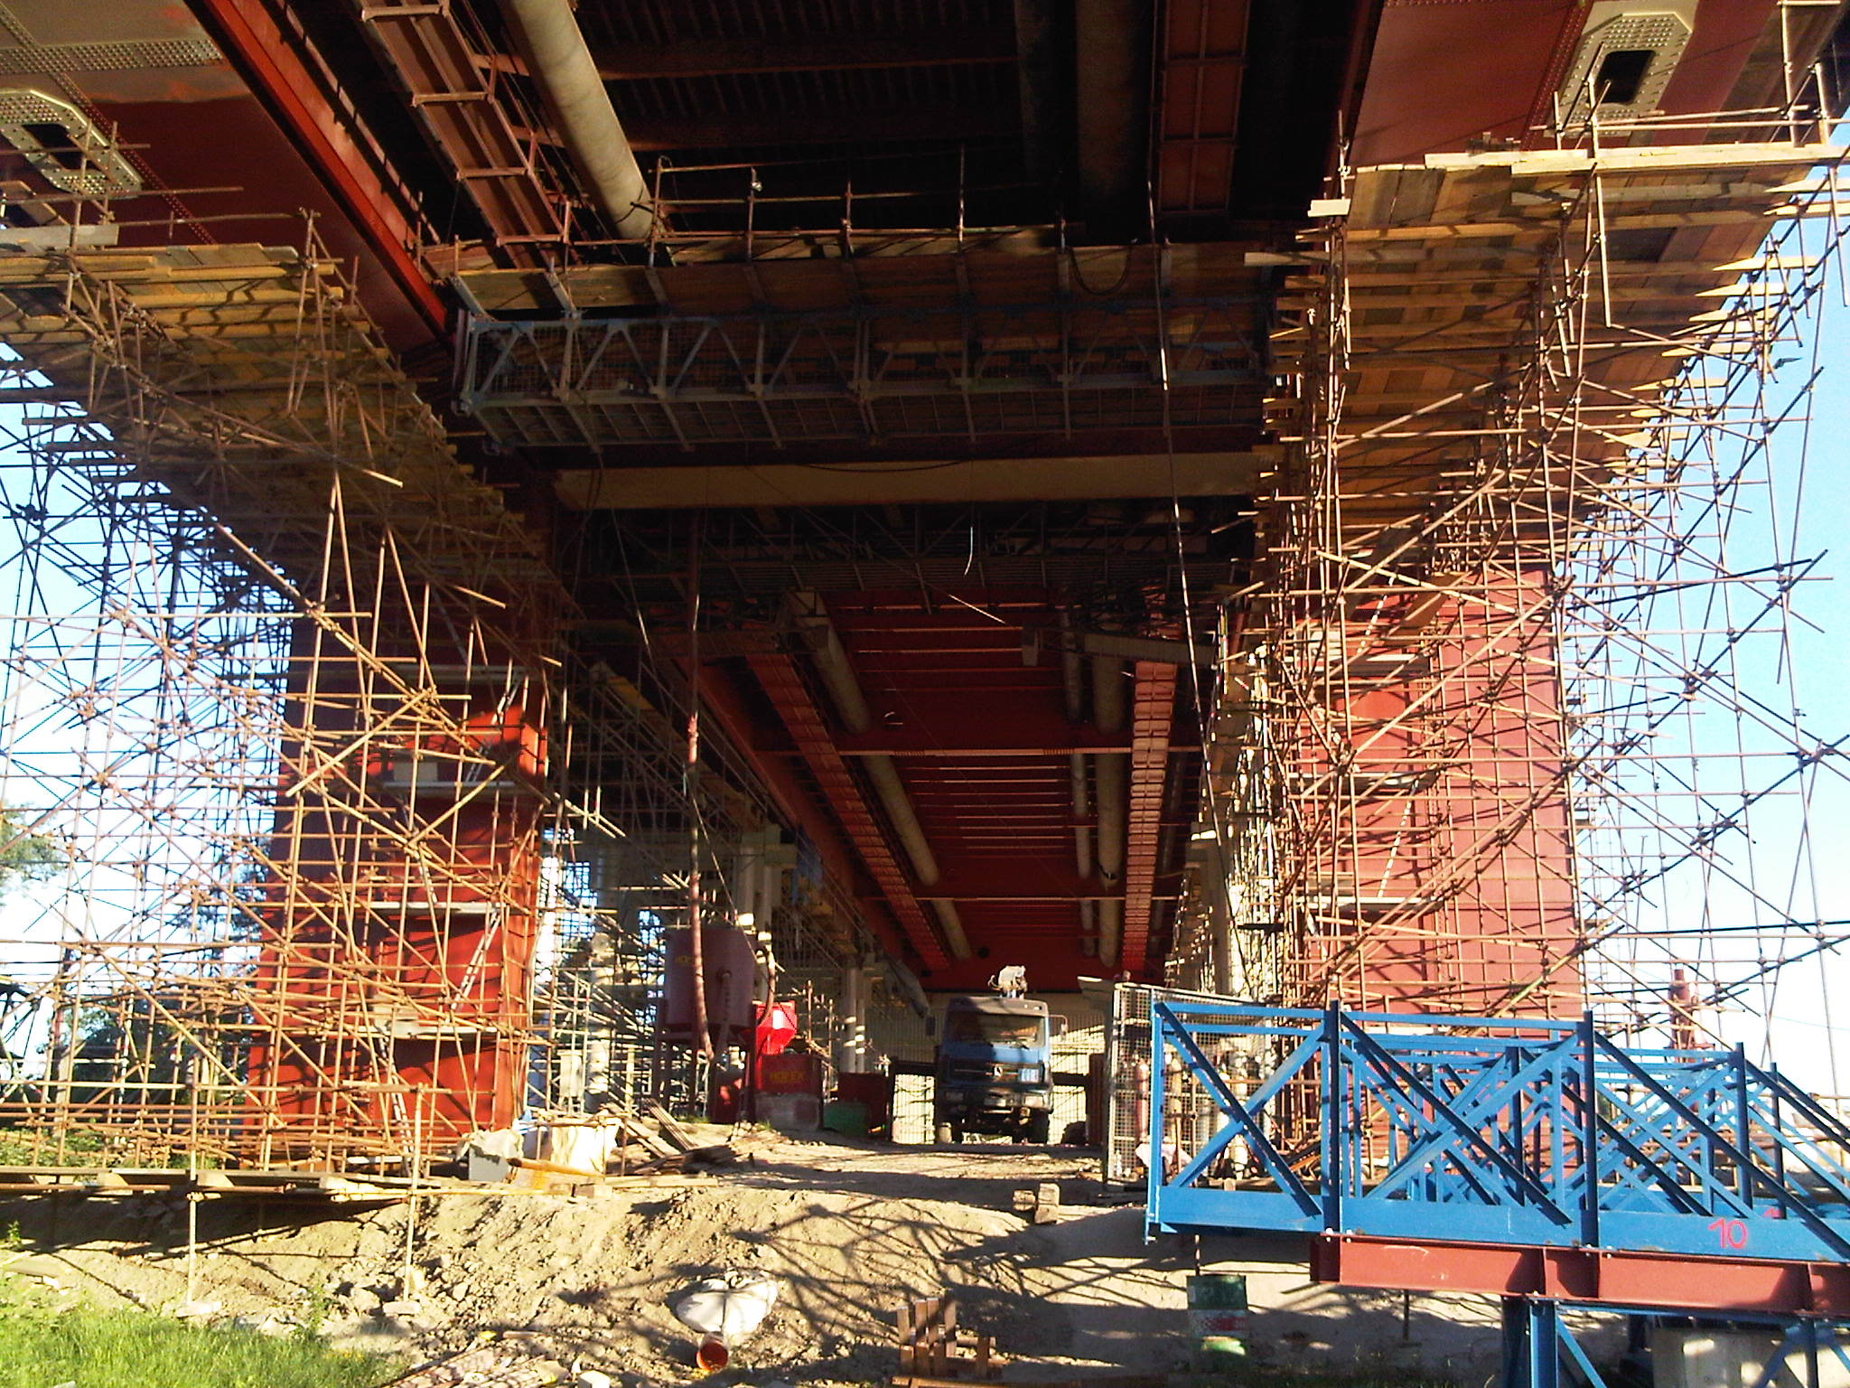
Building FREE

Slide 37
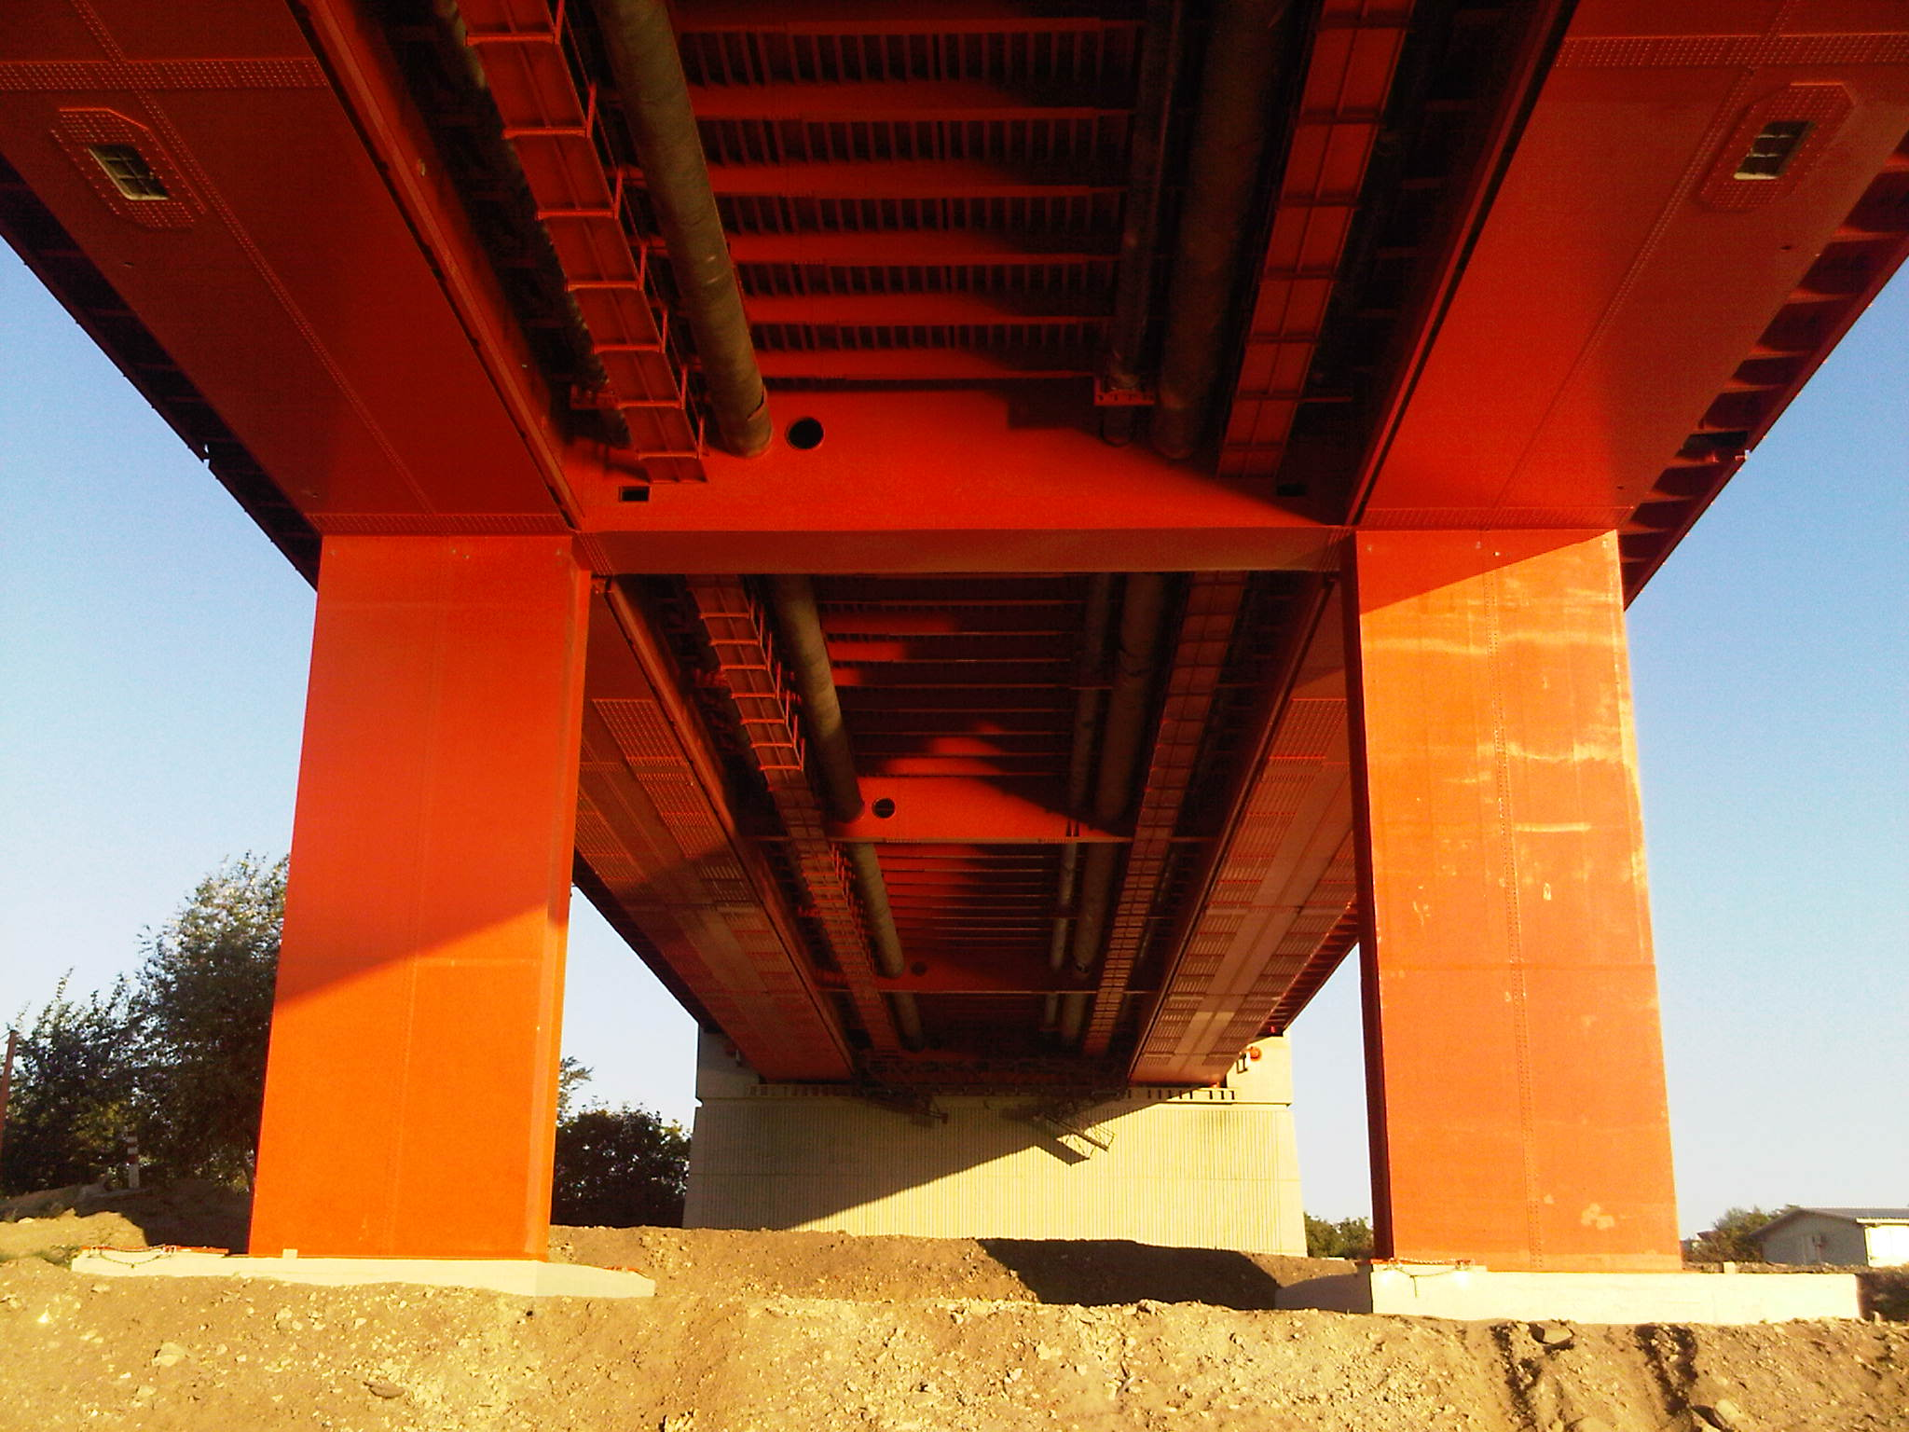
Building & FAST

Slide 38
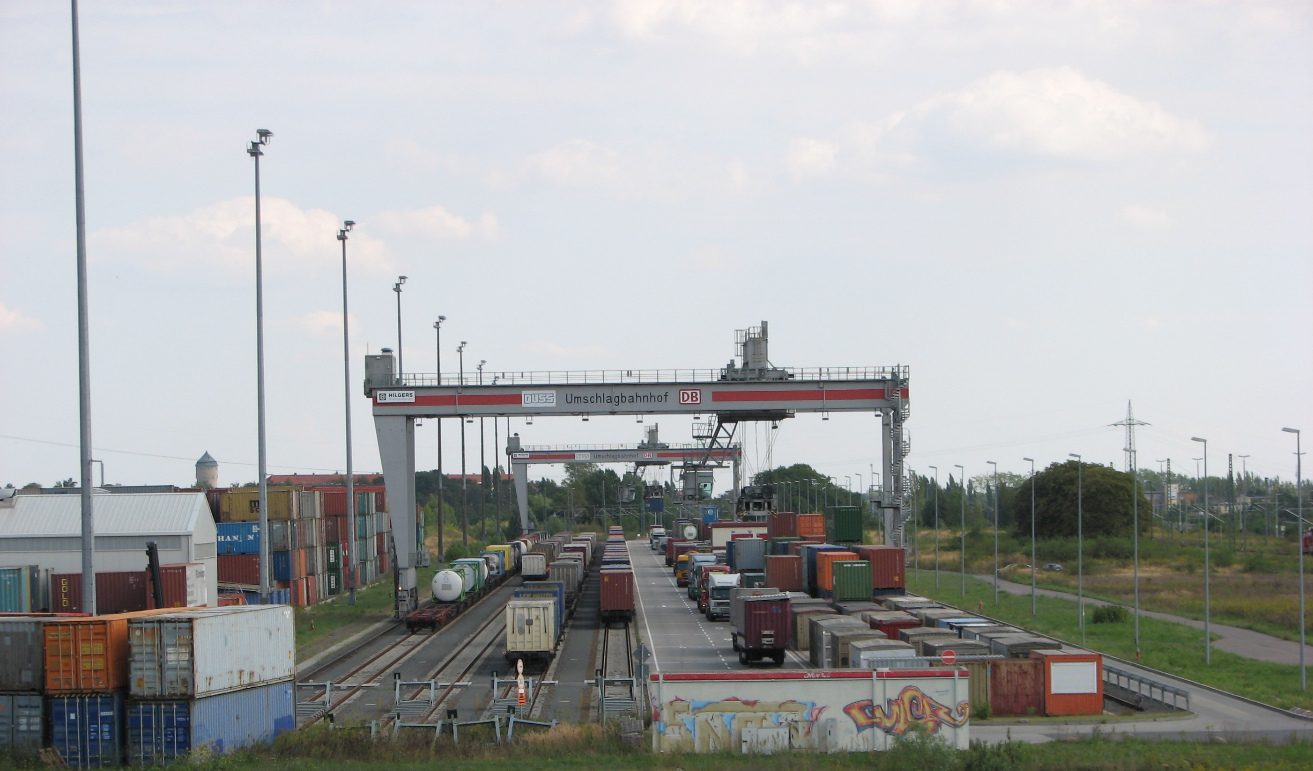
Logistic ON TIME

Slide 39
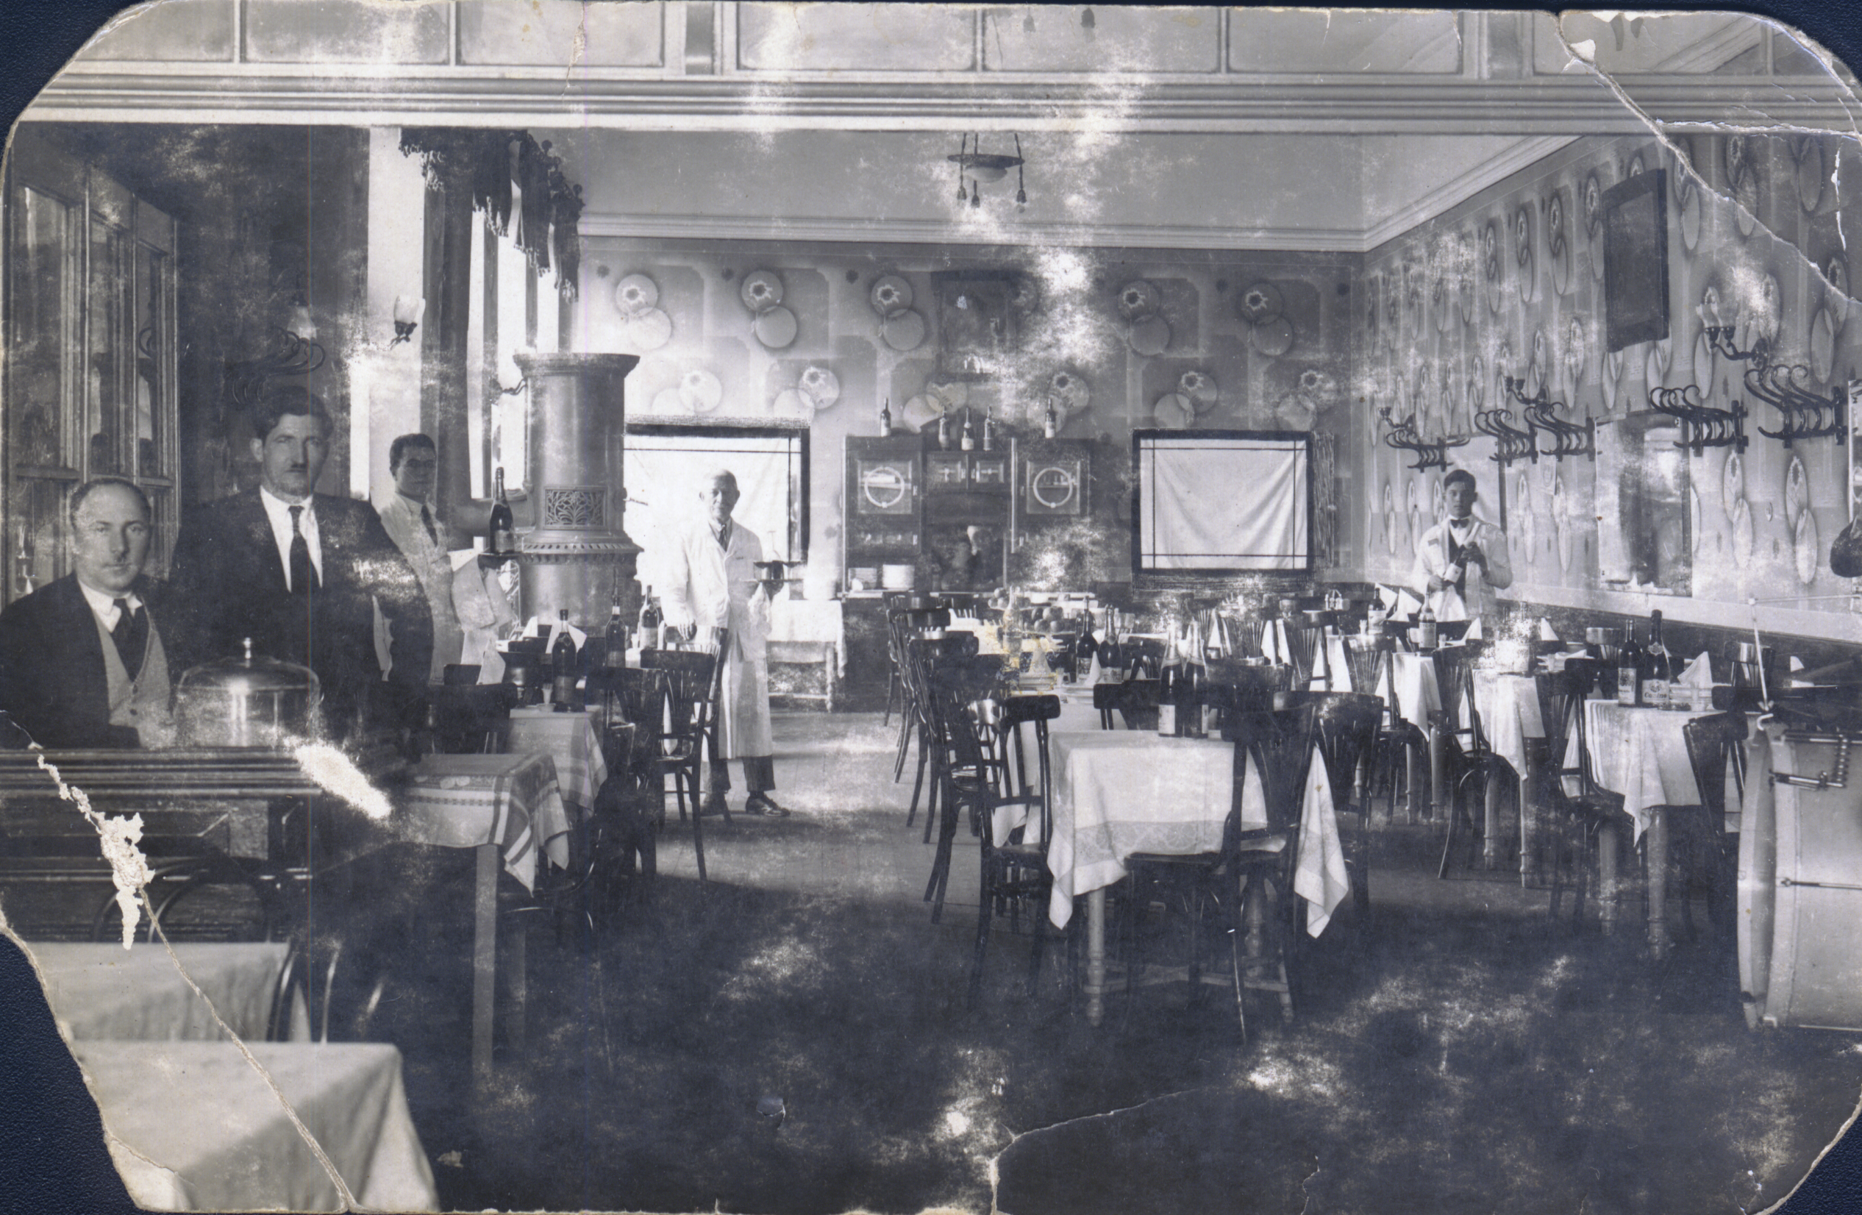
Services CHEAP

Slide 40

Municipality
State
Services
INCENTIVES IN FREE ZONE PIROT

Slide 41


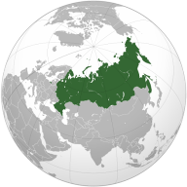
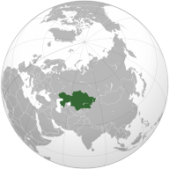

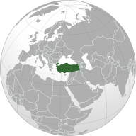
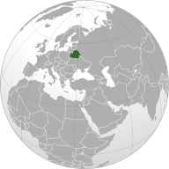

European Union
EFTA
Russia
Kazakhstan
  Easy accesss to free trade market
CEFTA
Turkey
Belorussia
USA – preff. trade regime
Notes:
41

Slide 42
RUSSIA
BELORUSSIA
EU
Custom 25-45 %
Cusrom 1%
Free Trade Agrement with Russia
Serbia

Slide 43
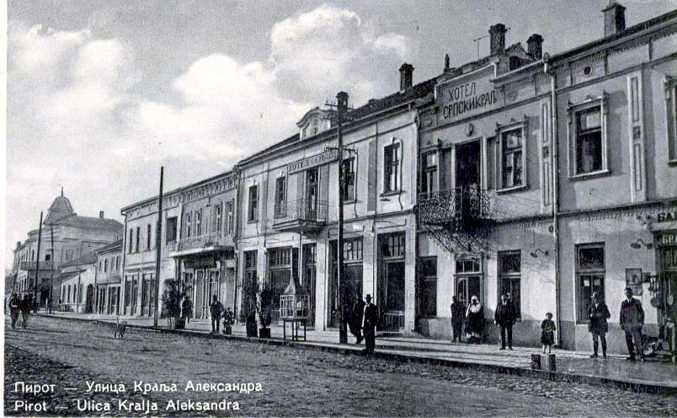
State INCENTIVES
Advantages VAT=0

Slide 44

State INCENTIVES
Adv CUSTOM DUTY=0

Slide 45
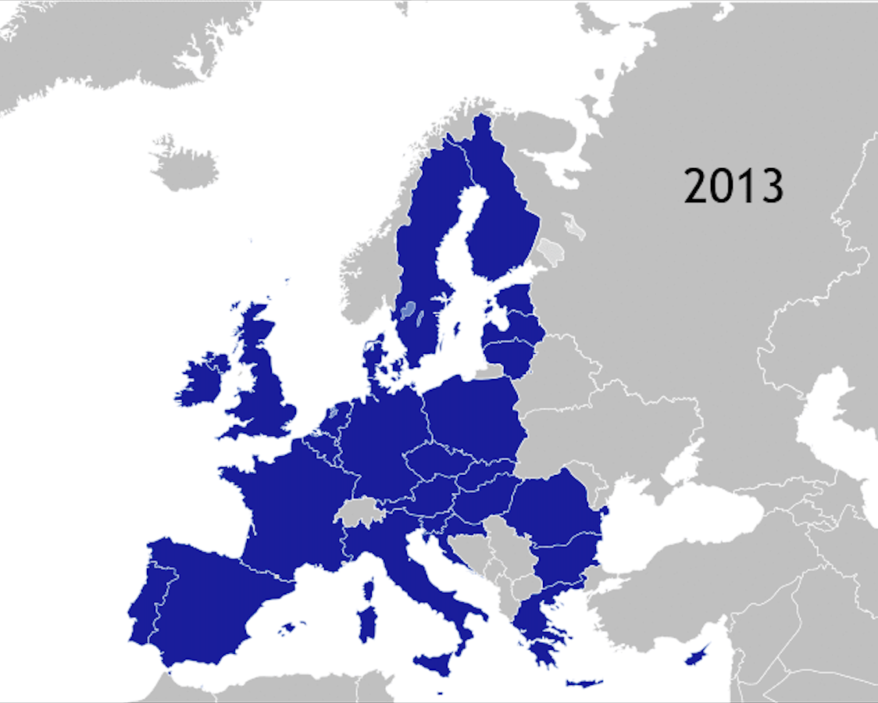
State INCENTIVES
Customs Community Code EU
National – Serbian Free Zone Law

Slide 46
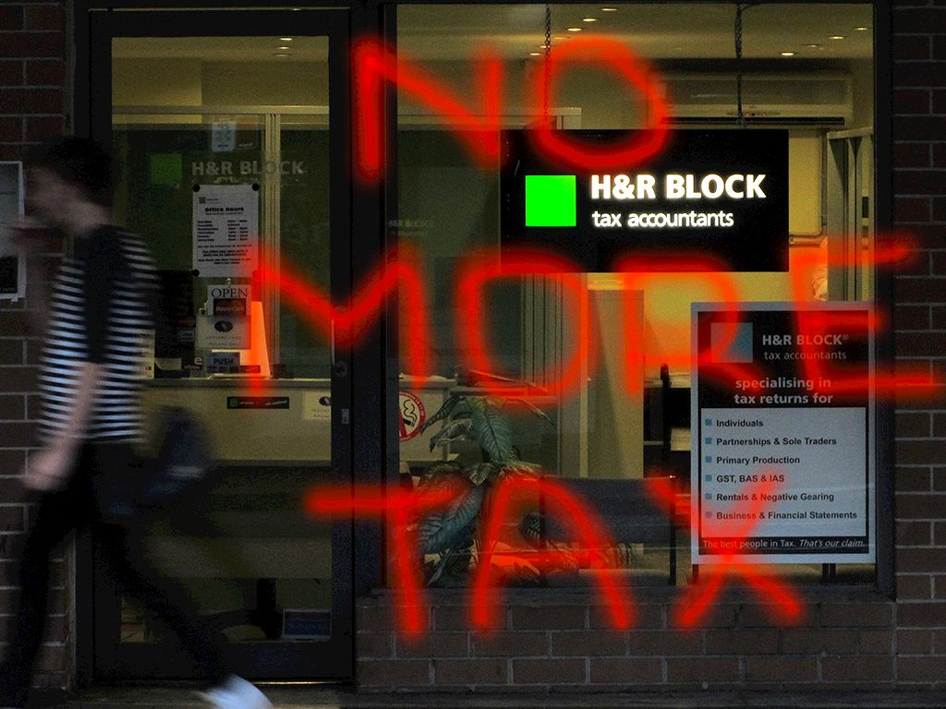
State INCENTIVES
  No Custom duty and VAT for export and import of goods and services within the free zone regime

Slide 47

State iNCENTIVES
  No Custom duty and VAT for imported material for constructions

Slide 48
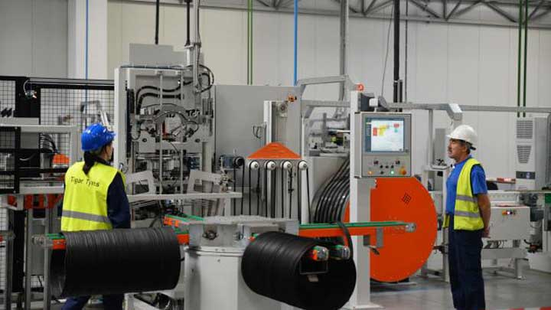
Free zone incentives
State iNCENTIVES
  No Custom duty and VAT for imported machines and equipment

Slide 49
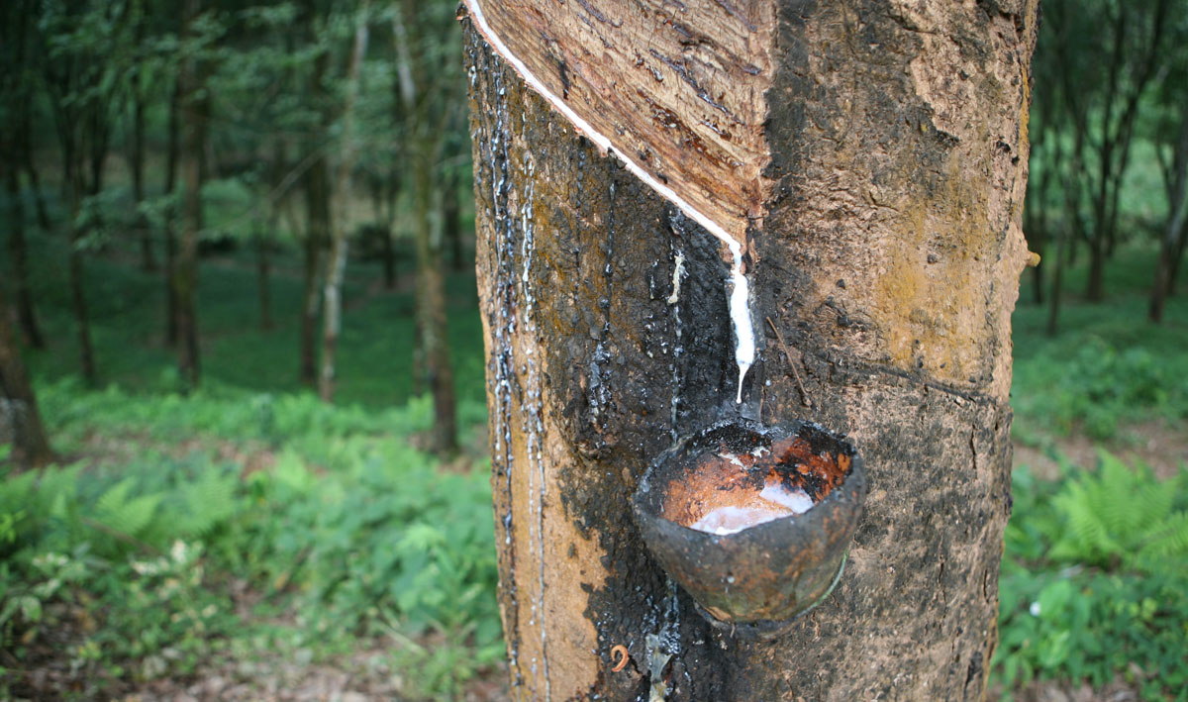
State iNCENTIVES
  No Custom duty and VAT for imported raw materials

Slide 50

  Exemption from VAT on goods and services trade within the borders of the free zone

Slide 51

State INCENTIVES
  No VAT on energy electricity, gas, fuel, oil, coal …

Slide 52

MUNICIPLITY
Photo by Sheba_Also Thanks for 8.5 Million + views - Creative Commons Attribution-NonCommercial-ShareAlike License https://www.flickr.com/photos/34534185@N00
Created with Haiku Deck

Slide 53
Municipality
Complete infrastructure equipped construction land (railways, roads, water, electricity, phones, fences, lighting, security)

Slide 54

All Municipality Taxes = 0

Slide 55

FREE
ZONES
PIROT
SERVICES

Slide 56
Free Zone Pirot Services
DGG
42. TERMINAL
EU FREIGHT
VILLAGE
Free Zone Pirot

Slide 57

Free Zone Pirot Services
Customs office in the zone

Slide 58
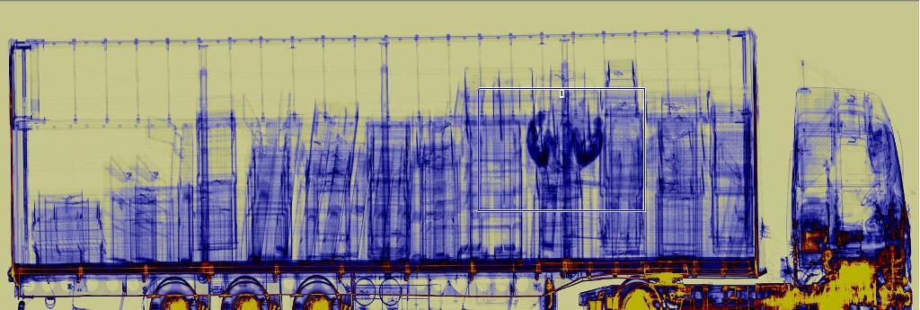
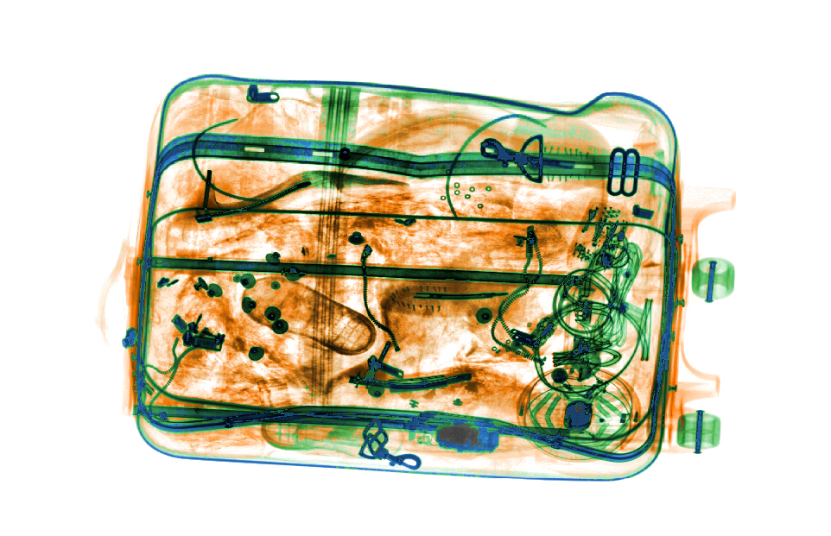
Terminal for customs inspections and truck parking with security
Free Zone Pirot Services

Slide 59

Free Zone Pirot Services
Quick and efficient import/export
procedure

Slide 60
Free zone incentives
Free Zone Pirot Services
Set of logistics services inland transport, shipping handling

Slide 61
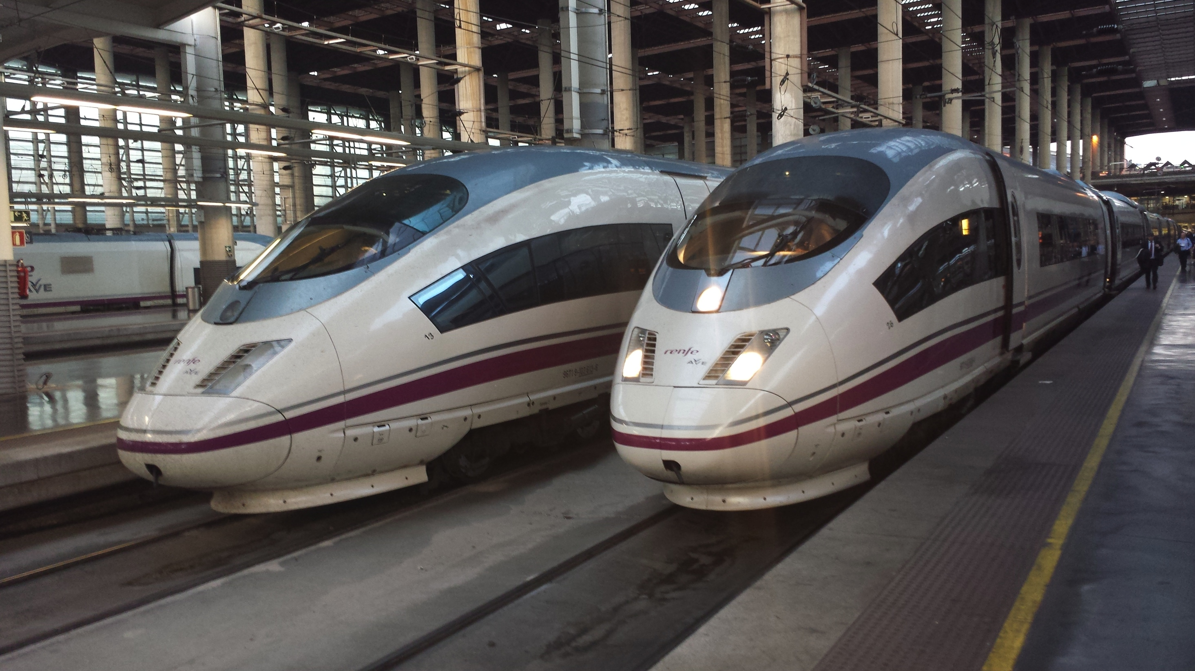
Free Zone Pirot Services
Two block train weekly
from Port of Burgas to Pirot

Slide 62

Free Zone Pirot Services
Available qualified and skilled workforce

Slide 63

Free Zone Pirot Services
Efficient administration (one stop shop)

Slide 64
Free zone Pirot
116 ha
15 production plants
150 trade companies
Employs > 5 000 workers

Slide 65
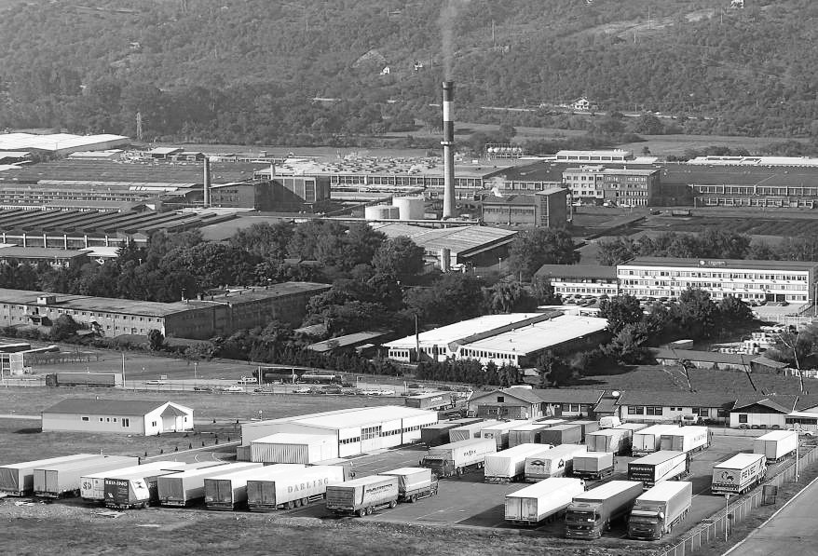

700 Mill €
turnover in 2014
Free zone Pirot

Slide 66
400 m€
export in 2014
MADE IN
FREE ZONE PIROT

Slide 67

LOOK
TO
THE
FUTURE

Slide 68
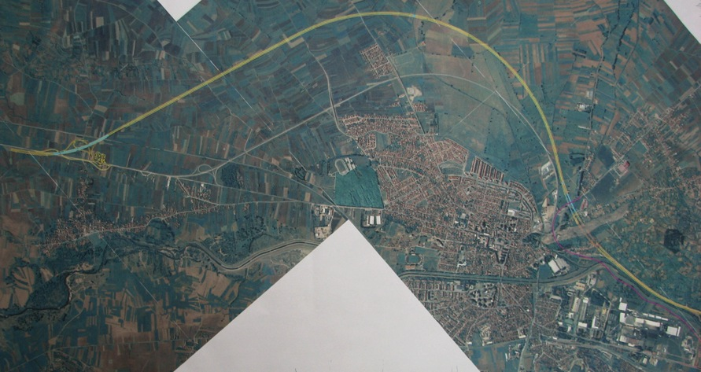
Future development phases of Free zone
FREE ZONE PIROT
NOW 116 ha
Corridor 10 – Highway
Corridor 10 – Railway
Corridor 10 – High speed railway
International road – Sofia – Niš
P3 = 114ha
P1 = 212 ha
P2 = 117ha

Slide 69





FREE ZONE PIROT WORD RANKING

Slide 70
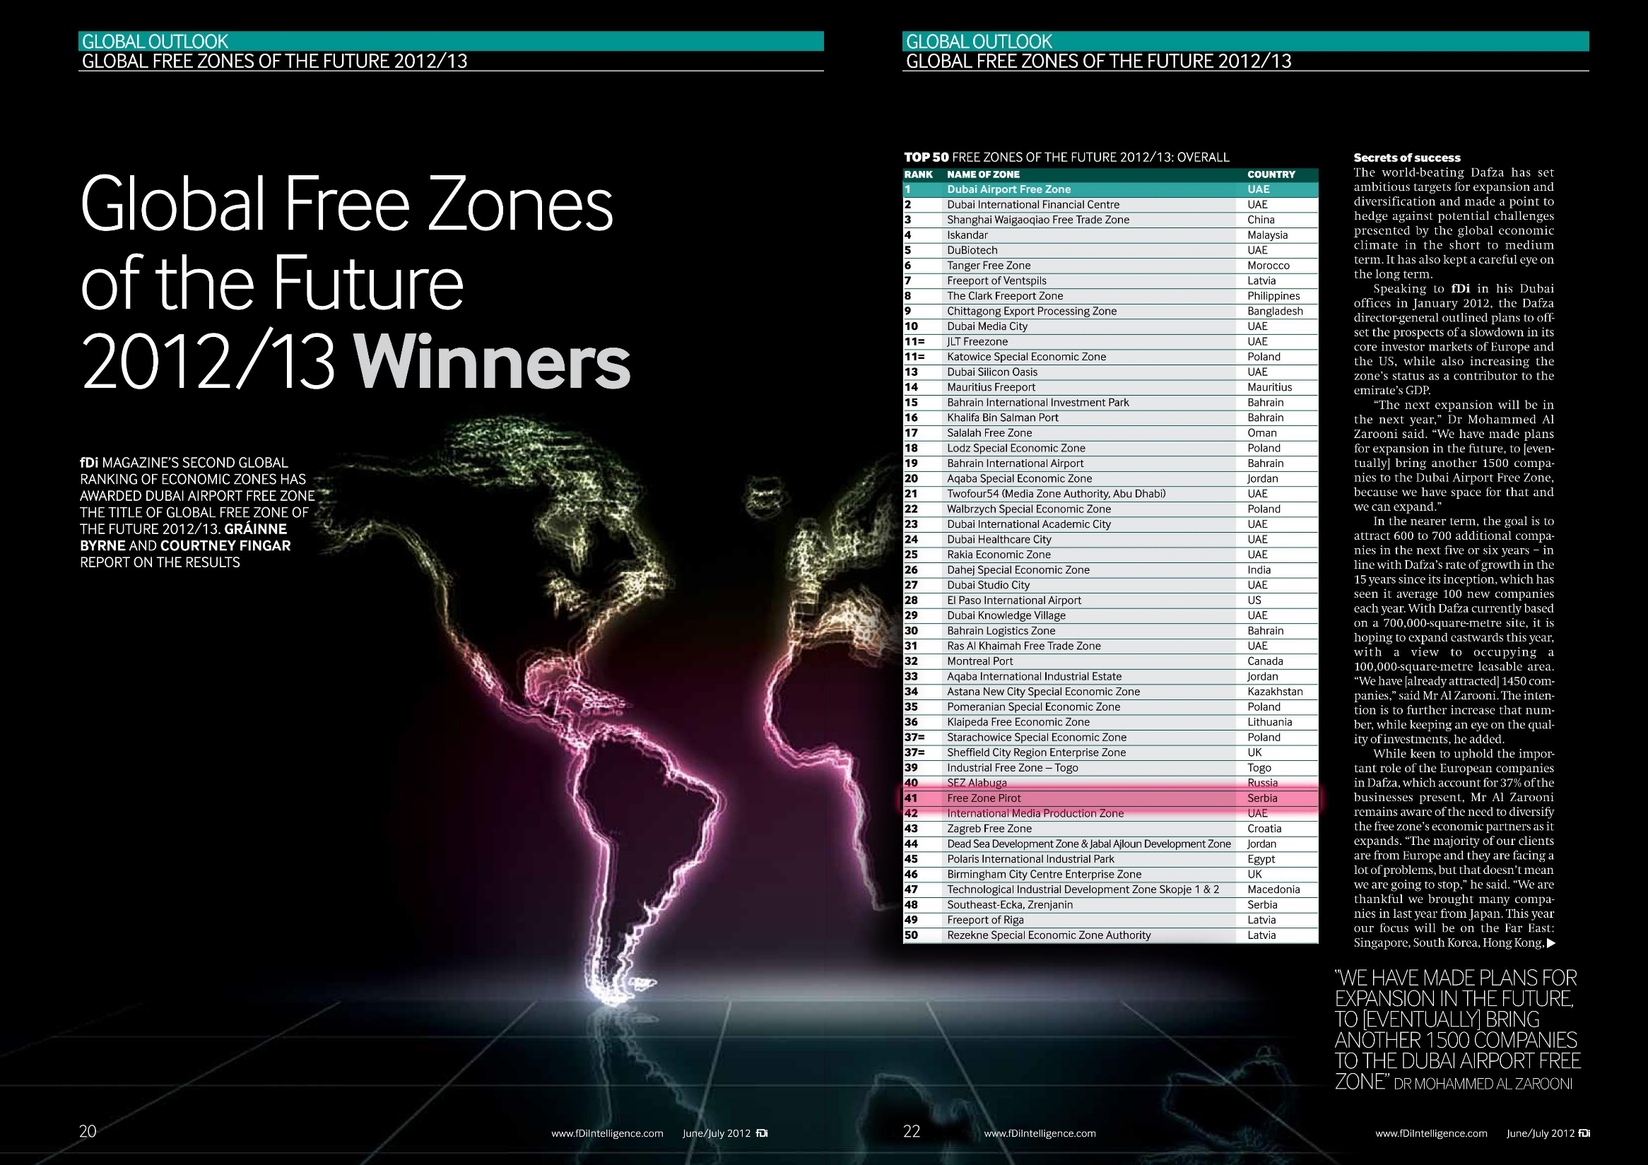

Slide 71


Slide 72


Slide 73

OUR
VISION
BE
THE
FIRST

Slide 74

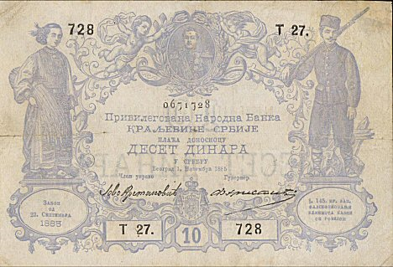
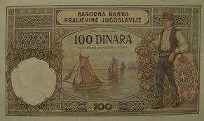


New Business Setup in Serbia

Slide 75

Free Zone Pirot
PhD Dragan Kostić, CEO
zona@freezonepirot.com www.freezonepirot.com

Slide 76

KAKO JE SRBIJA SMEŠTENA NA DREVNOM STRATEŠKOM RIMSKOM PUTU VIA MILITARIS SLOBODNE ZONE SRBIJE MOGU BITI MOST KOOPERACIJE U TRANSPORTNOM LANCU ROBA IZMEĐU ISTOKA I ZAPADA.
ZONE IMAJU POTENCIJALE ZA RAZVOJ PRIVREDE I INFRASTRUKTURE I AKTIVIRANJE POSTOJEĆIH PRIRODNIH RESURSA I RADNE SNAGE.

