Slide 1
NATIONAL COMPANY INDUSTRIAL ZONES
Strategic Partner for Investors in Bulgaria

Slide 2
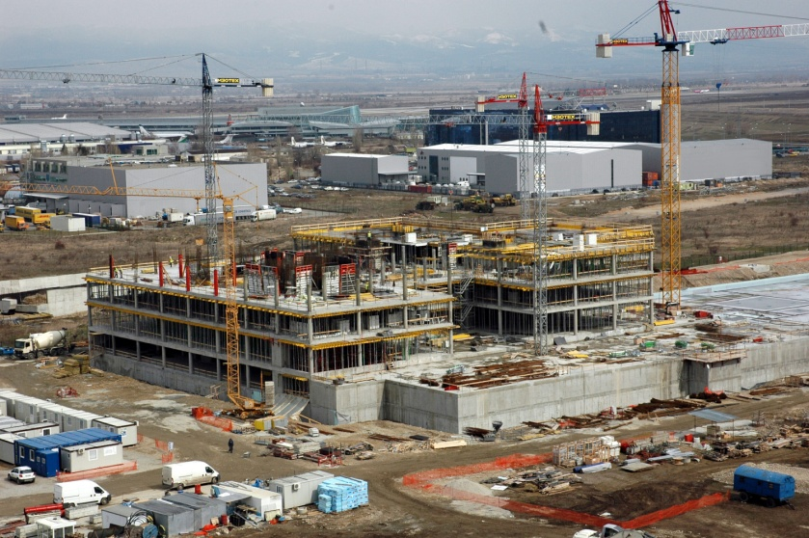
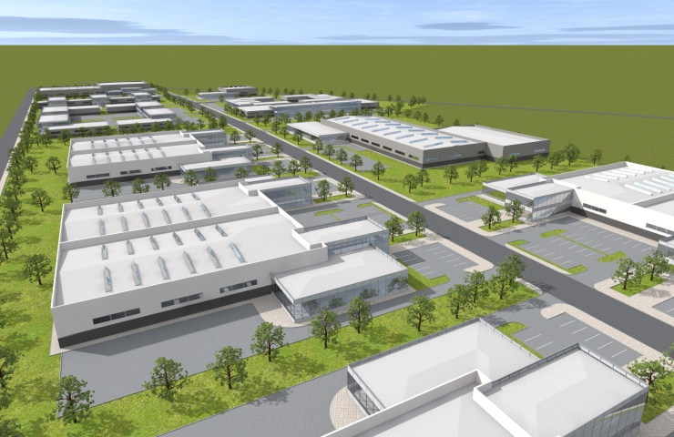
NATIONAL COMPANY INDUSTRIAL ZONES
OVERVIEW
NATIONAL COMPANY INDUSTRIAL ZONES (NCIZ) is a 100 % state-owned company with a sole shareholder – the Ministry of Economy of Bulgaria, specialized in:
Industrial park development
Management of industrial zones
Providing additional services for investors
Main activities:
Development of industrial zones in line with the latest standards
Encouraging investments in sectors with high
added value
Creating favourable conditions for investment

Slide 3
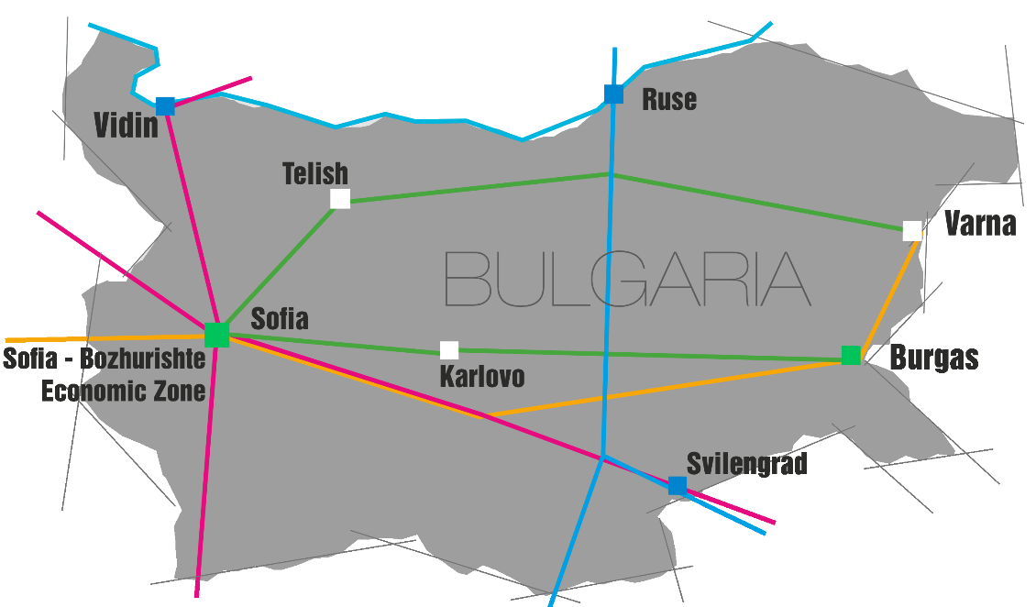
NATIONAL COMPANY INDUSTRIAL ZONES
OVERVIEW
3 functioning free trade zones:
Free Zone Ruse
Free Zone Vidin
Free Zone Svilengrad
2 newly constructed zones:
Sofia – Bozhurishte Economic Zone
Industrial & Logistics Park – Burgas
A total of 8 projects:
6 700 095 m² total area
73 909 m² built-up area
225 500 m² open-air warehouses
3 zones under development:
Industrial Zone Karlovo
Industrial Zone Telish /Pleven/
Industrial Zone Varna West

Slide 4
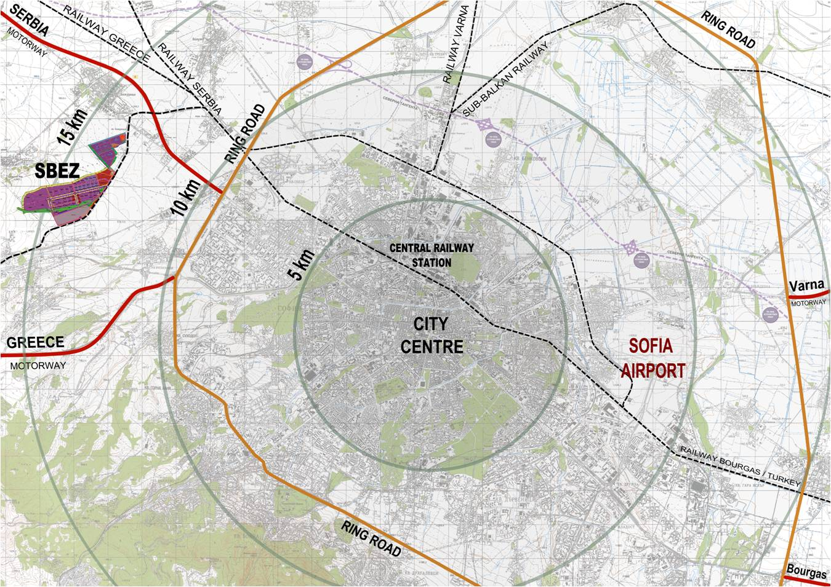
NATIONAL COMPANY INDUSTRIAL ZONES
SOFIA-BOZHURISHTE ECONOMIC ZONE
Total area: 2 665 595 m²
Sofia City Center – 15 km
Sofia Airport – 23 km
5 km to a highway bound for Greece
2 km to a highway bound for Serbia
30 km to a highway bound for the Black Sea
Next to the international road connecting
Europe with Turkey
Direct connection with the railway network
Plans for a subway terminal in the near future

Slide 5
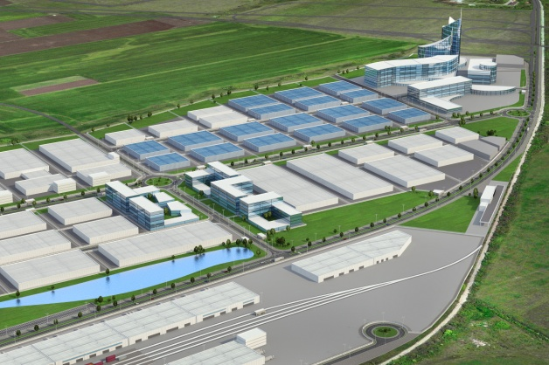
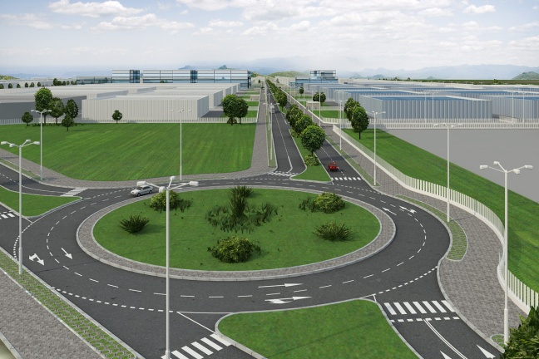
NATIONAL COMPANY INDUSTRIAL ZONES
SOFIA-BOZHURISHTE ECONOMIC ZONE
Spatial Plan:
Advanced manufacturing facilities
High-tech industry base
State-of-the-art administrative buildings
Comprehensive transport and logistics center

Slide 6
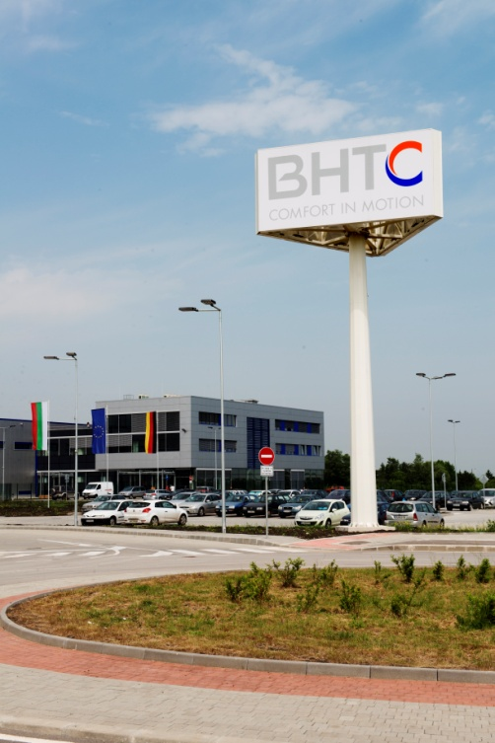
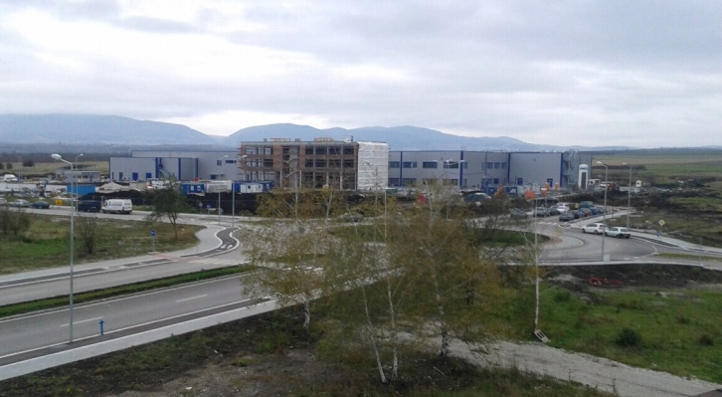
NATIONAL COMPANY INDUSTRIAL ZONES
INVESTORS IN SOFIA-BOZHURISHTE ECONOMIC ZONE
INVESTORS IN SOFIA – BOZHURISHTE ECONOMIC ZONE
Behr-Hella Thermocontrol GmbH, a German investor from the automotive industry, constructed a production facility and a R&D centre for engineering and manufacture of control units for automotive air-conditioning systems
Total amount of the investment – 21 million EUR
Approx. 350 new jobs
Ten innovative companies - total amount of the investment: 30 million EUR; approx. 550 new jobs
Six high-tech Bulgarian companies (High-tech Cluster – Sofia) - Total amount of the investment: 5.5 million EUR; approx. 150 new jobs
Several of the investment projects include the construction of R&D centres in addition to the production bases

Slide 7
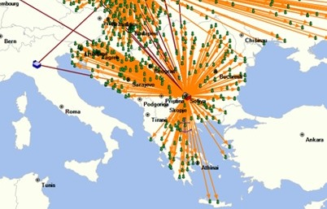
NATIONAL COMPANY INDUSTRIAL ZONES
SOFIA-BOZHURISHTE ECONOMIC ZONE
JYSK – Distribution Center Bozhurishte
The Danish furniture and interiors company JYSK Nordic will implement a large-scale investment project in Sofia – Bozhurishte Economic Zone by constructing the largest distribution center in South East Europe.
Bulgaria & Bozhurishte Economic Zone have been selected as the best business environment & the best location for production & distribution in SE Europe
Total amount of the investment – 100 million EUR over the
next two to five years
300 000 m² land

Slide 8
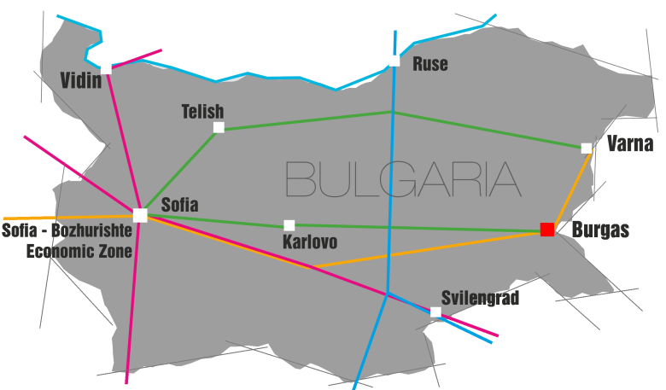
NATIONAL COMPANY INDUSTRIAL ZONES
INDUSTRIAL AND LOGISTICS PARK - BURGAS
Total area: 244 150 m²
Location:
In the second biggest Black Sea city and cargo harbour in Bulgaria
10 km to Burgas airport
4 km to Burgas harbor
2 km to a highway towards Turkey

Slide 9
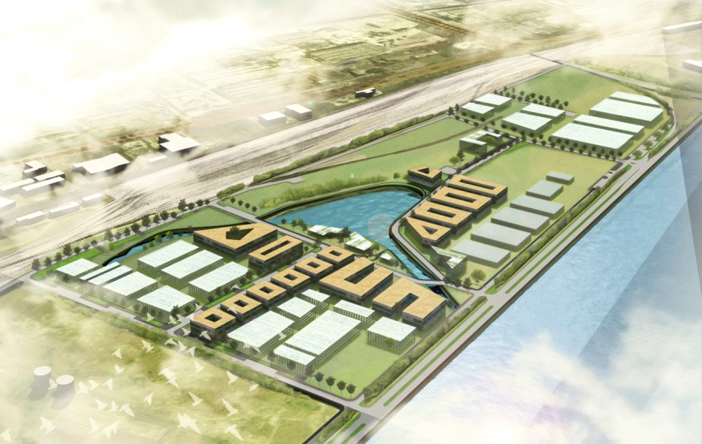
NATIONAL COMPANY INDUSTRIAL ZONES
INDUSTRIAL AND LOGISTICS PARK - BURGAS
Infrastructure:
Electricity
Water and sewerage
Telecommunication network
Development Stages:
The first stage of infrastructure construction has already been completed
The second stage of infrastructure construction includes electricity, optic lines, asphalt pavement, sidewalks and street lighting
Investors:
Eleven contracts have been signed with Bulgarian companies from the light industry and construction for establishing of production and warehousing facilities
Total amount of the investment – 5,5 million EUR
Approx. 260 new jobs will be created

Slide 10
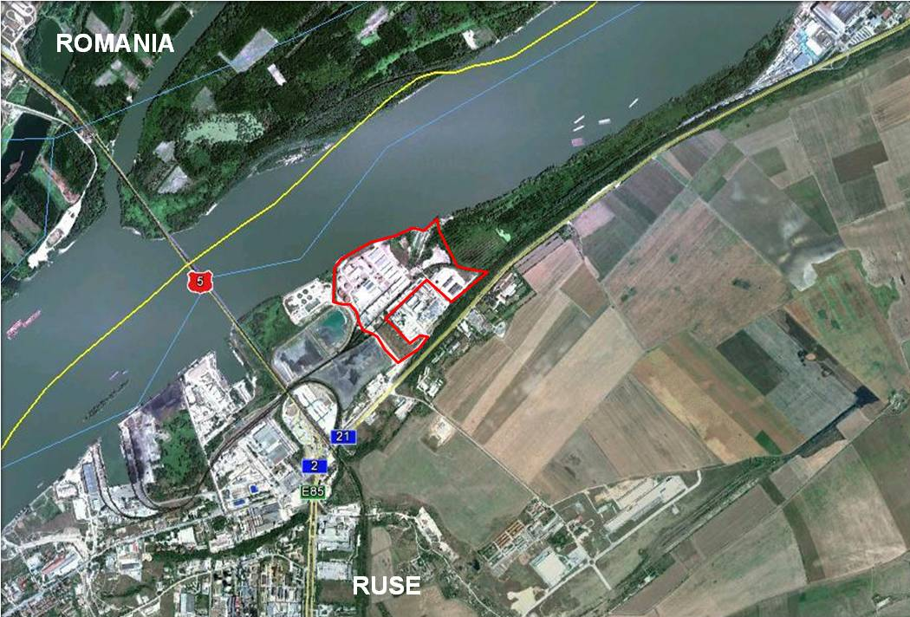
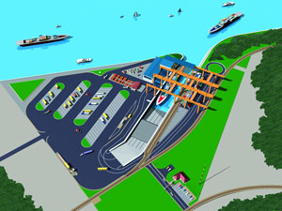
NATIONAL COMPANY INDUSTRIAL ZONES
FREE ZONE RUSE
Location:
800 m to the East of Danube Bridge connecting Bulgaria and Romania
Right next to the port of Ruse – the biggest river port in Bulgaria
A project to be constructed an Intermodal Terminal
Total area: 370 235 m²
Built-up area: 30 000 m²
Open-air warehouses: 20 000 m²
Infrastructure:
Well-developed road network
Electricity
Gasification
Water and sewerage

Slide 11
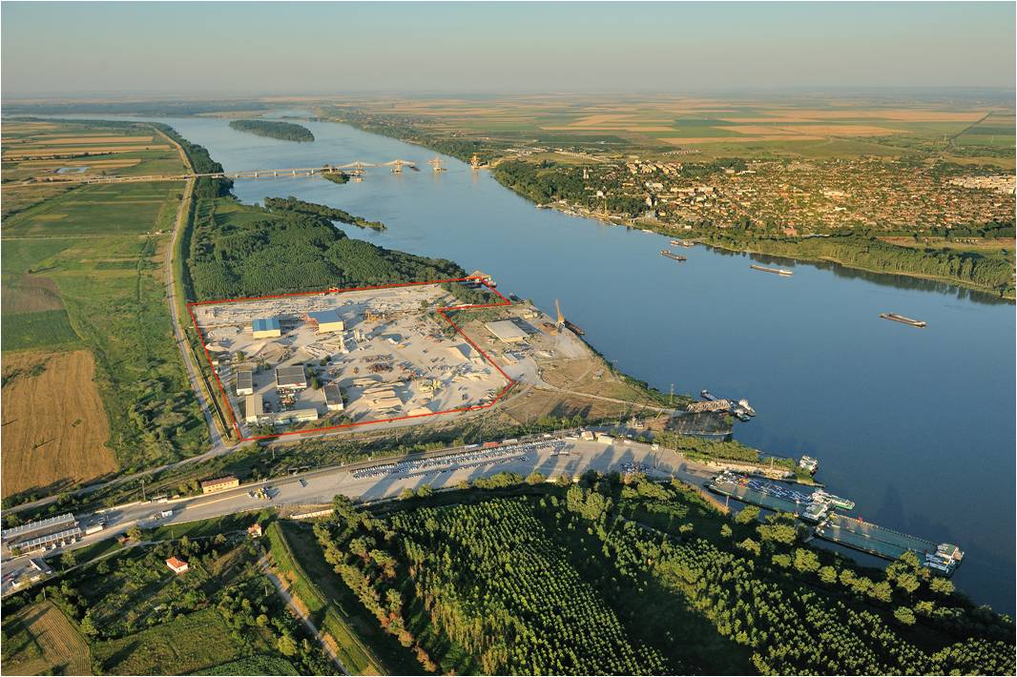
NATIONAL COMPANY INDUSTRIAL ZONES
FREE ZONE VIDIN
Location:
On the bank of the Danube river next to Danube
Bridge - 2, a freight port, and a ship terminal
Located on two borders – land with Serbia and river with Romania
Total area: 308 627 m²
Built-up area: 7 450 m²
Open-air warehouses: 203 000 m²
Infrastructure:
Well-developed road network
Electricity
Water and sewerage

Slide 12
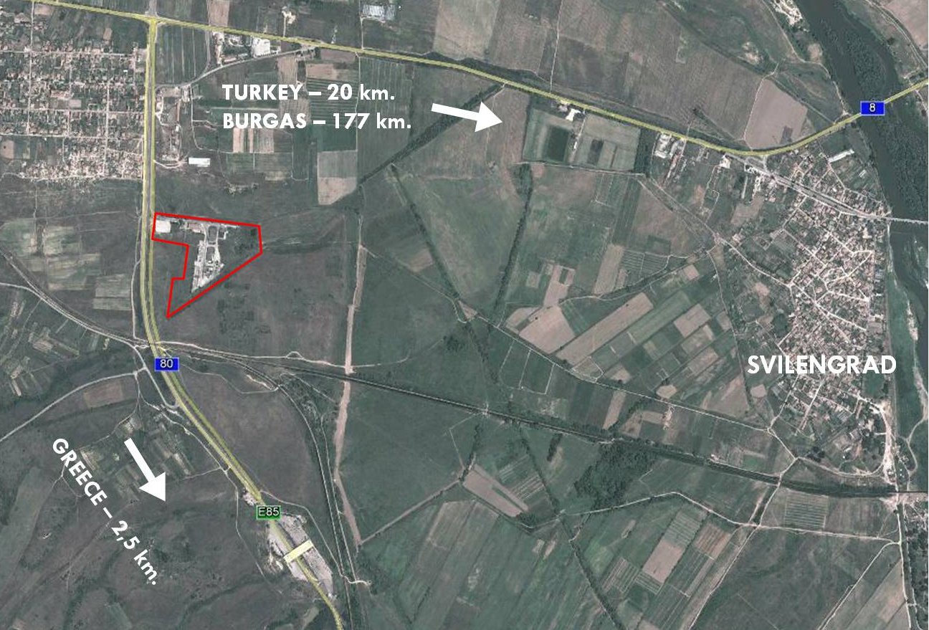
NATIONAL COMPANY INDUSTRIAL ZONES
FREE ZONE SVILENGRAD
Location:
2 km to the border with Greece
50 m to railway connections with Turkey and Greece
Access to a transport corridor, connecting Europe with Turkey
Total area: 70 000 m²
Built-up area: 4 130 m²
Open-air warehouses: 2 500 m²
Infrastructure:
Well-developed road network
Electricity
Water and sewerage

Slide 13
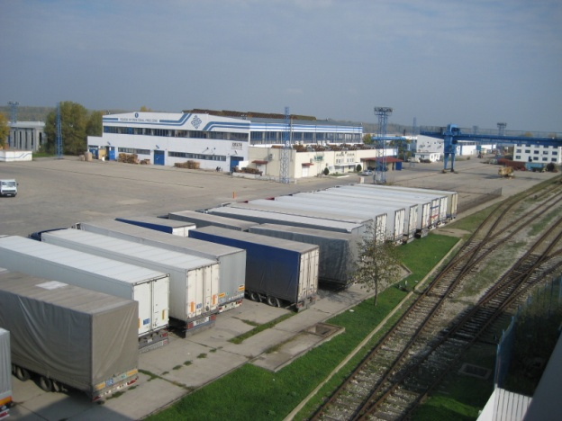
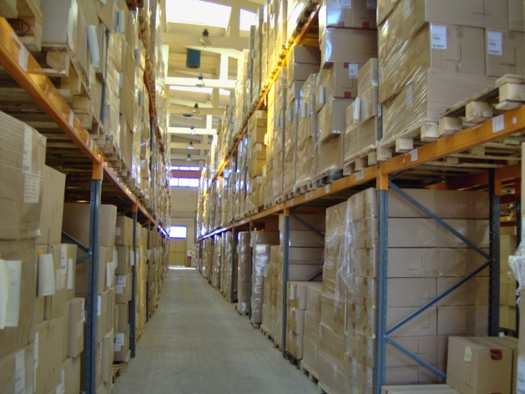
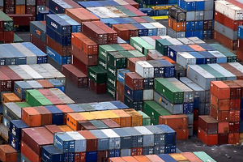
NATIONAL COMPANY INDUSTRIAL ZONES
FREE ZONES
Services offered to investors in NCIZ’s Free Zones:
Offices, industrial plots and open-air storage areas with the
necessary infrastructure for rent
Warehousing and storage of goods
Assistance in issuing, reissuing and authentication of certificates of origin of goods
Loading and handling operations
Storing of goods under customs supervision, representation to the customs authorities and processing of customs documentation
Trans-shipment operations
Auto scales for measuring heavy duty trucks
Completion of transport and customs documents necessary before the customs points
Reservation and return of licenses for international freight transport
Consulting on the different regulations and legislation in force in the Republic of Bulgaria

Slide 14
NATIONAL COMPANY INDUSTRIAL ZONES
COMMITMENT TO WORK WITH YOU
NCIZ offers its partners:
LOCATION – industrial zones with prime locations and excellent transport connectivity
INFRASTRUCTURE – industrial plots with all the necessary infrastructure (road network, electricity, water and sewerage, gasification, telecommunications)
PREDICTABILITY – as witnessed by our successful experience with numerous previous investors
COMPETITIVE CONDITIONS for investors certified under the Investment Promotion Act – the opportunity to be granted special incentives by the Invest Bulgaria Agency facilitating the investment project
PERSONAL ASSISTANCE AND PARTNERSHIP during the whole investment process – support and consultations for all administrative procedures in order to facilitate the investors’ projects as much as possible.

Slide 15
NATIONAL COMPANY INDUSTRIAL ZONES
FOR CONTACT:
STEFAN STAYKOV
Executive Director
1, Angel Kanchev Str.
Sofia 1000, Bulgaria
Tel.: +359 2 8902902
Tel./Fax: +359 2 9871684
e-mail: office@nciz.bg
www.industrialzones.bg
Your Strategic Partner for Investment in Bulgaria

