Slide 1
The Port of Thessaloniki: a sea-gateway for cargoes to and from Southeastern Europe
Christos K. Papadopoulos
Head of ICT Department
THPA S.A.

Slide 2
Agenda
1
Overview of the Opportunity
2
Operations Overview
3
Financial Overview
4
Business Plan & Master Plan Overview

Slide 3
Agenda
1
Overview of the Opportunity
2
Operations Overview
3
Financial Overview
4
Business Plan & Master Plan Overview

Slide 4
Milestones
  Establishment of the “Board of the Free Zone of Thessaloniki”
1923
  Merger between “Board of the Free Zone of Thessaloniki” and “Thessaloniki Port Fund”
1953
1970
  Port Management transferred to Thessaloniki Port Authority (ThPA)
1999
  The ThPA Public Entity is incorporated as a Societe Anonyme (S.A.)
2001
  ThPA SA listed on the Athens Stock Exchange
  HRADF receives a 23.3% stake in THPA SA from the Hellenic Republic
2012
  HRADF receives the remaining shares (51.0%) from the Hellenic Republic (total: 74.3%)
2014
  Launch of Tender Process
2016
  Phase B' of Privatization Process
  HRADF = Hellenic Republic Asset Development Fund

Slide 5
Key Attractions for ThPA SA
✓
  Main Gateway to the Balkans and Black Sea
✓
  Key Intersection for Transit Cargo to Central and Eastern European Countries
✓
  Significant Expansion Potential
✓
  Greek Macro Recovery will Provide Impetus to Trade Flows from Thessaloniki Port

Slide 6
Ideal Gateway to the Balkans and Black Sea
  Gateway port to Balkans and South Eastern Europe
  Strategically located in close proximity to major motorways and railway networks
  One of the five Greek Ports⁽¹⁾ that has been included in the core European Transport Network
  Direct access to the Balkans, Russia and Turkey through existing road networks
  Located at the ending point of road networks: Pan-European X and Trans-European IV
Vilnius
Minsk
Moscow
2,473km
Dublin
London
Amsterdam
ROTTERDAM
3,052nmi
Berlin
1,239km
Warsaw
THAMESPORT
2,977nmi
Brussels
Kyiv
1,627km
Prague
Bratislava
1,204km
LE HAVRE
2,847nmi
Paris
Berne
KOPER
1,045nmi
Budapest
Chisinau
BELGRADE
609km
CONSTANZA
529nmi
NOVOROSSIYSK
789nmi
GENOA
1,182nmi
Bucharest
  Legend
  Shipping route
    Road route
    Pan-EU X
    Trans-EU IV
    Egnatia route
Road Distance (in km)
Road | Distance
Skopje | 219
Sofia | 280
Tirana | 424
Bucharest | 608
Belgrade | 609
RIJEKA
1,009nmi
SOFIA
280km
BURGAS
443nmi
Rome
TIRANA
424km
Madrid
Ankara
THESSALONIKI
ISTANBUL
333nmi
Lisbon
PIRAEUS
252nmi
Greece
IZMIR
254nmi
Port Distance (in Nautical Miles)
Port | Distance |  | Port | Distance
Piraeus | 252 |  | Limassol | 653
Izmir | 254 |  | Damietta | 736
Istanbul | 333 |  | Novorossiysk | 789
Heraklion | 347 |  | Ashdod | 793
Burgas | 443 |  | Rijeka | 1,009
Varna | 482 |  | Koper | 1,045
Constanza | 529 |  | Algeciras | 1,693
GIBRALTAR
1,693nmi
Tunis
Algiers
Nicosia
MARSAXLOKK
727nmi
Damascus
Baghdad
Rabat
Tripoli
PORT SAID
736nmi
Beirut
Cairo
ASHDOD
793nmi
Riyadh
Note:
Including Piraeus, Thessaloniki, Patra, Igoumenitsa and Heraklion

Slide 7
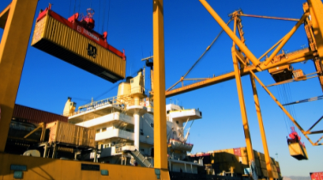
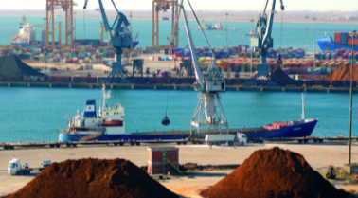

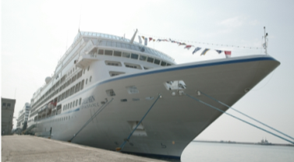
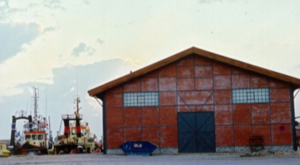
The Profit Centres of Our Business
Container
Conventional Cargo
  Strategic geographical position at the cross-roads of Asia-Africa-Europe
  Natural sea entrance (20m) with no need for dredging
  Advanced infrastructure and operations (24x7) throughout the year
  Infrastructure available to serve a range of ship sizes (depth up to 12m, 14 berths; various types of cranes)
  Capable of storing and handling bulk and general cargo
  Direct access to railway and road networks
352k TEUs
€31.7 MM
€19.4 MM
4.1 MM tonnes
€17.6 MM
€7.0 MM
Passenger
Exploitation of Spaces
  Upcoming destination for cruise
  Broad array of facilities (bunkers, slops etc.)
  Located in close proximity to tourist destinations
  Fully compliant with International Ship and Port Facility Security code (ISPS)
  Parking lots offer 595 parking spaces (245 and 350 lots in Pier 1 and 2, respectively)
  Both open and sheltered warehouses available
  Leasing of renovated warehouse venues for events and conferences
26k
passengers
€0.3 MM
(€0.1) MM
NM
€1.3 MM
€1.0 MM
Revenue Contribution 2015
Throughput 2015
Revenues 2015
EBITDA 2015

Slide 8
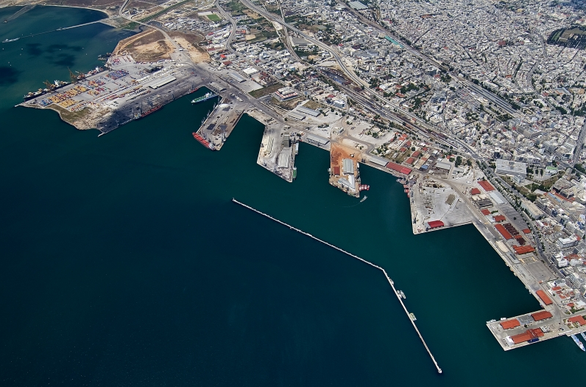
Overview of ThPA SA Location
Free zone
Container Terminal
Dry Bulk & General Cargo
Coastal/Cruise
Parking Lots

Slide 9
Free Zone Overview
1
Legislated in 1914 and started its operation in 1925
2
Operates in accordance with EU customs code
3
Provides same level of service to all cargoes, irrespectively of origin or destination
4
Provides comfortable free storage period for conventional cargo in transit
5
Maximum safety and security

Slide 10
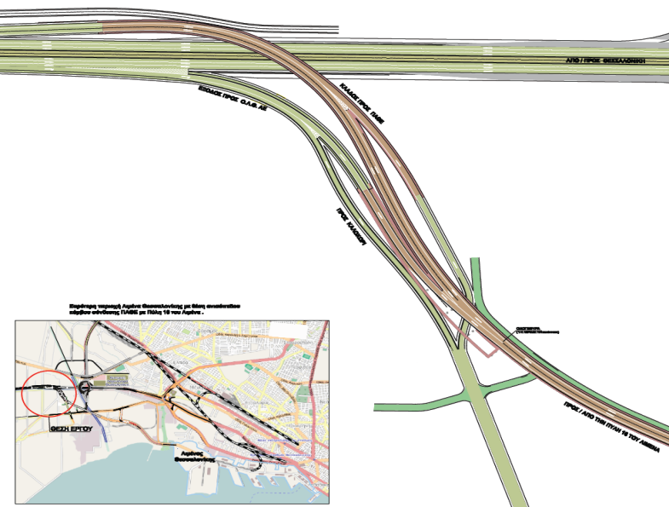
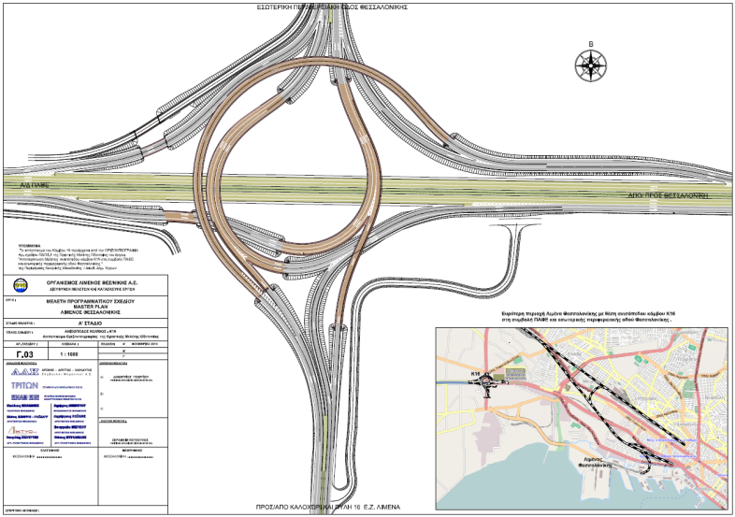
Road Connections to ThPA SA
Overview
Pier 6 Connection to Motorway 1 and Egnatia Road
The construction of Interchange Junction K16 needs to be completed for the connection of Pier 6 to Motorway 1 and Egnatia Road
Road connection to Pier 6 is evaluated in the Strategic Plan for Investments in Transport
Possibility to get funded from the Partnership Agreement for Greece, 2014-2020
At the moment, the project has not been qualified for implementation
Interchange Junction K16

Slide 11
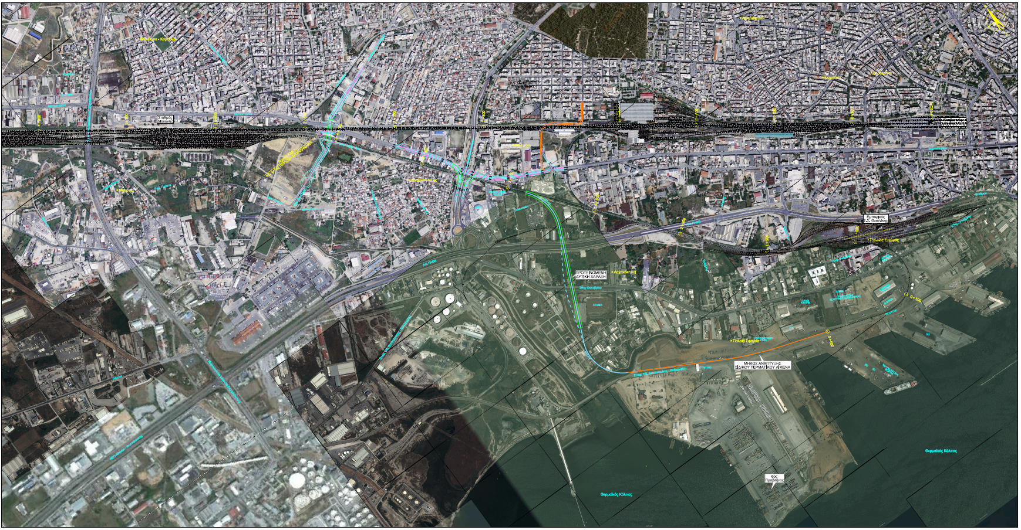
Railway Connections to ThPA SA

Slide 12
Agenda
1
Overview of the Opportunity
2
Operations Overview (Container Terminal)
3
Financial Overview
4
Business Plan & Master Plan Overview

Slide 13
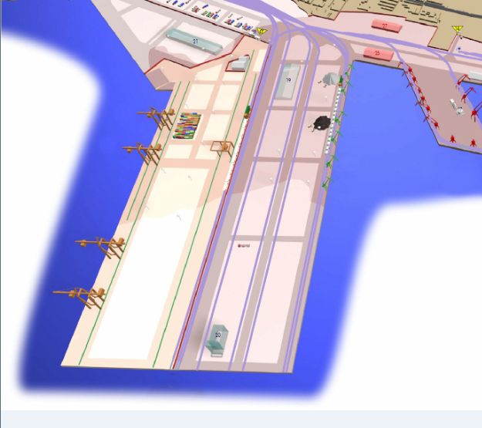
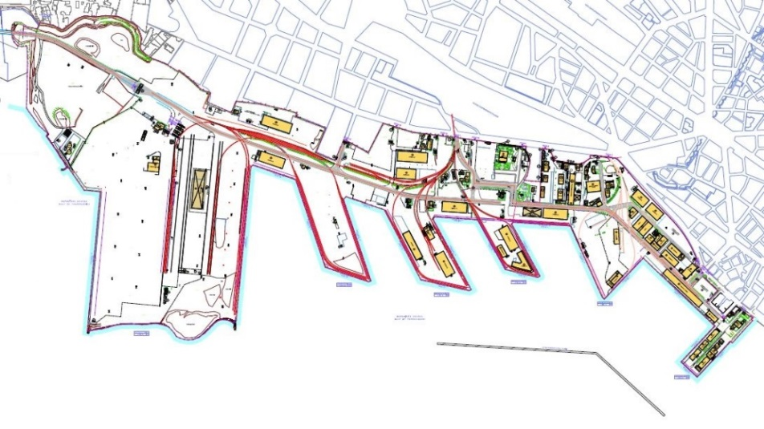
Container Terminal
Overview
    Serves the biggest shipping companies and has robust infrastructure
    Provides rail connection to Central/Eastern Europe and the Balkans
    Operational length 530 m, crane rails 480m, depth 12m MWL (1), max draft 10.8m
    Currently operating at 0.35 MM TEU (2015A)
    Throughput expected to increase to 366k TEU (c. 4% increase) in 2016E
    Operational capacity of 0.44 MM TEU
    Operates 24x7
    Offers a variety of services for competitive fees, including loading/unloading, quayside handling, container storage, reefer containers, inspection and rail handling
    ISO 9001:2008 for Terminal Operations and ISO 14001:2004 Environmental Management
Q-23
Q-23
Q-20
Q-20
Q-22
Q-22
Q-21
Q-21
Q-24
R
Q-26
Q-24
Q-26
Pier 5
Q-23
Pier 5
Liquid Bulk Facility
CS: Please include the grey bubble in the legend and annotate: “Pier”
Q-22
Q-20
Pier 6
Expansion Plan
Pier 6
Expansion Plan
Q-24
Q-26
General and Bulk Cargo Terminals
Q-21
5
Legend
Q Quay
Rail tracks
Legend
Q Quay
Rail tracks
6
Q-25
Legend
Q Quay
Rail tracks
Pier
Q-25
Pier 6
Q-25
Pier 6
West side
East side
Container
Terminal
Dry Bulk
Terminal
Note:
Mean Water Level
Container
Terminal
Dry Bulk
Terminal

Slide 14
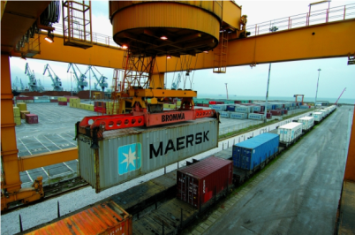
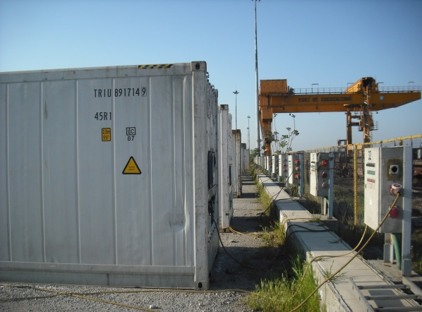
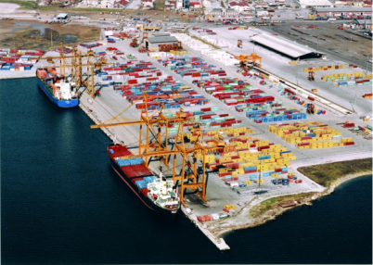
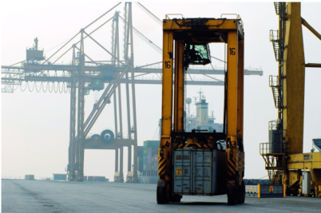
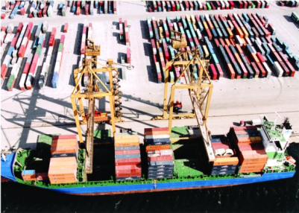
Container Terminal (Cont’d)
Location Specifications
  The area covers about 320,000 m² used for quayside/rail handling, truck handover, inspection, maintenance, container storage and general administration
  Operations are located in quay #26 with a total length of 585 m
  Maximum berth depth: 12m
  89 truck handover positions, 75 of which are on the West of the railhead, and the remaining 14 on the East
  Three installed rail tracks served by the train transtainer
  Administration building exploited for custom’s inspection, as well as for leasing space to shipping companies and forwarders
  On-dock workshop covers approximately 2,360 m² and is located close to the gate
  Local exports are currently directly handled form trucks to vessels. All these containers are stored in private storage yards
Operations Overview
  Containers are handled by 4 gantry cranes, 2 of which are Panamax (lifting capacity of 40-45 tn) and another 2 STS Post-Panamax (lifting capacity of 50 tn)
  Operations are conducted by 1 over 2 high straddle carriers: Storage at 2-high for full and 4-high for empty containers
  Dwell times: ~3 days for imports and ~0 days for local exports; for transit, import dwell times: ~3 days, while export: ~4 days
  Rail is handled 5 days per week at an assumed productivity of 20 containers per hour

Slide 15
Container Terminal (Cont’d)
Volumes Handled
Revenues
‘000 TEU
€ ‘000
Source: ThPA SA Management and Annual Financial Statements 2012, 2013, 2014, 2015
Source: ThPA SA Management and Annual Financial Statements 2012, 2013, 2014, 2015

Slide 16












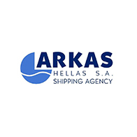


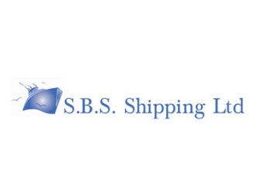

Container Terminal (Cont’d)
Key Customers
Pricing Policy
  ThPA SA pricing policy is unchanged since 2007
    ISPS code fees on cargo is imposed since 2012
    Container handling pricing favours export activity
Key Customers
2015A | Throughput
Shipping Line | TEU | Share (%)
MSC SA | 86,108 | 24%
A.P. MOLLER - MAERSK A/S | 54,343 | 15%
UNITED MARINE AGENCIES SA | 49,448 | 14%
COSCO SA | 29,961 | 9%
CMA GGM ΕΛΛΑΣ | 28,922 | 8%
SAMOTHRAKITIS ST. | 28,339 | 8%
ARKAS HELLAS | 26,280 | 7%
ZIM INTEGRATED SA | 25,783 | 7%
HAPAG LLOYD SA | 11,934 | 3%
OTHER | 10,623 | 3%
Source: ThPA SA Management

Slide 17
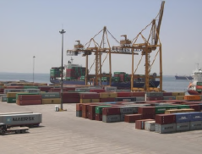
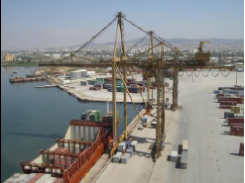
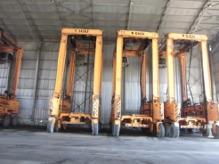
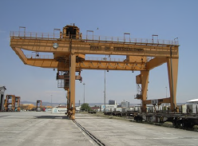
Major Container Terminal Equipment
Post Panamax Crane
Panamax Gantry Crane
Straddle Carriers
Transtainer
Units: 2
Commissioned: 1997
Manufacturer: X. Rokas
Lifting Capacity: 50 tonnes
Units: 2
Commissioned: 1987, 1991
Manufacturer: X. Rokas
Lifting Capacity: 40 - 45 tonnes
Units: 16
Commissioned: 1995 (3 units), 1998 (5 units), 2003 (2 units),
2007 (4 units), 2013 (2 units)
Manufacturer: Valmet, Sisu, Kalmar
Lifting Capacity: 40 tonnes
Units: 1
Commissioned: 1993
Manufacturer: X. Rokas
Lifting Capacity: 50 tonnes
Other equipment deployed such as Front Lifts for empty containers (3 units), Reach Stackers (2 units),
Tractors-Trailers and Forklifts

Slide 18
Agenda of the Day
1
Overview of the Opportunity
2
Operations Overview (Conventional Cargo)
3
Financial Overview
4
Business Plan & Master Plan Overview

Slide 19
Conventional Cargo
Overview
Annual throughput of 4.1 MM tonnes (2015A)
Berth depth of up to 12m MWL⁽¹⁾ capable of accommodating large bulk and general cargo vessels
Capability and experience in handling different commodities including ores, agricultural and iron products
Advantage and expertise in handling dry bulk products (85% of handled tonnage)
Rail connection to all berths makes the port very accessible
Offers quayside handling, loading/unloading services and storage facilities
ISO 9001:2008 for Bulk and General Cargo Operations and ISO 14001:2004 Environmental Management
R
Q-23
Liquid Bulk Facility
Q-19
Q-22
Q-15
Q-11
Q-20
Q-16
Q-14
Q-12
Q-24
Q-18
Q-21
Q-17
Q-13
5
4
3
6
General Cargo Terminal
West side
East side
General and Bulk Cargo Terminals
Container
Terminal
Dry Bulk
Terminal
Note:
Mean Water Level
Legend
Q Quay
Rail tracks
Pier

Slide 20
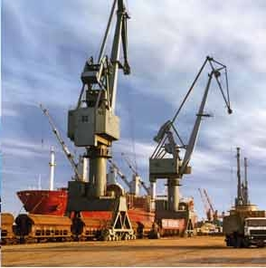
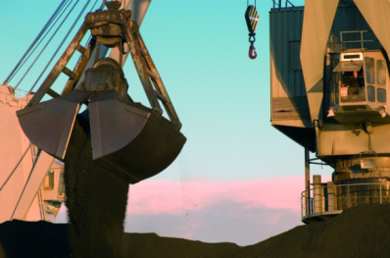
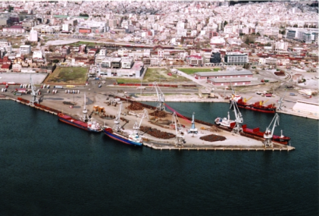
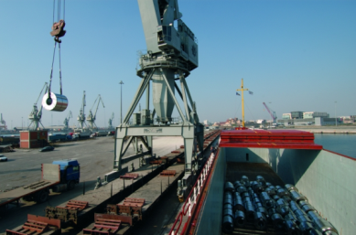
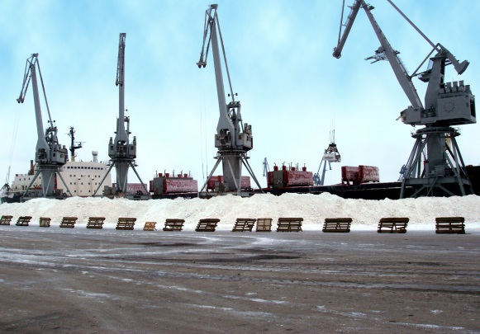
Conventional Cargo (Cont’d)
Location Specification
  General cargo and dry bulk activity takes place between berths #11-24
  Total quay length of 3,750m, fully operational with a berth depth ranging between 10 and 12m
    Quay #17/21/24 depth of 12m, rest of quays depth of 10.0m, and max draft 11.3m
  Rail tracks reach all the quays
    Ship to shore cranes can deliver cargo directly to wagons
  Direct access for trucks to both the general cargo and dry bulk berths
  The following sites are used for the storage of conventional cargo:
    Warehouses: 44,000 m² (out of which 24,780 m² as well as a reefer warehouse of 4,210 m² are located in the Free Zone)
    2 Sheds: 9,000 m² + 2,650 m²
    Outdoor Storage Areas: 670,000 m²
    Silo: 2,850 m²
Operations Overview
  Focus on bulk cargo and steel product handling
  Vessel handling volumes of up to 50,000 tonnes
  The conventional cargo terminal operates in two shifts at flat rates and allows for overtime with the corresponding surcharge

Slide 21
Conventional Cargo (Cont’d)
Volume Breakdown
Revenues
‘000 Tonnes
€ ‘000
Source: ThPA SA Management and Annual Financial Statements 2012, 2013, 2014, 2015
Source: ThPA SA Management and Annual Financial Statements 2012, 2013, 2014, 2015

Slide 22






Conventional Cargo (Cont’d)
Key Customers
Top 10 Customers
2015A | Revenue
Shipping Line | € 000s | Share (%)
NOVA LOGISTIK DOOEL Feni Industries – Cunico Resources | 5,121 | 29.2%
DAVELOPOULOS ROMYLOS TITAN Cement, Mittal Steel, Fertilizers | 3,204 | 18.3%
LARCO Ferronickel Producer | 1,369 | 7.8%
KABAKIS Duferco Steel Products, Fertilizers of Greek Industries | 1,367 | 7.8%
FERSPED A. D. SKOPJIE IGM Kavadarci, Mittal Steel | 895 | 5.1%
VIOHALCO S.A Metal Processing | 442 | 2.5%
STEREA KAUSIMA Solid Fuels, Cement | 396 | 2.3%
MARMARAS Agricultural Products | 332 | 1.9%
NITSIAKOS Poultry Feed | 269 | 1.5%
ILVA S.p.a in Amministrazione strao | 230 | 1.3%
Source: ThPA SA Management

Slide 23
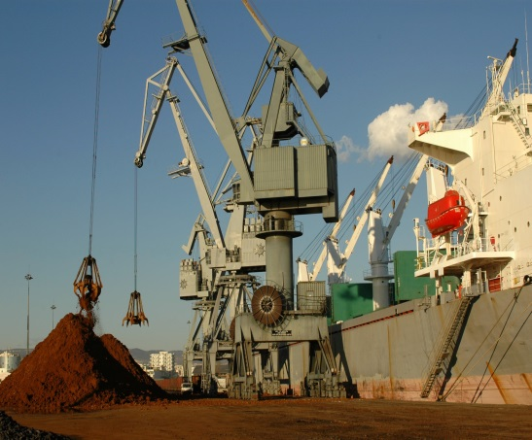
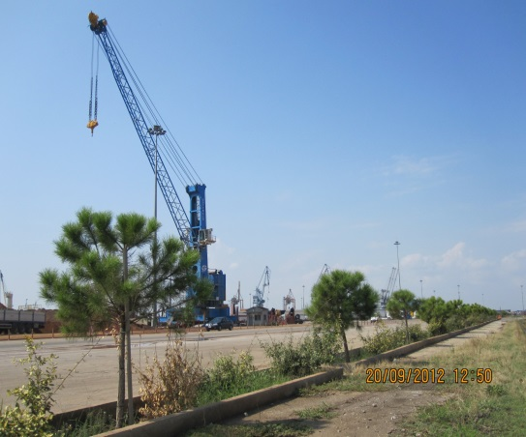
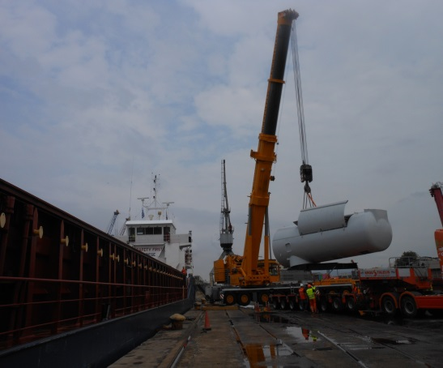
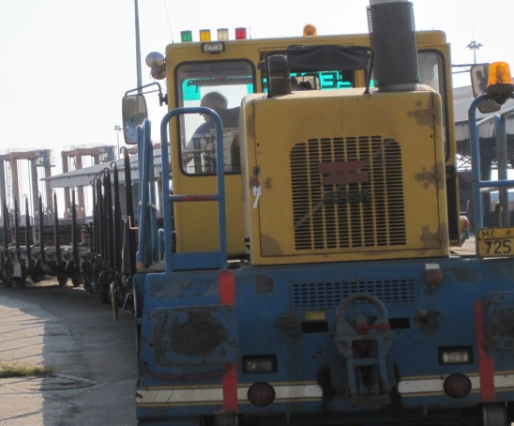
Major Cargo Terminal Equipment
Ship to Shore Cranes
Mobile Harbour Cranes
Mobile Telescopic Cranes
Road/Rail Shunting Locomotives
Image TBU
Units: 34 (17 mostly used)
Commissioned: 1953-2015
Manufacturer: Rokas/ Ganz/ Ceretti Tanfani, Ardelt Kranich
Lifting Capacity: max 100 tonnes
Units: 2
Commissioned: 2001/2010
Manufacturer: Gottwald
Lifting Capacity: 100 tonnes
Units: 2
Commissioned: 1993
Manufacturer: Demag/Liebherr
Lifting Capacity: 120 - 150 tonnes
Units: 5
Commissioned: 1996(2)/ 2002(1)/ 2014(2)
Manufacturer: Zephir
Other equipment deployed includes Forklifts, Loaders, Excavators and numerous other cargo handling equipment (platforms, etc.)

Slide 24
Agenda of the Day
1
Overview of the Opportunity
2
Operations Overview (Passenger Terminal)
3
Financial Overview
4
Business Plan & Master Plan Overview

Slide 25
Passenger
Overview
  Thessaloniki is growing to become an important destination port for cruise
  Thessaloniki and its peripheral area (Dion, Pella, Vergina), constitute points of special tourist interest
  International airport in Thessaloniki enhances tourism flow towards the port
  630m of operational quay shared between cruise and coastal services, capable of accommodating cruise ships of a vast range of sizes
  Total passenger throughput was 26,356 (2015A), out of which all were cruise passengers
  Coastal passenger traffic to Thessaloniki’s port has been temporarily paused for 2015, as ferry line operators were no longer subsidized
  A new passenger line to Sporades Islands and a ferry line to North Aegean will be launched in June 2016
  License issuance for the operation of a water airport is in progress
  ISO 9001:2008 Passenger & Cruise Terminal Services and ISO 14001:2004 Environmental Management.
Real-Estate use of port areas (cultural/ entertaining activities, combined with port operations)
Q-8
Q-7
Q-9
Q-6
Ferry Terminal
2
Q-5
Q-4
1
Q-3
Legend
Q Quay
Pier
Cruise Terminal
(between piers 1 & 2)
Q-1
Q-2

Slide 26
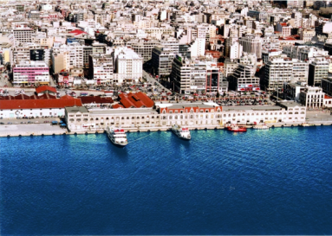
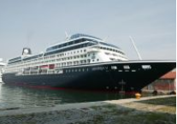
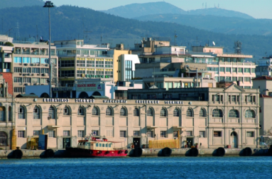
Passenger (Cont’d)
Location Specifications
  Cruise
  The port of Thessaloniki is in close proximity to main tourist destinations adorned by monuments from various historical periods (Ancient Greece, Roman Period, Byzantium)
  Quay length of 400m (quays No4- No8) and quay 9 length of 230m are used for cruise services
  Berth depth range from 8 to10m; capable of serving most existing cruise ships
  Coastal
  The passenger port has a large waiting area for trucks and private vehicles before embarkation and a passenger terminal building located opposite the main gate of the port
  2 stern berths are at the disposal of coastal traffic
  Maximum berth depth at 8m; capable of serving all ferry vessels
  Large landside area of 1.8ha is located besides the ferry berth
Operations Overview
  Cruise
  Thessaloniki port serves cruise ships in transit
  The terminal is fully equipped according to ISPS standards with X-ray scanners, metal detectors and sniffer dogs
  Coastal
  Currently there is a Ro-Ro line to the North East Aegean which serves only trucks
  Coastal passenger traffic to Thessaloniki’s port has been temporarily paused for 2015 and 2016, due to the paused ferry lines as the operators were no longer subsidized

Slide 27
Passenger (Cont’d)
Passenger Volumes
Revenues
‘000 pax
€ ‘000
Ro-Ro Traffic
‘000 tonnes
Source: ThPA SA Management and Annual Financial Statements 2012, 2013, 2014, 2015
Source: ThPA SA Management and Annual Financial Statements 2012, 2013, 2014, 2015

Slide 28




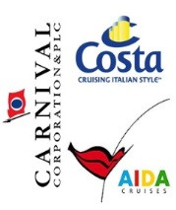
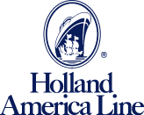

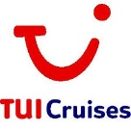

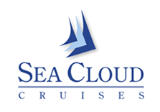







Passenger (Cont’d)
Key Cruise Customers
  The ThPA SA cruise terminal serves a broad spectrum of cruise companies and vessels, ranging from small sailing vessels to large cruise ships
  The location of the Thessaloniki port provides further potential to develop the cruise and coastal activities due to its proximity to the city, airport and rail station

Slide 29
Agenda
1
Overview of the Opportunity
2
Operations Overview (Exploitation of Spaces )
3
Financial Overview
4
Business Plan & Master Plan Overview

Slide 30
Exploitation of Spaces
Overview
  Ample storage space and warehouses leased to third parties
  Indicative warehouses located within free zone are listed below:
    Warehouse 22: 4,021 m²; general cargo
    Warehouse 24: 4,907 m²; general cargo
    Warehouse 25: 4,210 m²; fruit and vegetables
    Warehouse 26: 3,212 m²; general cargo
  Area 19: Sheltered area for outdoor storage, used for general cargo ~ 9,000 m2
  2 parking lots in the area of Pier 1/2
    245 lots in Pier 1
    350 lots in Pier 2
  Pier 1 contains renovated warehouses for multipurpose use (restaurants, conference halls, festivals, etc.)
WH-27
WH-24
WH-25
WH-26
A-19
Q-23
WH-22
Q-19
Q-22
Q-18
Q-15
Legend
Q Quay
A Outdoor Area
P Parking Space
WH Warehouse
Non - operating Rail tracks
Pier
P-2
Q-10
Q-8
P-1
Q-7
Q-9
Q-6
Q-5
2
Q-4
Q-3
Q-1

Slide 31
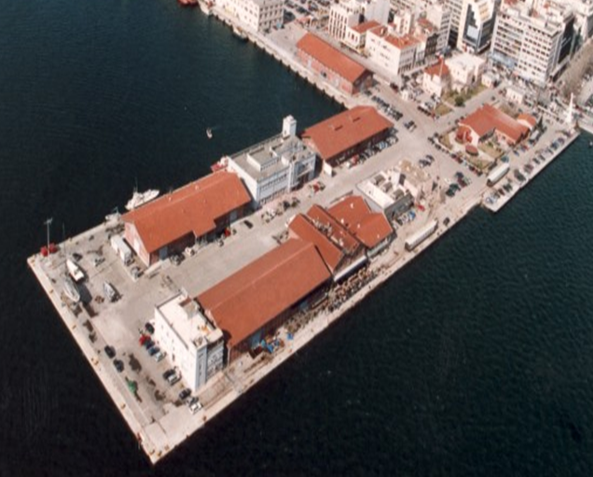
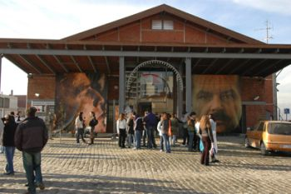
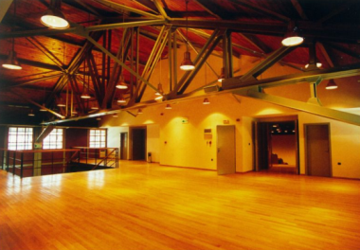
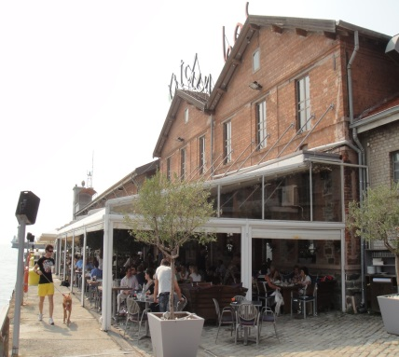
Exploitation of Spaces (Cont’d)
Pier 1 Space Exploitation
Sites Overview
    2 amphitheatres (245 seats, each)
    Cinema museum and photography museum
    2 museums of contemporary art
    Kitchen-bar
    Multi-purpose cultural hall
    2 amphitheatres (263 seats, each)
Event Halls
  A series of warehouses on Pier 1 have been renovated for multipurpose uses (i.e. conferences, seminars, exhibitions, film projections and reception halls)
  Warehouses on Pier 1/2 have been leased (8 years leasing period) and are currently exploited as cinemas, restaurant/cafeteria and a gym
  Parking Lots
  ThPA SA has created and is successfully operating two outdoor parking lots with a total capacity of 595 vehicle parking spaces
1
1
A
A
D
B1
B2
B1
C
B2
D
Pier 1
C
Revenues
€ ‘000
Source: ThPA SA Management and Annual Financial Statements 2012, 2013, 2014, 2015

Slide 32
Agenda
1
Overview of the Opportunity
2
Operations Overview
3
Financial Overview
4
Business Plan & Master Plan Overview

Slide 33
P&L Overview: Revenue Composition
Revenue Breakdown
Overview
€ ‘000
  ThPA SA’s main revenue drivers are the container terminal and loading/unloading services of the conventional port, which account for approximately 97% of the overall revenue in FY15
    Revenue downfall in FY15 was mainly due to the decrease of general cargo activity
    In FY14, container revenue growth was primarily driven by the increase of loading and unloading services (containers of 40’ c.c.)
ThPA SA revenue for the FY15 amounted €50.9 MM (-7.2% y.o.y.) impacted by decreases of container terminal (~0.9%) and conventional cargo (~17.2%) segments
FY14A
Revenue Contribution
FY15A
Revenue Contribution
58.4%
38.6%
0.5%
2.5%
62.3%
34.5%
0.6%
2.6%
Source: ThPA SA Management and Annual Financial Statements 2012, 2013, 2014, 2015

Slide 34
P&L Overview: Personnel Expenditure
Personnel Expenditure
Overview
  ThPA SA had declining annual payroll costs in FY12 (22%), FY13 (8%), FY14 (8%) and FY15 (4%)
  Manpower
  Manpower is segregated into “dockers” and “employees”
  Contract duration for both types of employment is set to indefinite and the counterparties involved are the ThPA SA and the Greek federation of dockers or Greek port federation for dockers and employees, respectively
    Salary for dockers is set on a “daily basis” (€51.8 /day) while for employees to a “monthly wage” (amount depends on contract agreement)
  Severance payment are estimated to equal 7 months of salary for both dockers and employees, with a max remuneration capped at €15k
  Significant decrease in payroll costs has been achieved since 2012, with the total payroll costs decreasing by ~6.5% p.a (lower payroll and related costs as a result of compliance to L.4024/2011)
Headcount
Source: ThPA SA Management and Annual Financial Statements 2012, 2013, 2014, 2015
Note:
Excluding personnel compensation provisions

Slide 35
Agenda
1
Overview of the Opportunity
2
Operations Overview (Conventional Cargo)
3
Financial Overview
4
Business Plan & Master Plan Overview

Slide 36
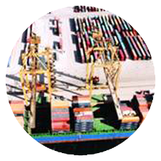
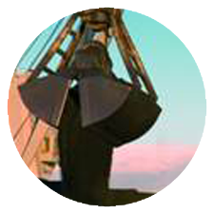
Key Initiatives to Further Develop the Port
ThPA SA approved a 25-year Master Plan and a 5-year Business Plan. Key Proposals are the following:
Container Terminal
  ThPA SA will be completing the Container Terminal expansion in 2021
  The west side of Pier 6 (quay 26) will be expanded by 650 m and will be capable of handling 1.36 MM TEU per year
  Aim is:
    To develop new, deeper quays (16m depth LWL⁽¹⁾) and increase capacity to 1.36 MM TEU per year
    To acquire modern, high-performance handling and storing equipment in order to be able to serve larger containerships
    To serve direct calls and bigger vessels
    To provide berth window to liner services
    To develop capacity for loading / unloading containers on trains and transportation with block & shuttle trains directly from the Container Terminal
  Direct Access for Trucks with modern gate processes
Conventional Cargo Terminals
  Expansion of the east side of Pier 6 (quay 24) by 350m until 2021 developing deeper quays (16m depth) and offering additional capacity, reaching in total 8 mn. tons of bulk cargo, in order to serve larger bulk carrier vessels of more than 100,000 metric tons transportation capacity
  Acquisition of modern handling and storing equipment, offering enhanced dust management capabilities - enclosed conveyors, sheds, metal warehouse for special handling cargo
  Capacity development for loading / unloading bulk cargo on trains and transportation with block & shuttle trains directly from the Terminals
  Option to combine and extend piers 4 and 5 into a larger pier, with expanded storage capacity and increased pier head depth (15m), upon sufficient demand
  Aim is to increase volume of “in transit” cargo given close proximity and accessibility to SE Europe and the Balkans

Slide 37
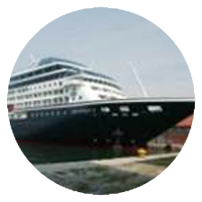
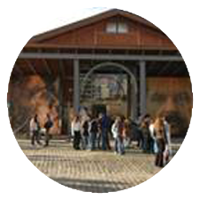
Key Initiatives to Further Develop the Port (Cont’d)
Passenger Terminals
  Cruise
  The main goal is to position Thessaloniki as a major destination and “home” port, included in main cruise routes in the Eastern Mediterranean, which will boost passenger traffic and arrivals of larger cruise ships
  Optimal utilization of the existent passenger terminal and the current port infrastructure in the basin between piers 1 and 2
  Development of a new modern cruise passenger terminal in pier 2
  Efficient integration of cruise terminal to passengers’ transport chains (cooperation with the airport and the rail station of Thessaloniki)
  Exploite business opportunities with cruise companies (terminals’ concession, development of new services etc.)
  RO-Pax International Service
  Development of Ro-Pax service line connecting Thessaloniki to Izmir, as well as potential connections between Thessaloniki and Black Sea ports
  Coastal Service
  Re-launch of ferry routes to and from Aegean Sea islands
  Enhance and improve services to coastal
  passengers
Other
  Renovation of the protected building of the old passenger terminal
  Development of piers 1 and 2, adjacent to the city center, for commercial, touristic and cultural activities relevant to port operations
    Relative investments will fully comply with legal requirements regarding the "historic character” of the area and without disrupting port activities
    Smart Port
  ThPA aspires to become a Smart Port that will have the following characteristics:
    Environmentally friendly
    IT integrated operations
    Energy Efficiency

Slide 38
Traffic Forecasts
Throughput
Market | 2015A | 2016E | 2017E | 2018E | 2019E | 2020E | 2021E
Container
Throughput (‘000 TEUs) | 352 | 366 | 380 | 393 | 411 | 444 | 501
Growth | 0.6% | 4.0% | 4.0% | 3.3% | 4.7% | 7.9% | 12.9%
Conventional Cargo
Bulk (MM Tonnes) | 3.6 | 3.3 | 3.9 | 4.4 | 4.5 | 4.6 | 4.7
Growth | (12.6%) | (10.3%) | 18.2% | 14.0% | 2.4% | 2.4% | 2.4%
General (MM Tonnes) | 0.4 | 0.5 | 0.6 | 0.6 | 0.6 | 0.6 | 0.7
Growth | (36.7%) | 21.3% | 9.2% | 12.2% | 2.2% | 2.2% | 0.7%
Passenger
Ferry (‘000 pax) | 0 | 0 | 35 | 35 | 36 | 36 | 37
Growth |  |  |  | 1.4% | 1.4% | 1.4% | 1.4%
Cruise (‘000 pax) | 26 | 28 | 29 | 30 | 52 | 76 | 100
Growth | 33.7% | 6.2% | 3.6% | 3.4% | 73.3% | 46.2% | 31.6%
Ro-Pax/Ro-Ro (‘000 vehicles) | 2.8 | 2.9 | 15.1 | 23.3 | 24.5 | 28.7 | 33.9
Growth | (18.2%) | 6.0% | 416.8% | 54.2% | 5.1% | 17.2% | 18.2%
Source: ThPA SA Management, Annual Financial Statements 2015, 2017-2021 Business Plan

Slide 39
Key Investments Planned for 2016
Investments Overview
Investment | Cost (€ ‘000) | Terminal
Procurement of 2 Rail Mounted Cranes (60t) for Quay 21 | 3,400 | Conventional Port
Procurement of 6 Tractors and 6 Trailers for the Container Terminal | 800 | Container
Upgrade of Gantry Cranes motion control system (G/G 3 & 4, PLC, Drives & trolley | 790 | Container
Dredging | 660 | Conventional Port
Procurement of 2 FrontLifts | 640 | Container
Container and Trucks integrated gate control system for the Container Terminal(OCR camera portal) | 600 | Container
Construction of new and reconstruction of existing rainwater drainage and sewage network in specific port areas | 480 | Conventional Port
Dredging | 440 | Container
Procurement of 2 FrontLifts with 37TN lifting capacity | 350 | Conventional Port
Imporvement of Container Terminal Lighting | 340 | Container
Construction of new and reconstruction of existing rainwater drainage and sewage network in specific port areas | 320 | Container
Passenger Port Construction Works | 300 | Passenger Terminal
Procurement of 3 Open Top Spreaders | 300 | Container
Procurement of 4 grabs for 32tn and 25tn cranes | 300 | Conventional Port
Procurement of Automotive and Mechanical sweepers | 287 | Conventional Port
Container Terminal Bay Plan System | 280 | Container
Reconstruction of Electrical Grid and Crane Rails of Quay 21 | 240 | Conventional Port
Source: ThPA SA Management, Annual Financial Statements of 2015, 2017-2021 Business Plan
Source: ThPA SA Management

Slide 40
Summary of Port Development Areas
Major Development Projects for the first 5 years
DESCRIPTION
BUSINESS UNIT
BUDGET (€ MM)
2017 – 2021
1
Expansion of Container Terminal Quay 26 (Infrastructure and Equipment)
Container
185.9
Road & Rail works
4.1
Buildings
13.5
Marine works
132.8
Equipment
35.4
2
Expansion of Dry Bulk Terminal Quay 24 (Infrastructure and Equipment)
Conventional Cargo
107.5
Road & Rail works
7.9
Buildings
10.2
Marine works
65.6
Equipment
23.8
3
Combination and extension General Cargo piers 4 and 5 into a larger one (Infrastructure and Equipment)
Conventional Cargo
1.8
4
Development of the ferry – coastal terminal in pier 3 (Ro-Pax, Ro-Ro)(Infrastructure and Equipment)
Passenger
10.0
5
Development of the cruise terminal in pier 2, the mega yacht port facility between piers 1 and 2, as well as renovation of the passenger terminal protected building (Infrastructure and Equipment)
Passenger
3.7
Source: ThPA SA Management, 2017-2021 Business Plan

Slide 41
Summary of Port Development Areas (Cont’d)
Major Development Projects for the Investment Horizon
BUDGET (€ MM)
SHORT DESCRIPTION
2017 – 2021
2022 – 2026
2027 – 2036
2037 – 2045
2046 – 2050
INVESTMENT BY SEGMENT
1
Container Terminal Expansion
185.9
35.0
46.0
33.8
28.7
2
Dry Bulk Terminal Expansion
107.5
62.9
135.4
46.4
23.7
3
Piers 4 and 5 Combination
1.8
0.0
59.9
9.9
0.0
4
Ferry – Coastal Terminal Development
10.0
0.0
0.6
0.0
0.0
5
Cruise Terminal Development
3.7
34.7
1.1
0.0
0.0
6
Jetty Pier Development
0.0
0.0
5.6
0.0
0.0
Source: ThPA SA Management, 2017-2021 Business Plan

Slide 42
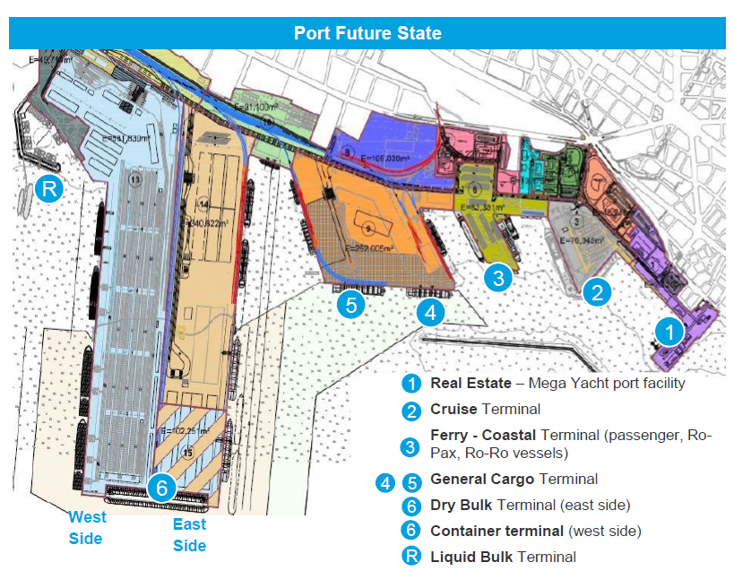
Envisaged Port Overview Post Investment

Slide 43

Container Terminal Development Plan
Pier 6 Site Plan
Current Length
Future Length
1,235 m.
(+ 650 μ. )
585 m.
West side of Pier 6 (quay 26):
Container Terminal
Current Capacity
Future Capacity
440,000 TEUs
1,360,000 TEUs

Slide 44
Container Terminal Forecasts
Container
Revenues
TEU ‘000
€ MM
  Container port throughput is expected to keep its growth momentum (CAGR c. 6% 15A-21E)
  Transit traffic is projected to grow significantly more than domestic, in line with ThPA SA’s strategic focus on growing transit throughput
  Based on historical traffic, transshipment throughput is expected to be minimal
  Revenue expected to grow at a CAGR of c. 9% between 2015A and 2021E
  EBITDA margin expected to stabilise at the 55-60% level
Source: ThPA SA Management, Annual Financial Statements 2015, 2017-2021 Business Plan
Source: ThPA SA Management, Annual Financial Statements 2015, 2017-2021 Business Plan

Slide 45

Conventional Port Development Plan
Pier 6 Site Plan
Piers 4 & 5 Site Plan (after combination & extension)
5
East side of Pier 6 (quay 24):
Dry Bulk Terminal
4
Current Length
Future Length
668 m.
1,388 m
(+720 m.)
General Cargo Terminal
Current Capacity
Future Capacity
Current Depth
Future Depth
Dry Bulk
12 m.
15 m.
4.8 mn. tons
6.75 mn. tons
The new terminal will comprise of 4 berths deep enough to host vessels of 225m. length and 45,000 DWT.
After the investment plan completion, the General Cargo Terminal will be able to serve approximately 1.1 mn. tons of general cargo, as well as 1 mn. tons of dry bulk cargo.

Slide 46
Conventional Port Forecasts
General Cargo / Dry Bulk
Revenues
MM tonnes
€ MM
  [ ]
  [ ]
  [ ]
  [ ]
  Traffic in the conventional port is expected to grow at c. 5% (CAGR 2015A-2021E)
  Bulk Cargo is expected to grow substantially, given ThPA SAs role as a Sea Gateway for metals and Dry Bulk
  The low growth in General Cargo is attributed to an expected reduction in the metals processing industry in 2016E
  Revenue expected to increase in line with traffic growth
  EBITDA margin expected to remain stable at the 36-39% level
Source: ThPA SA Management, Annual Financial Statements 2015, 2017-2021 Business Plan
Source: ThPA SA Management, Annual Financial Statements 2015, 2017-2021 Business Plan

Slide 47
Passenger Port Development Plan
Piers 1, 2 & 3 Site Plan
2
Real Estate
3
Cruise
Ferry –
Coastal
Planned Developments:
Mega Yacht
Port Facility
Ferry - Coastal
Terminal
Mega Yacht port facility
1
Water Airport
Cruise Terminal
Renovation of Passenger Terminal protected building
Other
Facilities
Other facilities include:
  A jetty pier which offers liquid bulk cargo services and will be located at an area adjacent to the west side of pier 6

Slide 48
Passenger Port Forecasts
Passengers
Revenues
PAX ‘000
€ MM
  [ ]
  [ ]
  [ ]
  [ ]
  Cruise traffic is projected to increase substantially over the Business Plan period
  Coastal passenger traffic to Thessaloniki’s port has been temporarily paused for 2015 and 2016, due to the paused ferry lines as there was no subsidy to operators
  These services will be re-launched in June 2016, serving various routes to the Aegean Sea islands
  Significant revenue increase and EBITDA margin improvement expected as a result of enhanced cruise activity
Source: ThPA SA Management, Annual Financial Statements 2015, 2017-2021 Business Plan
Source: ThPA SA Management, Annual Financial Statements 2015, 2017-2021 Business Plan

Slide 49
Full Business Plan Forecasts
Revenue
€ MM
(1)
EBITDA
€ MM
(1)
(1)
Source: ThPA SA Management, Annual Financial Statements 2015, 2017-2021 Business Plan
Note:
Data labels not shown as amount is comparatively out of scale

Slide 50
Catchment Area with Population of ~ 20 million
Ukraine
Moldova
3.0
10.0
Romania
Hungary
800km
20.0
41.1
4.3
Zagreb
Serbia
Bucharest
Constantza
Rijeka
Bosnia
600km
Croatia
3.8
Belgrade
Varnas
20.1
Sarajevo
7.0
Bulgaria
Burgas
Montenegro
Sofia
7.5
Split
0.6
Kosovo
300km
Istanbul
Bar
3.0
Skopje
Durres
Tirana
2.0
FYROM
Thessaloniki
Albania
Turkey
Greece
Athens
  Legend
  Legend
    Major Ports
    Capitals
    Thessaloniki
Major Ports
Direct Market
Capitals
Secondary Market
Population (In MM)

Slide 51
Thank you very much for your attention

