Slide 1
Development Opportunities
Becoming part of a Transport Logistics Network
Presented by Dimitar Ivanov, September 1-2 of 2016
International High Level Meeting SEE Co Modality 2016 in Plovdiv, BG

Slide 2
Previous Activities and Experience
SEE Co Modality 2016
River Transport Service:
from 2005 to 2013
four voyages per week
Sea Transport Service:
from 1995 to 2010
one voyage per week

Slide 3
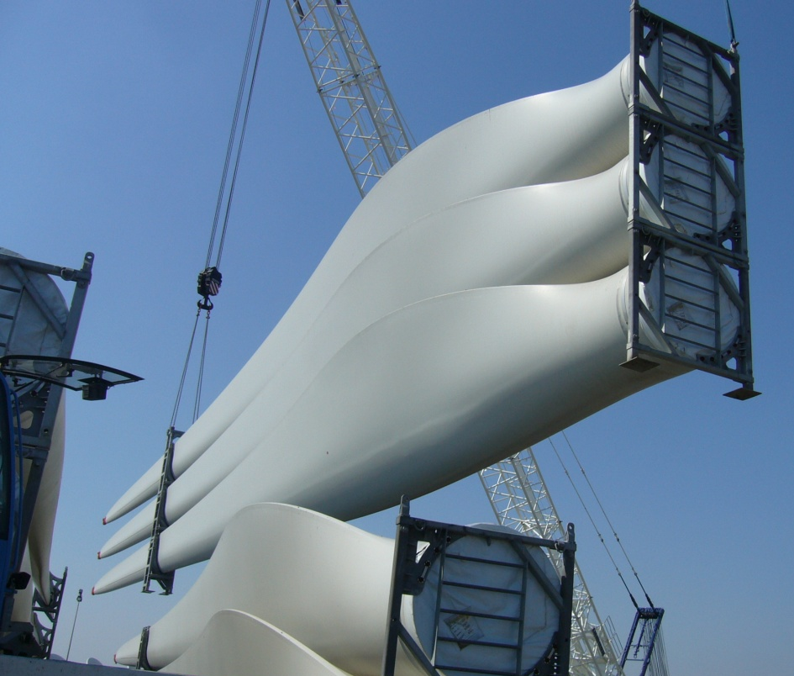
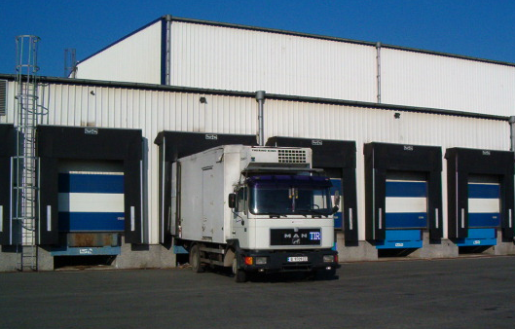
Previous Activities and Experience
SEE Co Modality 2016
Via Danube Project
under the
Marco Polo Programme
Warehousing and Forwarding
of windmill components
Food Deliveries to US&EU
Military bases in
Afghanistan

Slide 4
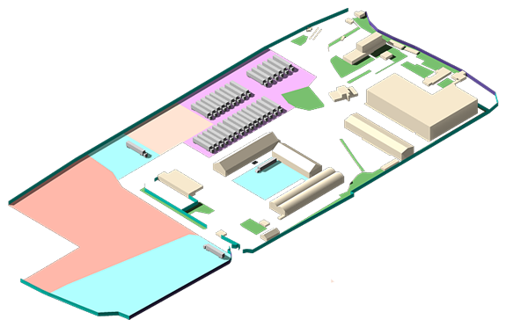
Burgas Property: Quick Details
SEE Co Modality 2016
more than 200 000 m² total area, incl.
20 000 m² covered warehouses and offices
100 000 m² parking space

Slide 5
Burgas Property: Transport Mode Connections
SEE Co Modality 2016
Burgas
Airport
Railroad
System
Road
Network
Port
Burgas

Slide 6
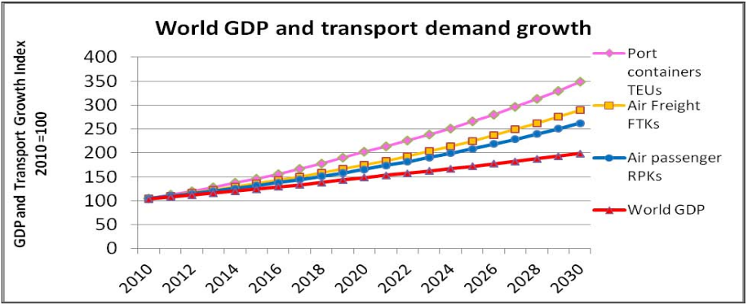
Burgas Property: Potential for Expansion
SEE Co Modality 2016
Burgas: one node from the Orient/East Med Core Corridor within the TEN-T
Expected 3x worldwide increase of the transportation demand by 2030 (Figure: OECD)

Slide 7
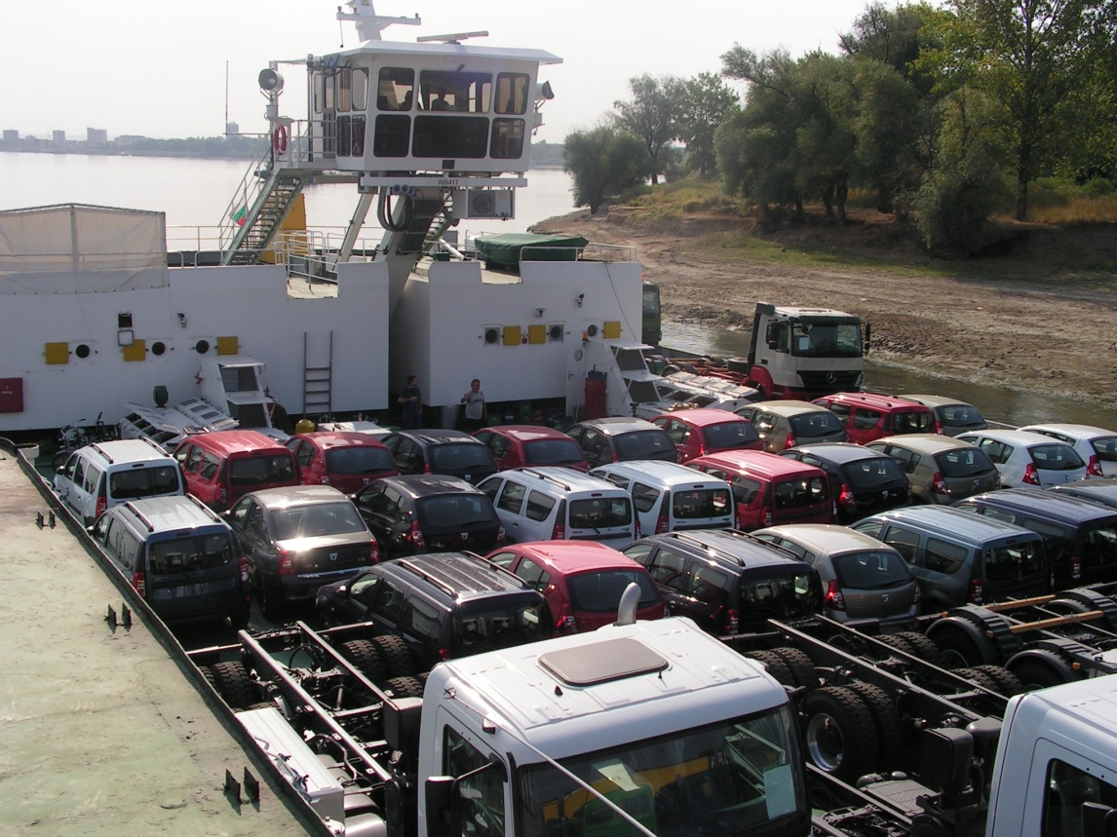
Vidin Property: Quick Details
SEE Co Modality 2016
River Port Terminal around 70 000 m² total area, incl.
4 000 m² temporary customs warehouse (open)
truck weighing scale
gas station
designed to handle two
river vessels simultaneously

Slide 8
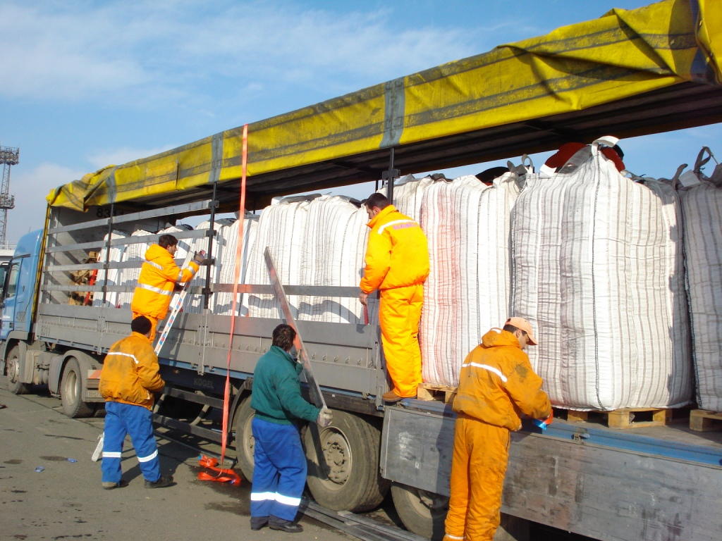
Working together for combined benefits
SEE Co Modality 2016

Slide 9
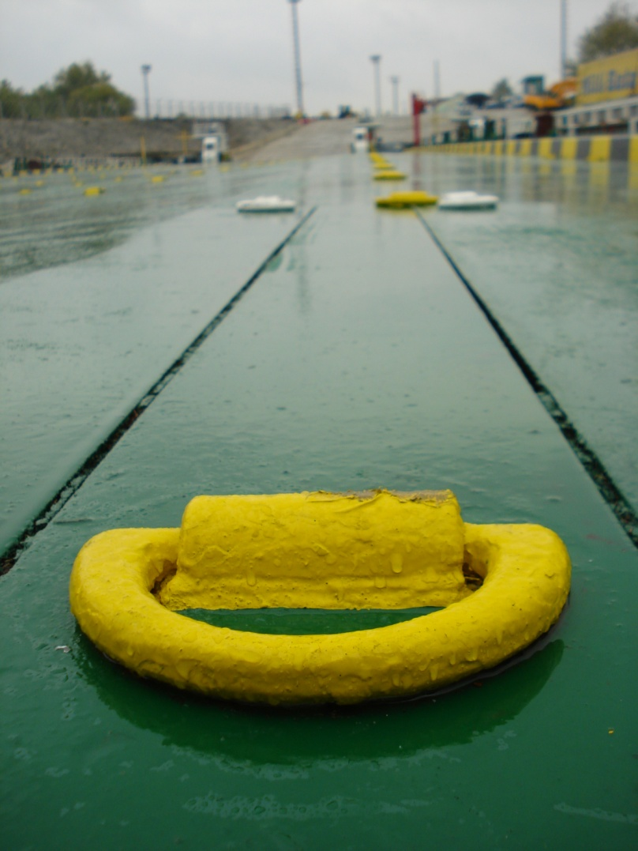
Thank you for your time!
SEE Co Modality 2016
We are looking forward
to hear from you!
For further information or interest,
please don’t hesitate to contact us.
Contacts
Mail: DIvanov@intershipping.net
ITomova@intershipping.net
Web: www.intershipping.net

