Slide 1

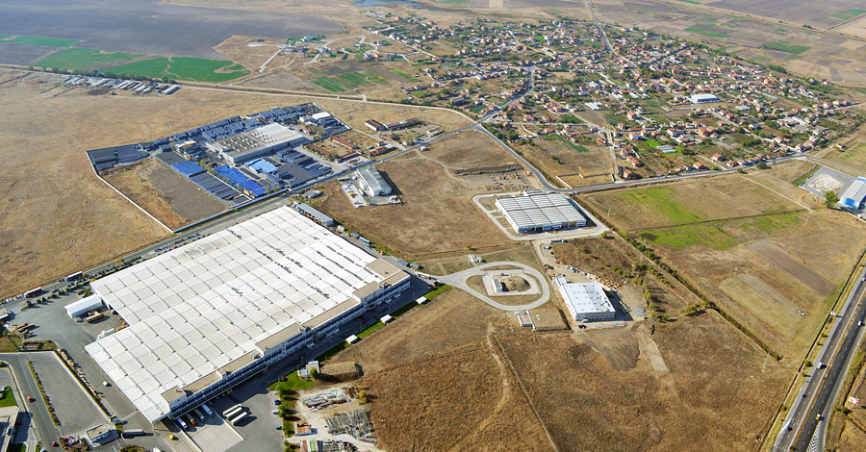
Trakia Economic Zone
Public private partnership

Slide 2

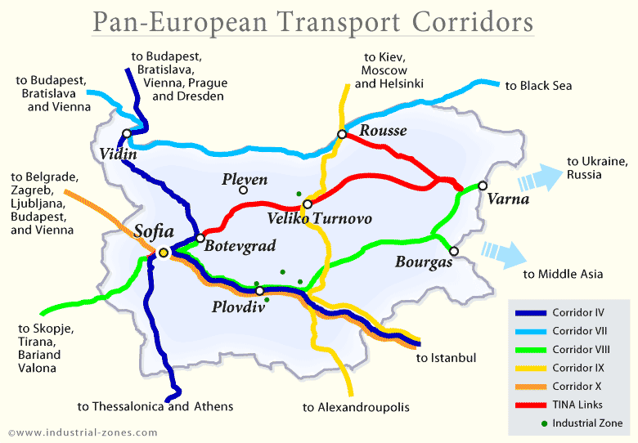

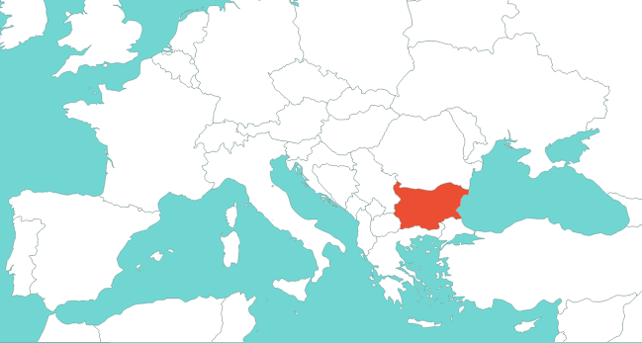

TRAKIA ECONOMIC ZONE /TEZ/
GEOGRAPHIC LOCATION
• South East Europe
• Bulgaria
• In the region of Plovdiv, the
second largest city in Bulgaria
• Crossroad between Europe and Asia
• Close proximity to European Transport
Corridors
Plovdiv
BULGARIA
www.tez.bg
Slide 2

Slide 3

WHY BULGARIA
ADVANTAGES
- Politically stable, member of EU and NATO
- Financial stability
- Strategic location
- Free access to the markets in the whole EU
- Quality labor force
- Legal framework fully harmonized with EU
legislation
- Excellent climate and beautiful nature,
good way of living
ATTRACTIVE COSTS OF DOING BUSINESS
- The lowest operational costs in EU
- 10% corporate tax - the lowest in EU
- 10% personal income tax
- Government support for investment
projects
www.tez.bg
Slide 3

Slide 4


PROJECT MILESTONES
First Region for Priority Support from the State in Bulgaria
Industrial project supported by 9
municipalities and 2 clusters
2005 industrial zone “Rakovski”, part of TEZ,
was officially awarded
“The first industrial zone in Bulgaria –
Public Private Partnership model”
Attracted investors from Europe, USA, Canada, Israel, Turkey, and Japan
www.tez.bg
Slide 4

Slide 5
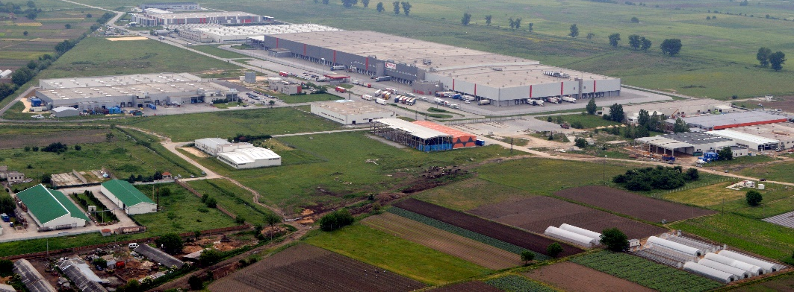
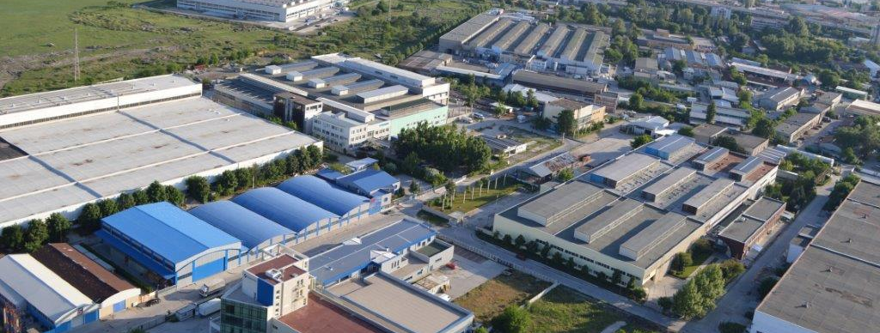
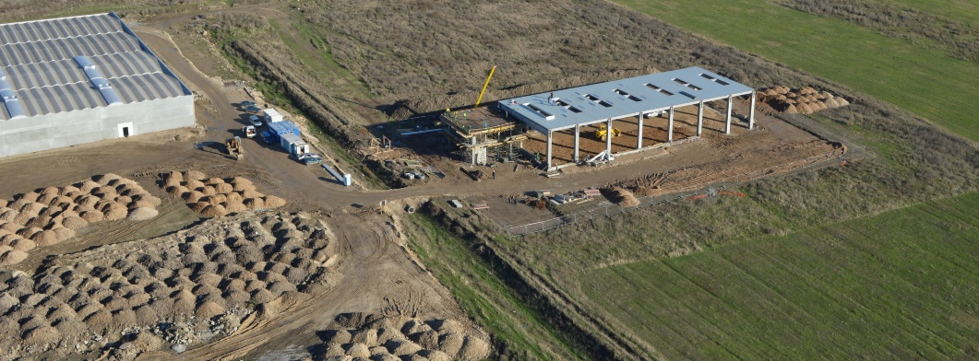
CHARACTERISTICS OF TEZ (1)
- Total area - 10 700 000 m²
- TEZ unites the good experience and
development of 6 industrial zones:
  "Maritza"
  "Rakovski"
  "Kuklen"
  "Education and hi-tech Park"
  Park “Innovations”
  "Kaloyanovo"
www.tez.bg
Slide 5

Slide 6
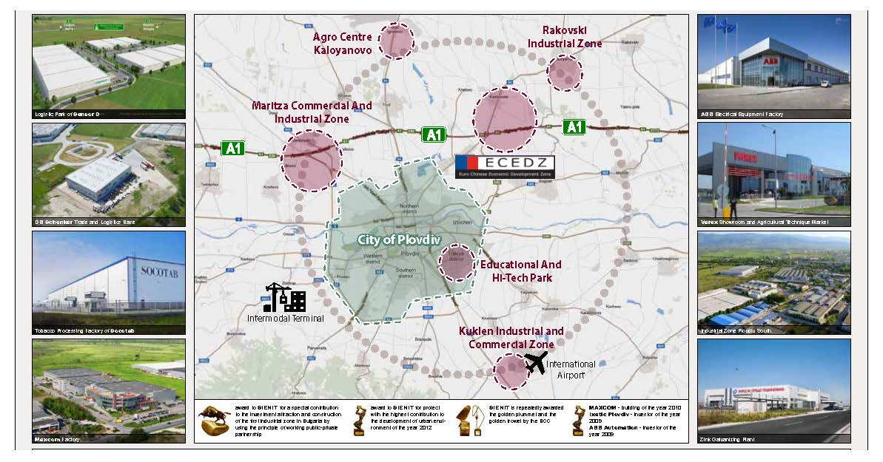
CHARACTERISTICS OF TEZ (2)
Park
“Innovations”
www.tez.bg
Slide 6

Slide 7
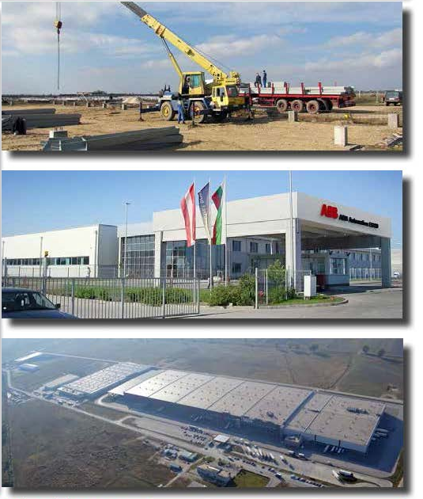
CHARACTERISTICS OF TEZ (3)
Our experience so far:
- Investments - over 1 billion EURO
- Investors attracted - over 120, over 80 of
them international
- Occupied area - 3 250 000 m²
- More than 15 000 employees work in the
enterprises and the logistic bases
Industrial and logistic space of 845 000 m² built
Our future potential:
- Free area for development - 7 450 000 m²
- Expected new jobs to be created - 30 000
www.tez.bg
Slide 7

Slide 8
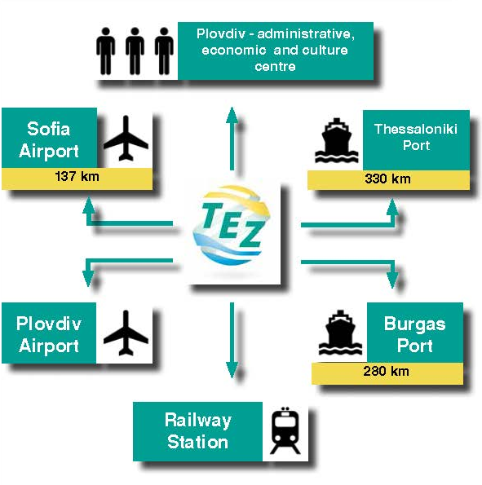
ADVANTAGES OF TEZ
- Convenient geographic location - on
important railway routes and European
transport corridors, connecting Europe,
Asia and Africa
- Infrastructure secured - transport,
electricity, gas, water, sewerage,
telecommunications
- Specialized administrative unit provides additional services, accelerated procedures
- Qualified work force
- 9 major universities with technical and economics disciplines
- More than 80 schools, language and
specialized high schools
- Special training center for education of the personnel
www.tez.bg
Slide 8

Slide 9
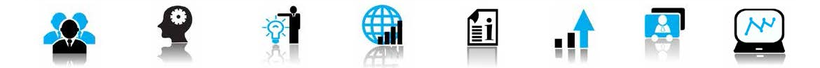
BENEFITS AND INCENTIVES FOR INVESTORS
OPPORTUNITIES FOR EUROPEAN
FUNDING
- Easy access to funds of EU operational
programs under the new programming
period 2014-2020
- Experienced consultants who assist the
investors in applying for European
programs
WORKING TOGETHER
- TEZ is a Public - Private Initiative
- Cooperation with local authorities and
institutions: 9 municipalities and 2 clusters
have signed a Memorandum for active
support for the implementation of TEZ as a
vehicle of regional economic development
SHORT TERMS FROM FIRST STEP TO A
COMPLETED FACTORY
- Quick start of operation - thanks to the
finished spatial planning of the territory
- The team of the Economic Zone -
specialists with over 15-years of experience
in the construction of industrial, logistic,
infrastructural, energy and commercial
sites, lawyers, brokers contributing to the
fast project implementation.
- The Zone has ready production, logistic,
commercial facilities to offer
- Construction of sites upon the
requirements of the investor - specialized
logistics and customs services
www.tez.bg
Slide 9

Slide 10



WHAT WE OFFER
SALE of land for investment projects:
Suitable for industrial, commercial, logistic and office projects
Strategic geographic location
Secured modern infrastructure – road infrastructure, electricity, gas, water, sewerage, telecommunication
SALE of ready production, logistic, commercial and office space
and
RENTAL of ready production, logistic, commercial and office space
CONSTRUCTION of sites by the request of the investor
Short deadlines for project implementation, e.g. enterprise of 10 000 m² production area is ready in 6 month
www.tez.bg
Slide 10

Slide 11



















MAJOR INVESTOR IN TEZ (1)
www.tez.bg
Slide 11

Slide 12




















MAJOR INVESTOR IN TEZ (2)
www.tez.bg
Slide 12

Slide 13




















MAJOR INVESTOR IN TEZ (3)
www.tez.bg
Slide 13

Slide 14


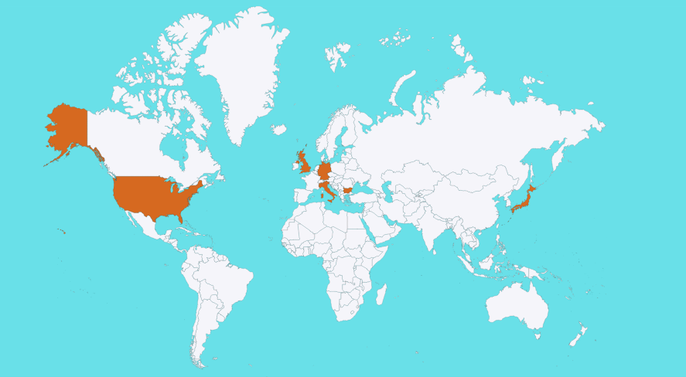




2015 – NEW INVESTMENTS IN TEZ
UK
IV Business expansion
Zone “Rakovski”
New
production
area
GERMANY
New logistics area and expansion of the production area
Zone “Maritza”
Business activity expansion
USA
I stage of factory -
1500 new working places
JAPAN
Zone “Maritza”
Zone “Maritza”
180 000 м² land
bought
Zone “Rakovski”
BULGARIA
ITALY
New production plant
Zone “Maritza”
New modern factory
www.tez.bg
Slide 14

Slide 15

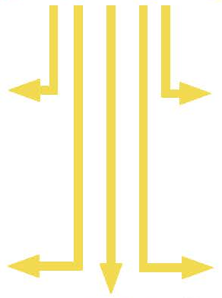
SCOPE OF TEZ
Industrial Zones
Education
Agriculture
Environment
Commerce
www.tez.bg
Slide 15

Slide 16
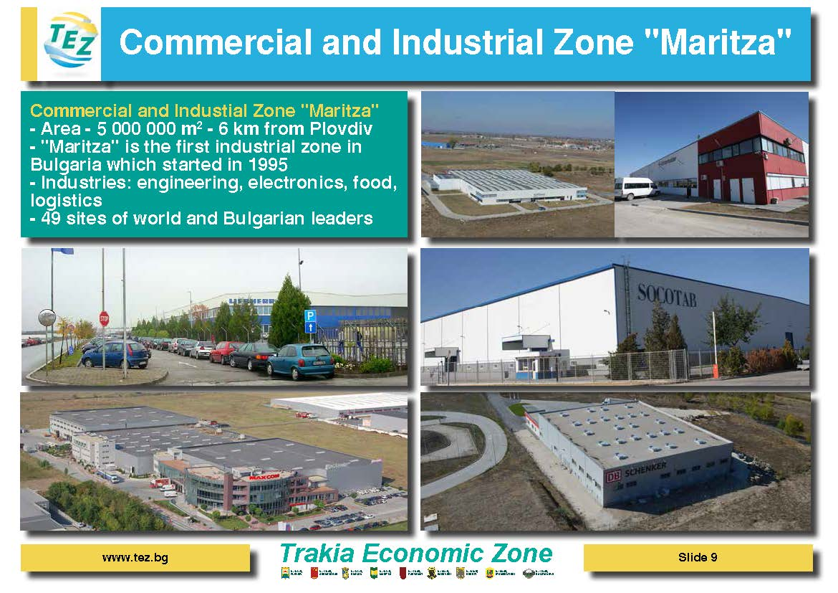
COMMERCIAL AND INDUSTRIAL ZONE "MARITZA"
- Area - 5 000 000 m2
- "Maritza" is the first industrial zone in
Bulgaria which started in 1995
- Industries: engineering, electronics, food,
logistics
www.tez.bg
Slide 16

Slide 17
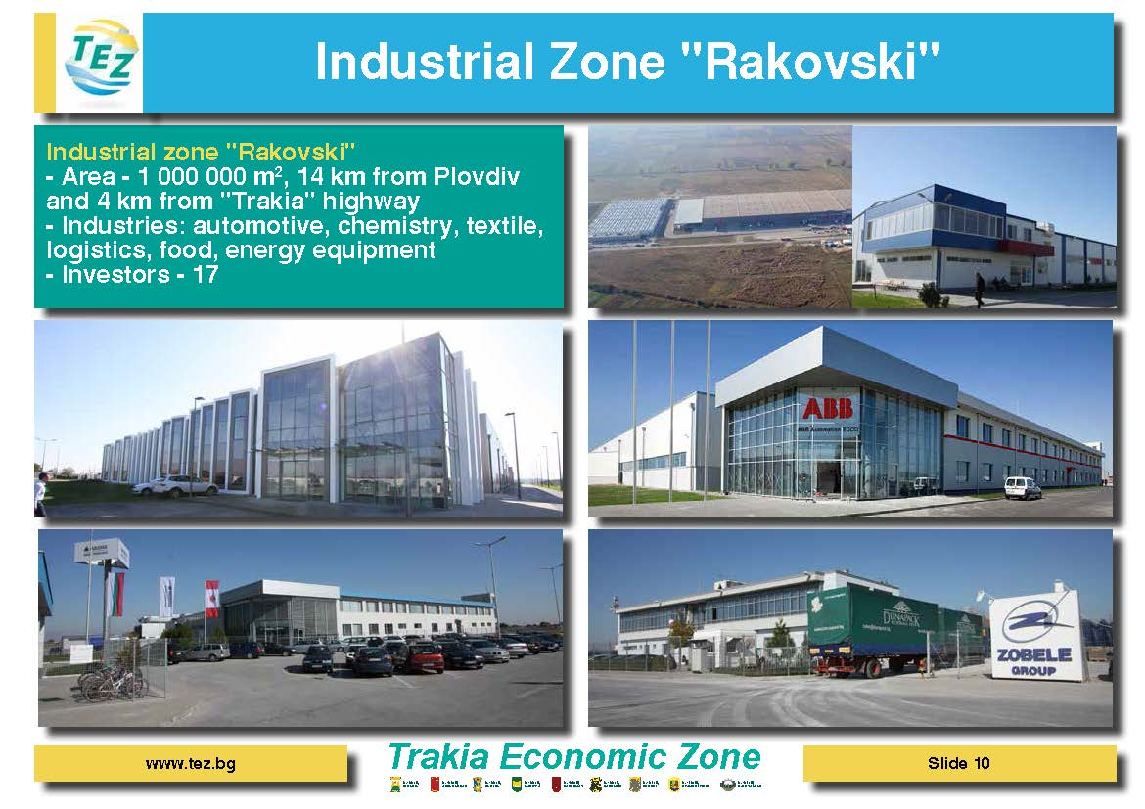
INDUSTRIAL ZONE "RAKOVSKI"
- Area - 1 000 000 m2
- Industries: automotive, chemistry, textile, logistics, food, energy equipment
www.tez.bg
Slide 17

Slide 18
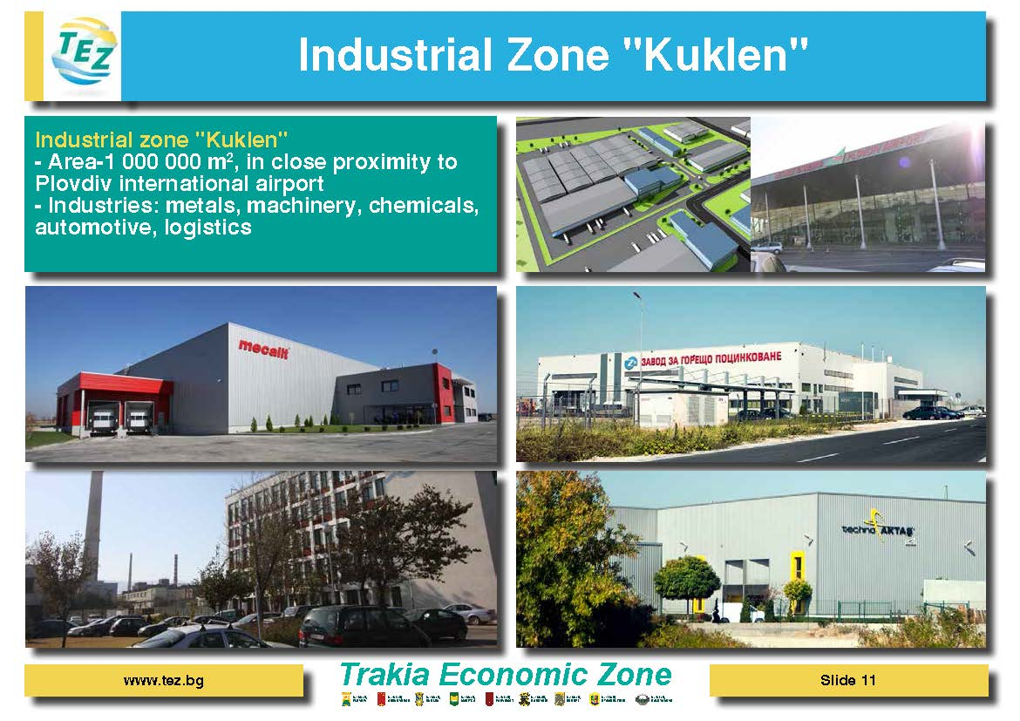
INDUSTRIAL ZONE "KUKLEN"
- Area-1 000 000 m², in close proximity to Plovdiv international airport
Industries: metals, machinery, chemicals, automotive, logistics
www.tez.bg
Slide 18

Slide 19
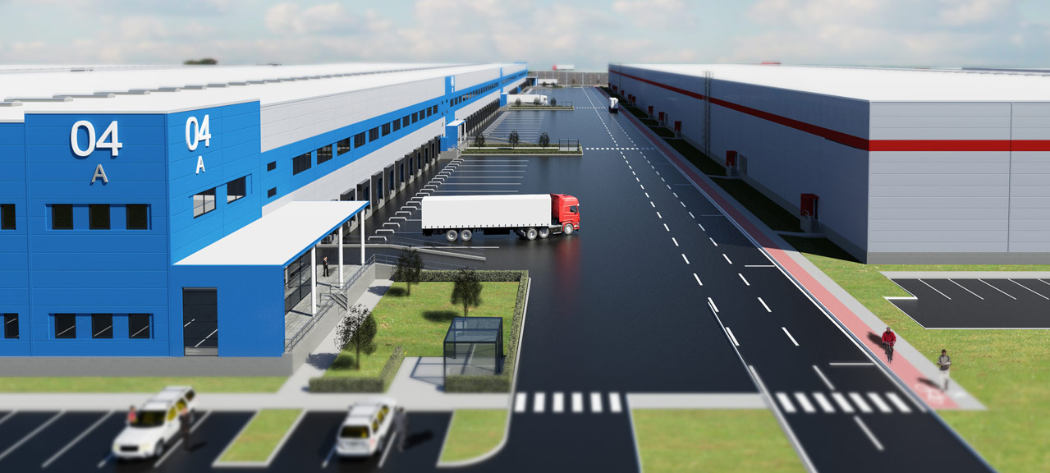
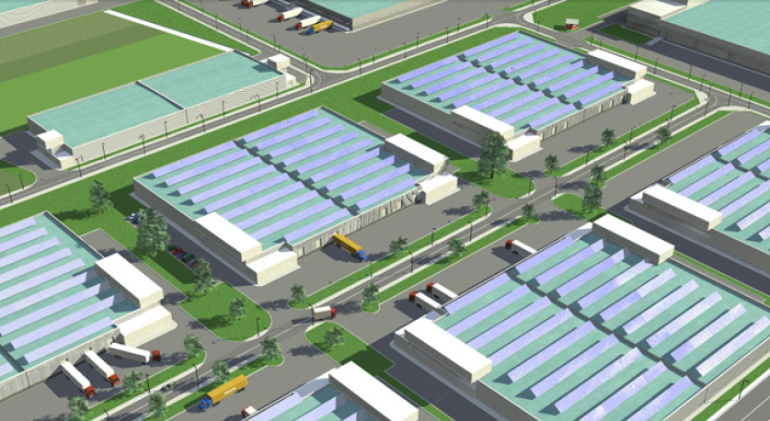
"EURO-CHINESE ECONOMIC DEVELOPMENT ZONE"
AREA:
Private land - 2 550 dka
Municipal land - 150 dka
Land for infrastructure - 300 dka
PROJECT CONCEPT:
Estimates feature the construction of logistics buildings, commercial facilities, production facilities, and a cargo terminal for
automobile and railway transport. Agricultural parameters of the region are likely to start facilities engaged in the production, storage
and trade of agricultural produce.
www.tez.bg
Slide 19

Slide 20
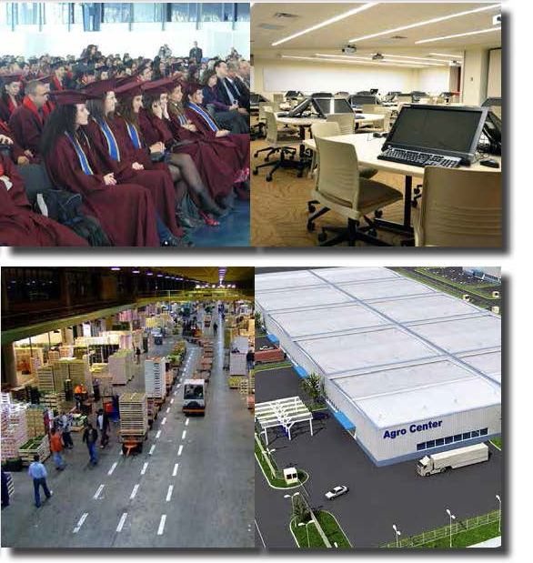
EDUCATION AND AGRICULTURE
Educational and Hi - Tech Park
- Area-300 000 m2
- Located on the territory of the city of
Plovdiv
- Plovdiv Municipality has the ambition to
attract investors of the sector of innovative
production and high technologies.
- Implementation of partner projects with
research institutes and universities.
Agro Centre "Kaloyanovo"
- Area - 800 000 m2
- Focus - development of organic farming
and bio products
- Activities - food industry, production of
packaging materials, distribution,
equipment, chemicals, know-how and
service.
- The Zone will apply waste - free
technologies
www.tez.bg
Slide 20

Slide 21






ORGANISATIONS SUPPORTING TEZ
Invest Bulgaria Agency
Ministry of Economy and Energy
Bulgarian-Chinese Business
Development Association
Bulgarian Small and Medium Enterprises Promotion Agency
Confederation of Employers and Industrialists in Bulgaria
German-Bulgarian Chamber of
industry and commerce
Union of Economists in Bulgaria
Hellenic Business
Council in Bulgaria
Bulgarian Construction Chamber
Bulgarian-Nordic Chamber
of Commerce
Plovdiv Chamber of
Commerce and Industry
American Chamber of Commerce in Bulgaria
Union of Architects in
Bulgaria
French-Bulgarian Chamber of
Commerce
Trakia Economic Zone
Cluster
Belgo-Bulgarian Association
Best2B
Information and Communication Technologies Cluster Plovdiv
www.tez.bg
Slide 21

Slide 22
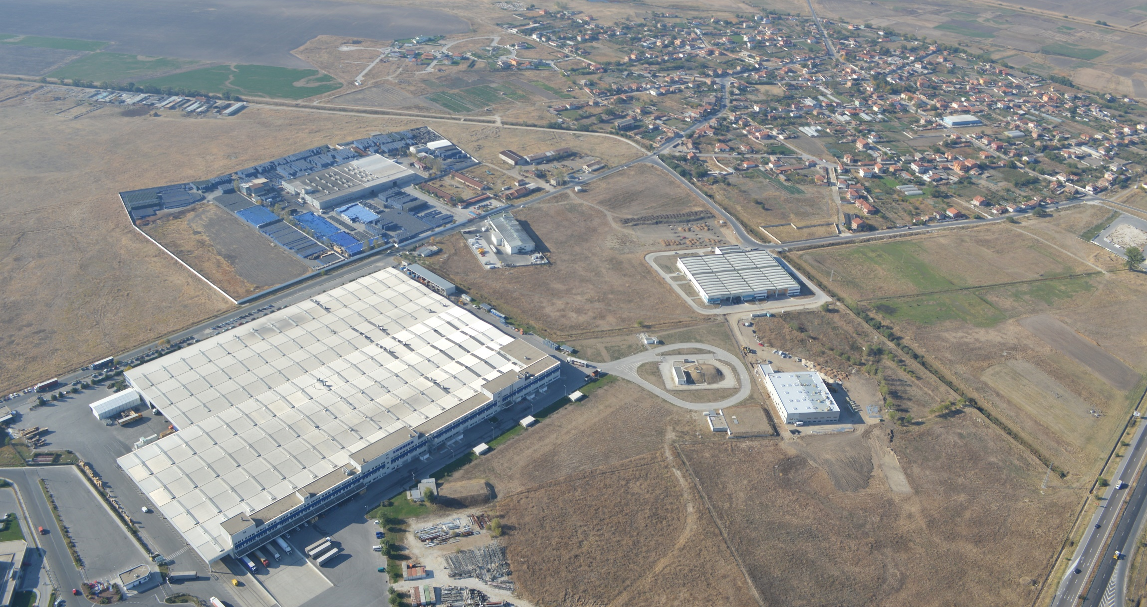

Thank you for the attention!
Office Plovdiv,
Bulgaria
+359 32 600 160
Office Sofia, Bulgaria
+359 2 971 09 10
Office ShenZhen, China
+86 156 2212 5609
info@tez.bg
www.tez.bg
Slide 22

