Slide 1
PIMK RAIL The Recent Bulgarian railway operator which exciting

Slide 2
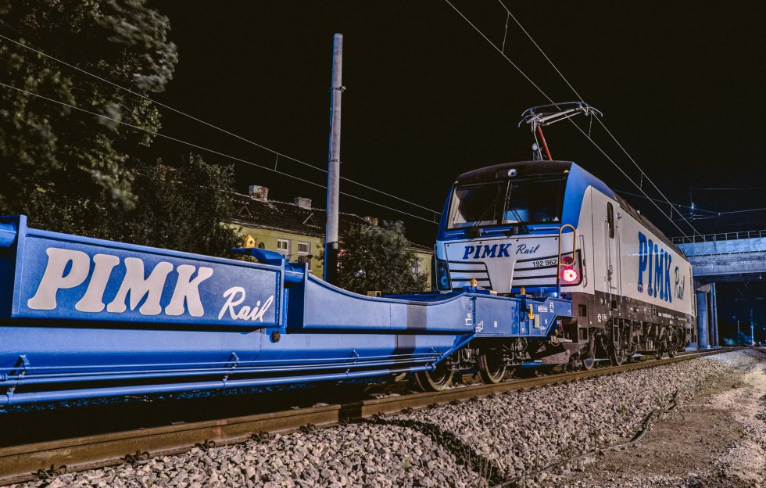
PIMK RAIL is new player in Bulgarian railway market with following fleet:
Double pocket wagons which is suitable for transport of :
Trailers ,approved for railway transport
20,30,40,45 feet containers
Tanks for fuel, food

Slide 3
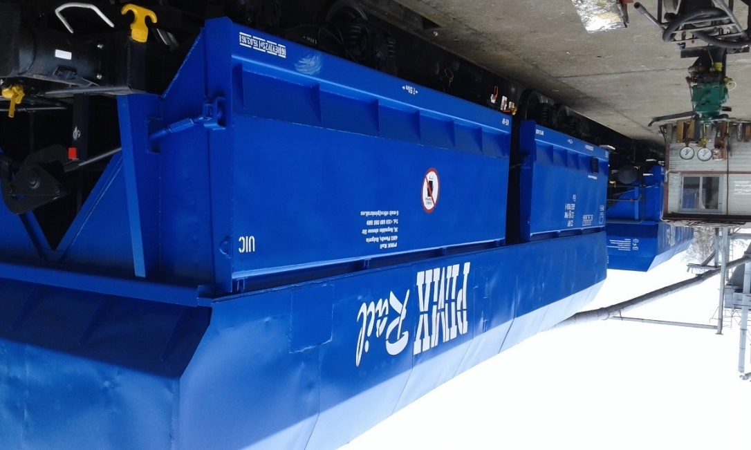
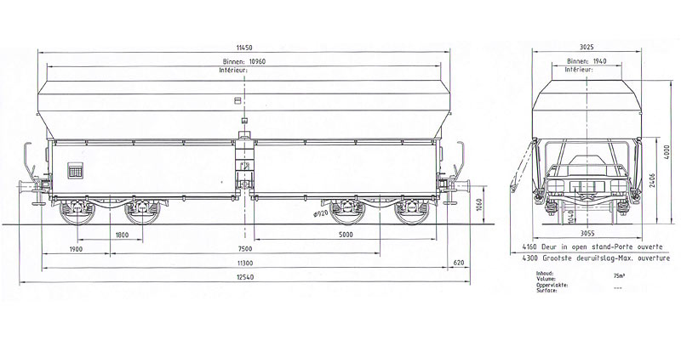
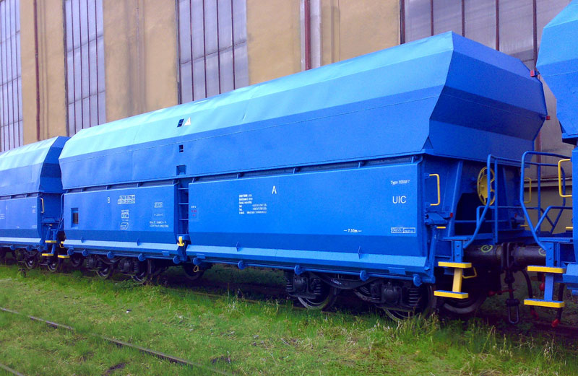
Wagons Type FALS
Four-axle hopper wagon designed to transport of bulk commodities (coal, ore, stones ,sand), which do not require protection from rain, snow and climatic influences during transport.
Wagon loading is provided using hoppers or excavator, unloading is provided using mechanically actuated discharging flaps.

Slide 4
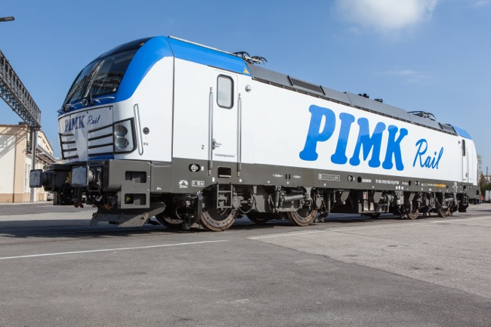
PIMK RAIL LOCO FLEET
Vectron AC Medium Power electric 5.6 kW
Maximum speed | 160 km/h (99 mph) or 200 km/h (120 mph)
Power output | 5.2 MW (7,000 hp) or 6.4 MW (8,600 hp)
Tractive effort | 300 kN (67,000 lb_{f}) (starting
Certified for Bulgaria, Romania, Germany , Austria

Slide 5
Diesel Locomotives series 07
Diesel Locomotives from overhaul 2 items
Power 2206 kW
3000 hp

Slide 6
LOCOMOTIVE SERIE 55 FOR SHUNTING
Power 919(1250 hp)kW

Slide 7
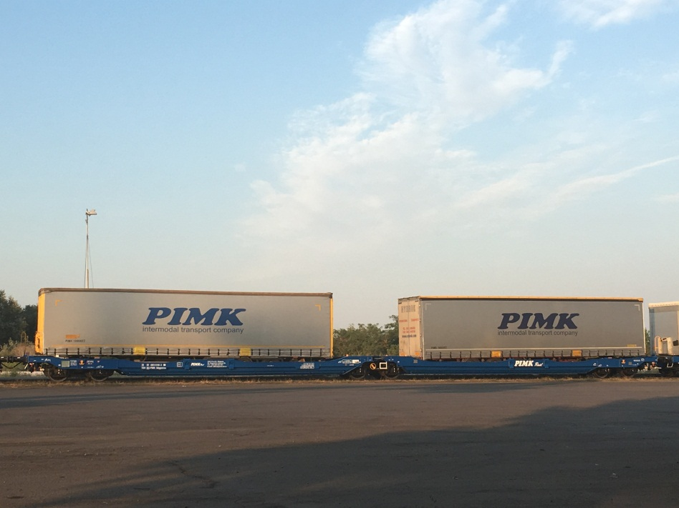
Where we are operating now ?
We are operating in Bulgarian segment in line Ruse -Wels
PIMK already collaborates with DB Cargo, which operates a block train on Ruse-Wels line. PIMK RAIL is in charge with operations on the Bulgarian market, while DB Cargo will cover operations in Romania and Austria.

Slide 8
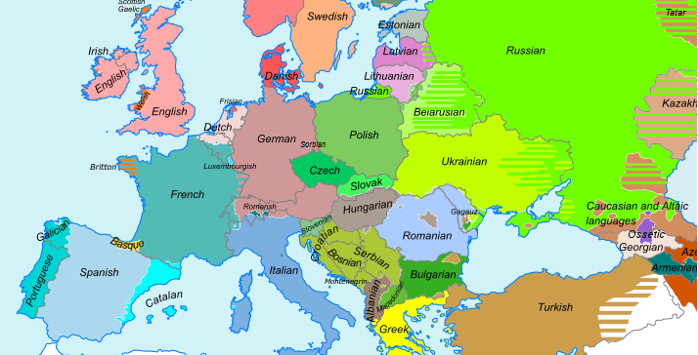
OUR PLANS

Slide 9
Our partners

Slide 10
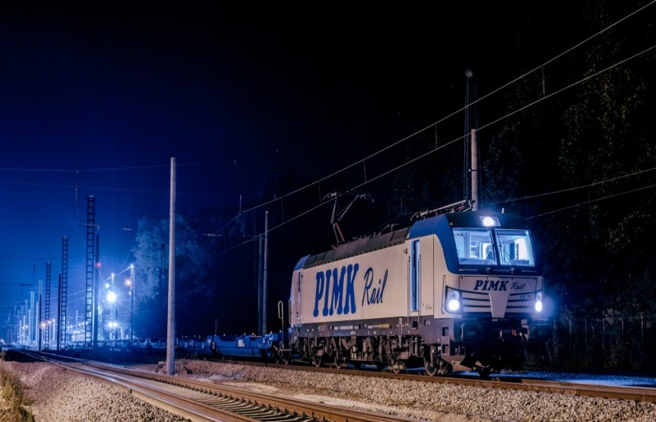
Contact :PIMK RAIL PLS
Plovdiv,Rogoshko shosse 36
Tel:088959 59 89
E-mail:office@pimkrail.eu

