Slide 1
Bulgarian River Shipping J.S.Co – Rousse
The Bulgarian Danube Carrier

Slide 2
“Bulgarian River Shipping” JSCo Ruse is the undisputed leader among the Bulgarian companies dealing with river navigation, as the volumes of transport activities and the company's fleet exceed considerably those of its closest competitors sailing under Bulgarian flag.
The company was established in March 1935 under the name “River Cabotage”. In May 1940 it was transformed into a separate company “Bulgarian River Shipping” based in the town of Rousse. The company has been public till January 2004, its shares are currently traded on the official stock market – segment “B” of the Bulgarian Stock Exchange – Sofia JSCo.
„”Chimimport” through “Bulgarian Shipping Company”, as well as through other subsidiaries, is the owner of 82,10 % of the capital of “Bulgarian River Shipping”.
As of 31.12.2015 the shared capital of the company amounts to 35,708,674 BGN, as the shares are in possession of more than 500 shareholders legal entities and individuals.

Slide 3
As to 31.12.2015 Bulgarian River Shipping is the owner of a fleet, consisting of:
Self-propelled vessels:
Pushers with 1540-2700 HP – 19 pcs.
Tugboats – 2 pcs.
Self-propelled ships – 3 pcs.
Assisting ships – 2 pcs.
Maneuver ships – 2 pcs.
Ferryboat platform for transport of passengers and motor vehicles;
Pontoons – 20 pcs.
Non-propelled fleet:
3 tank-barges;
54 barges, including:
29 pcs. with hatch covers →
- Type SЕ-2000 with TTC up to 2000 MT – 8 pcs.
- Type SЕ with TTC between 1500-1700 MT – 13 pcs.
- Type SB with TTC up to 2100 MT – 5 pcs.
- Barges for the self-propelled ships with max. TTC 1100 MT – 3 pcs.
- 21 pcs. open top barges with max. TTC up to 2200 MT;
- 13 pcs. barges with crew with TTC from 1000 to 1500 MT;
- car-carrier type barges – 2 pcs.
- Ro-Ro – 2 pcs.

Slide 4
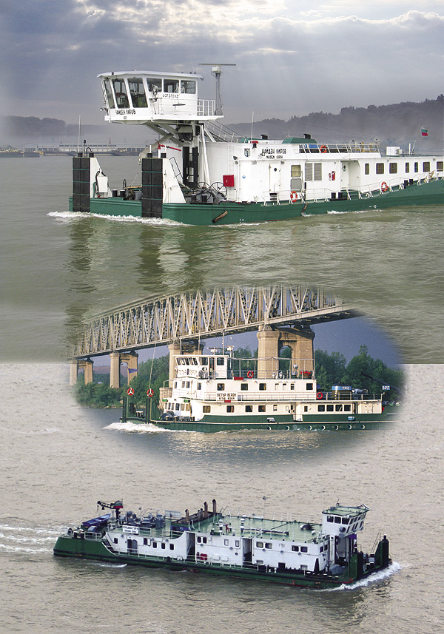
Bulgarian River Shipping JSCo offers a wide range of services to its clients, covering most of the needs of the companies looking for transport on the Danube. The company is specialized in:
Transport of bulk and general cargoes, liquid non-hazardous cargoes and fuels, large-sized and concentrated cargoes;
Container transport;
Ferry services between Port Nikopol and Port Turnu Magurele;
Agency services for Bulgarian and foreign ships in all Bulgarian Danube river ports;
Shipping, forwarding and chartering of river and sea vessels;
Organizing of combined transport: river – railroad – sea and river – sea .

Slide 5
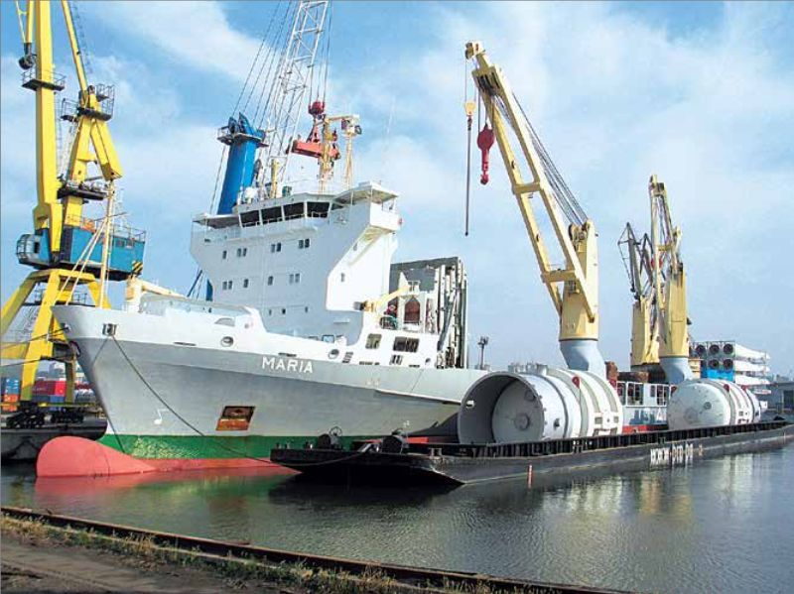
Bulgarian River Shipping maintains:
Own agency offices rendering agency services to the fleet of the company, as wells as to other ship-owners in the ports of Rousse, Lom, Vidin and Svistov;
Agency representative office in the port of Budapest, dealing with agency and chartering of own and foreign vessels.
Bulgarian River Shipping JSCo has its own repair facilities in the town of Rousse for ship repairs and technical works.
Transshipment of heavy parcels at Port of Constanta

Slide 6
Holding company “Chiimport” undertook to invest in Bulgarian River Shipping JSCo 25 million EUR during 2007 – 2011 through its subsidiary company “Bulgarian Ship Company “.
The main objective of the investment program was the increasing of the tonnage of Bulgarian River Shipping, as well as renovating the fleet of the company by replacing ship engines with new ones, product of “Caterpillar”; making constructive changes in some of the pushers thus enabling them to sail in the Upper Danube. The full reconstruction and replacement of the engines of 6 of the pushers was completed and their exploitation proved exceptionally good, resulting in low fuel consumption and minimal environmental pollution.
The investment program paid special attention to the building of new vessels, as well as to the growth of the fleet through purchase of vessels from other ship-owners.
Upon signing a contract with "Ship Building" JSC – Varna in 2008 started the building of six covered barges (2 000 DWT dry cargo river barges "Europe-II” type). "Ship Building" JSC – Varna launched the first two barges in 2008 and by the end of 2009 with the building of the other 4 barges the series was completed and they were put also into operation. At present, these barges are the newest barges on the Danube under Bulgarian flag.

Slide 7
In 2010 in implementation of the investment program Bulgarian River Shipping increased its fleet with purchasing, as follows:
- 10 pcs. river vessels, incl. 3 self-propelled vessels with 3 barges to the vessels, 2 non-propelled river barges and 2 pushers. The acquisition of the vessels was due to the contract between Ship Building JSCo and Bulgarian River Shipping, as a result of which the fleet of the company was increased by additional loading capacity of 9400 MT and power of 6600 HP;
- 4 pcs. non-propelled river barges and 1 pusher, purchased from Eastern River Shipping - Rousse.
Due to these two transactions the fleet of the company was increased by a total of 17,000 MT loading capacity and 7,500 .
The investment program of Bulgarian River Shipping foresees the building of a logistics center with a capacity of over 25,000 square meters, facilities for the storage and marketing of petroleum products with a capacity of over 10,000 tons and grain silo with a capacity of 2,780 cubic meters.
The center is going to cover an area of 185,000 square meters (45,7acres) owned by BRS in the Industrial Zone Rousse-East, next to bank of the Danube River.

Slide 8
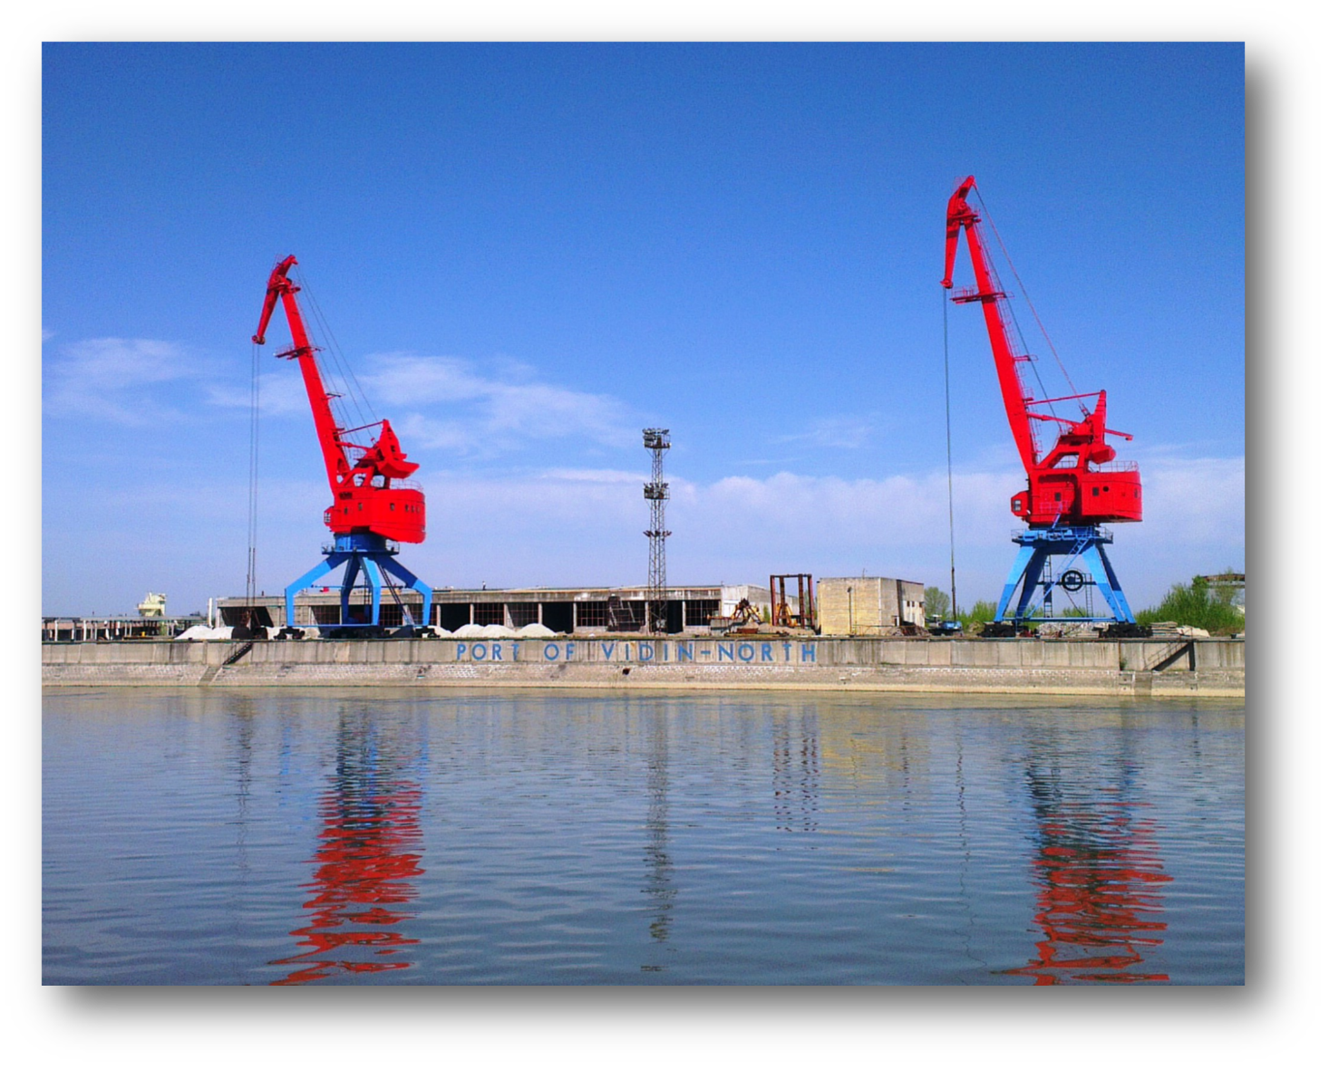
On 20.08.2010 the Ministry of Transport, Information Technologies and Communications concluded with Bulgarian River Shipping JSCo contract to award a 35-year concession for the operation of Port Terminal “Vidin-North” and Ferryboat Terminal “Vidin“, parts of Port for Public Transport of National Importance Vidin. The contract entered into force on 20.10.2010 and is for a period of 30 years.
Port terminals “Vidin-North” and Ferryboat Terminal “Vidin“ form the territory and operational aquatory of port “Vidin-North”, namely from km. 792.800 till km. 793.600 according to Danube mileage.
Port Terminal “Vidin-North” is with overall port area of 120 000 m2, disposes of railway tracks, there is a road connection with national road E79. The open storage area is total up to 10 000 m2, there is a built and functional covered storage with total are 4 000 m2. On the territory of the terminal is set up and is functional storage under the customs warehousing procedure. Port Terminal “Vidin-North” disposes of 4 berths, two of them are specialized in handling of grains (at berth No.4 e. g. the output is 250 MT/hour transshipment from truck to ship without any crushing, scattering or contamination of the grain) and the other two berths are multipurpose.

Slide 9
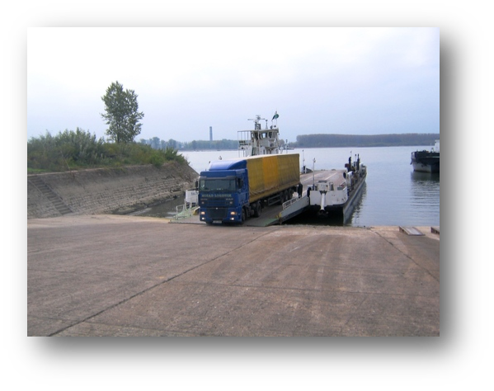
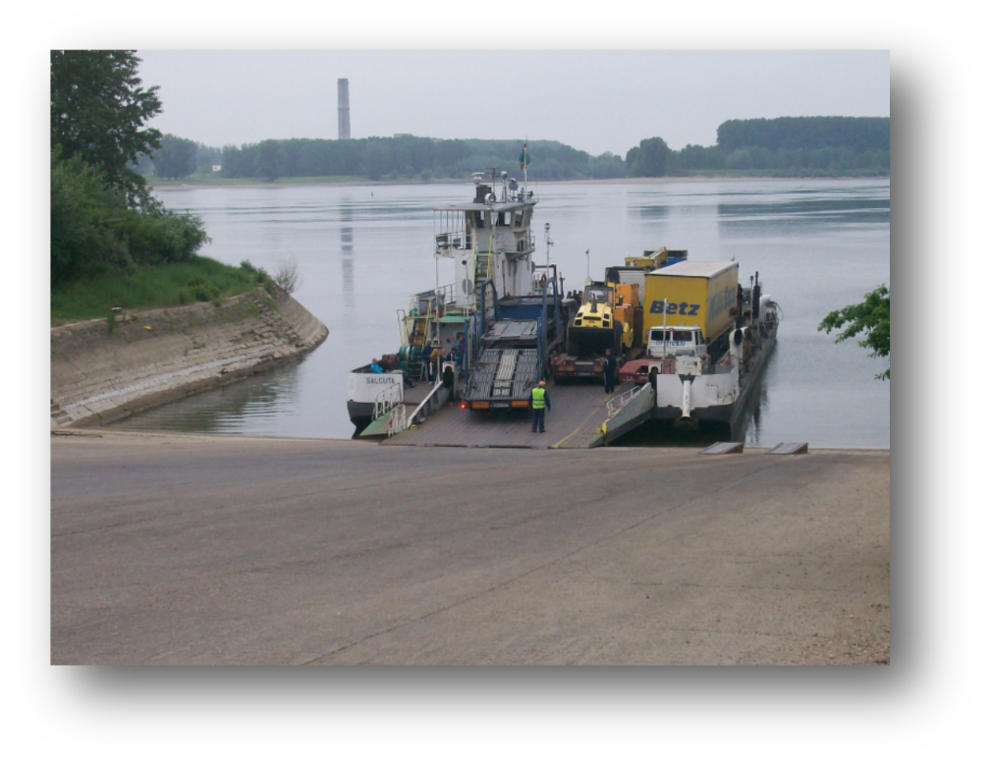
Huge problem for most river ports are the low waters of Danube River during the summer months. Having in mind the depth of the port aquatory and the technical parameters of the port technique for transshipment, this matter does not concern port Vidin-North at all. Even during the lowest water levels ever measured so far, the port provides incessancy of the transshipment operations, which contributes to more qualitative services for the clients.
Port Terminal “Vidin-North” is certified for handling of general cargoes (containers, metals, machinery, equipment, over-dimensioned and heavy packages, etc.), bulk cargoes (grains, aggregates, woods, coal, etc.), non-hazardous liquid goods (vegetable and animal oils, liquid chemical products and preparations, etc.), supplying ships with electricity and communication, ship bunkering (fuel, lubricants, water, etc.), providing of maritime-technical services, supplying with food and other products.
Major proportion of the total cargo volume is for the bulk cargoes; leading bulk cargoes with highest volume are the agricultural products, followed by gypsum, technical wood, coal, etc.

Slide 10
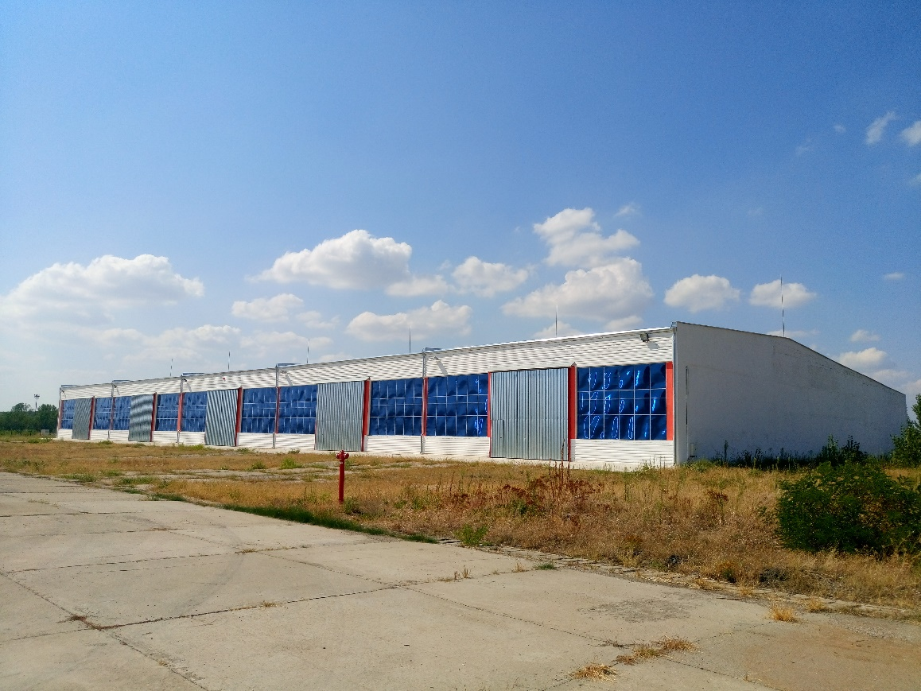
The covered warehouse is with total built-up area of 3725 м2 and it’s divided into 5 separate sections, each with area of 745 м2.
Height, width and length of every section are, as follows: 6,10 m/17,75 m/42 m.
Port “Vidin-North” is an advanced modern port with well-developed infrastructure.
The port terminals dispose of the necessary equipment, advanced technologies and qualified personnel for providing the full circle of port services – handling of ships, wagons and trucks from accepting the cargoes, their storage in open and covered storage areas until their expedition to the final recipients.

Slide 11
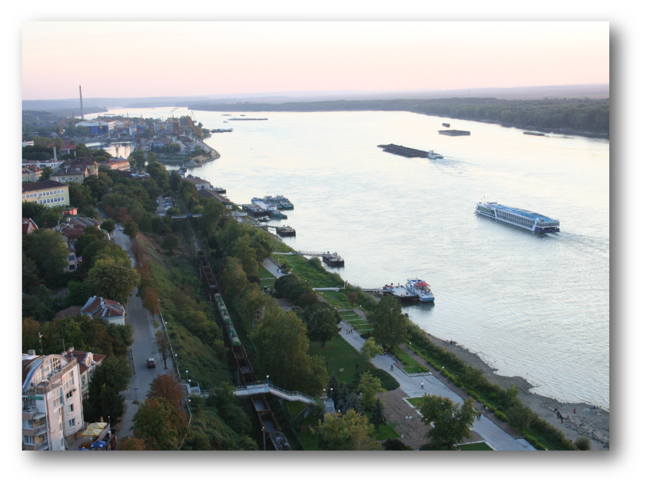
Since the entry into force of the contract for gaining admission for providing port services in Port for Public Transport of Regional Importance “Pristis” Ruse till the end of 2014 the number of ships, which have visited the port, exceeds 4 500.
The number of handled passengers exceeds 117 000.
“Port Pristis” Ltd. is registered in September 2010 as a limited liability company with registered offices and head office: Bulgaria, Ruse 7000, 2 Otets Paisii Sq., floor 8.
Bulgarian River Shipping JSC is the main shareholder (55%).
Port “Pristis” is specialized in handling passengers, stay of ships and their supply, ship bunkering and disposes of 11 berths. On the territory of the port are provided maritime-technical services (mooring services, supplying ships with water, electricity and communication, ship bunkering, etc.); services on handling of passengers – embarkation and disembarkation of passengers, loading, discharging and storage of luggage; additional activities (sports and leisure activities, agency-forwarding services, restaurant and commercial services, etc.)

Slide 12
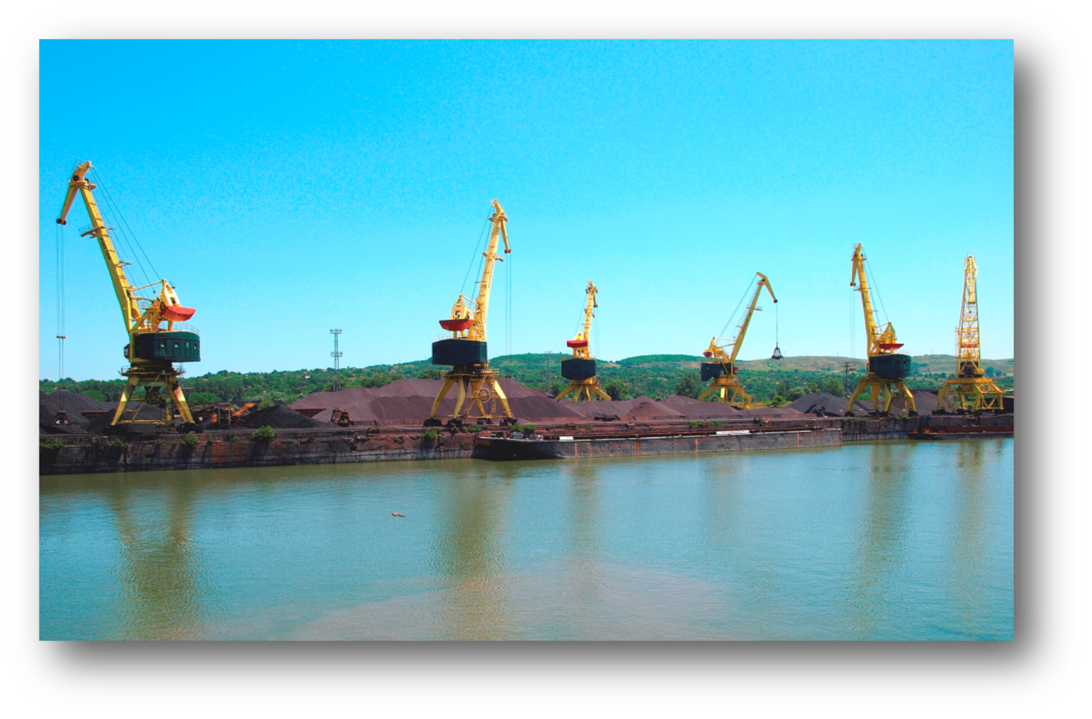
“Port Invest” Ltd. is registered as a limited liability company with registered offices and head office: Bulgaria, Ruse 7000, 2 Otets Paisii Sq., floor 8. Bulgarian River Shipping JSC is the sole owner of the capital. “Port Invest” Ltd. is determined as a concessioner of Port Terminal Lom, part of Port for Public Transport of National Importance Lom. By the conclusion of the contract “Port Invest” Ltd. acquired the right of sole port operator of Port Lom. Port Lom is situated on the right shore of the Danube River; from river-km. 742.000 to river-km. 742.500, in the central part of the city of Lom, district Montana, North-western Bulgaria. It is 162 km. north of Sofia, 56 km. south-east of Vidin, 49 km. north of Montana and 42 km. west of Kozlodui. The city of Lom is an administrative and economic centre and second in population in the district. The development of the city as a big port centre on the river (2nd after Ruse) is defined by being the closest port to the capital of Bulgaria (Sofia).
Port Lom is with overall port area of 371 129 m2. The basic port infrastructure and facilities are built on area of 302 379 m2. The port is connected with the National railway network and the road network. Through the city of Montana there is a connection with international road E 79.
Infrastructure, technological and technical security of Port Lom:
Piers and berths: the port disposes of 5 piers and 13 berths, three of them (No. 1, 2 and 3) are situated on the main Danube and the other 10 – in the firth.
Covered and open storage areas: solid storages and shelters with overall area of 8 343 m2 and open storage area 117 921 m2.

Slide 13
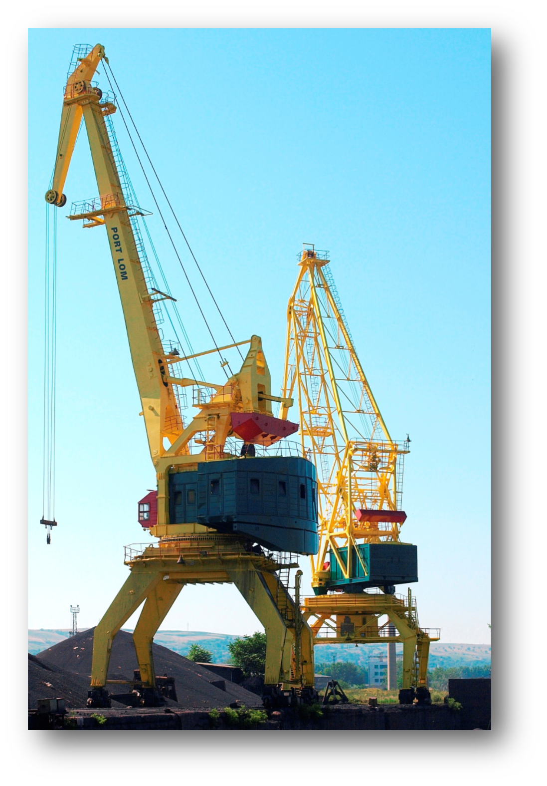
Cranes and transshipment facilities: the basic transshipment facilities for handling of cargoes are 19 el. gantry cranes with lifting capacity between 5 and 20 t. The port disposes of parking zones for cars/ trucks, as well as internal port railway network. The port fleet consists of 1 pusher, supporting the port aquatory and the adjacent roadstead.
On the territory of the terminal are located border crossing point, customs office, plant-health control post, etc. The cargoes from and for the port are being transported by road, railway and inland waterway. The Port Terminal is designed for handling of import and export cargoes. The port services, typical for universal port, are guaranteed by the located on the territory of the port open and covered storage areas, handling facilities and engineer infrastructure for water supplying, energy supply system for the specialized handling facilities and lighting facilities.
In carrying on its activity, Port Invest Ltd. is guided by the best European practices, existing normative documents and the integrated by the company Quality management system. Port Lom holds: certificate in the Registry of the State agency for metrological and technical surveillance (SAMTS); certificates for handling of bulk and general cargoes, issuing of transport documentation, repair works and port services, issued by SGS Bulgaria Ltd., as follows: BS OHSAS 18001:2007, ISO 9001:2008, ISO 14001:2004.

Slide 14
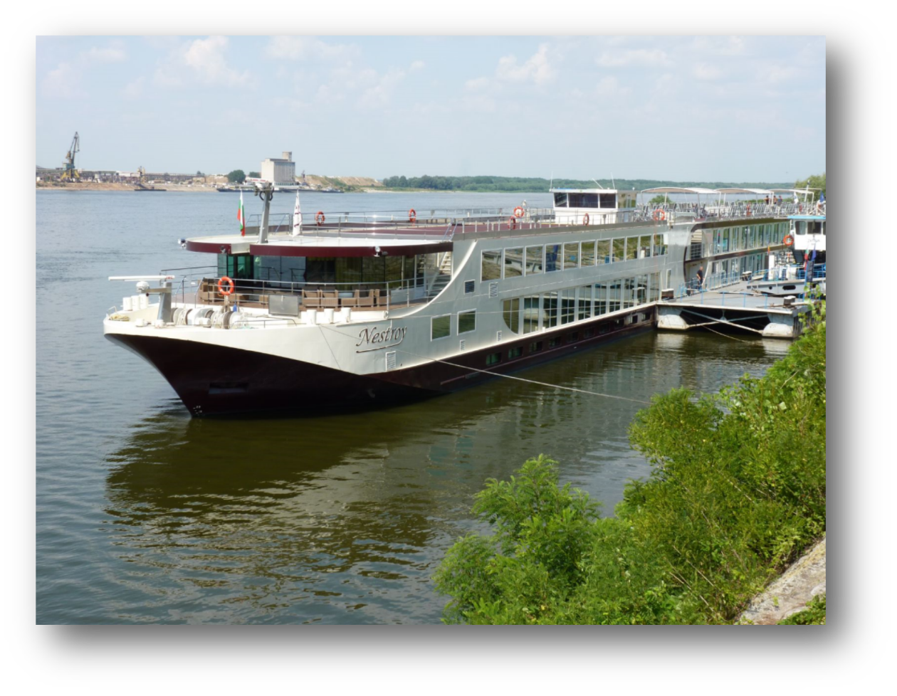
In October 2013 Bulgarian River Shipping JSC concluded a contract with the Ministry of Transport, Information Technologies and Communications to award a 35-year concession for the operation of “Port Terminal Nikopol”.
“Port Terminal Nikopol” is a part of Port for Public Transport of National Importance Ruse and it is situated on the south (right) shore of the Danube River from river-km 597,900 to river-km. 597,550 from the mouth of the Danube River in the western part of the city of Nikopol, district of Pleven.
The port terminal is situated on the Pan-European Transport Corridor VII (Rhein-Main-Danube). Its main purpose is to provide place for arrival of ro-ro ships with horizontal loading for passengers, cars and agricultural and wheeled vehicles, sailing between the Bulgarian and Romanian shore on the Danube River within the ro-ro line Nikopol – Turnu Magurele.
Port Terminal “Nikopol” was designed, built and entered into force in 2008. The overall port area is 17 642 m2. On the territory of the terminal are located border crossing point, customs office, plant-health control post, etc. The cargoes from and for the port are being transported by road and inland waterway.

Slide 15
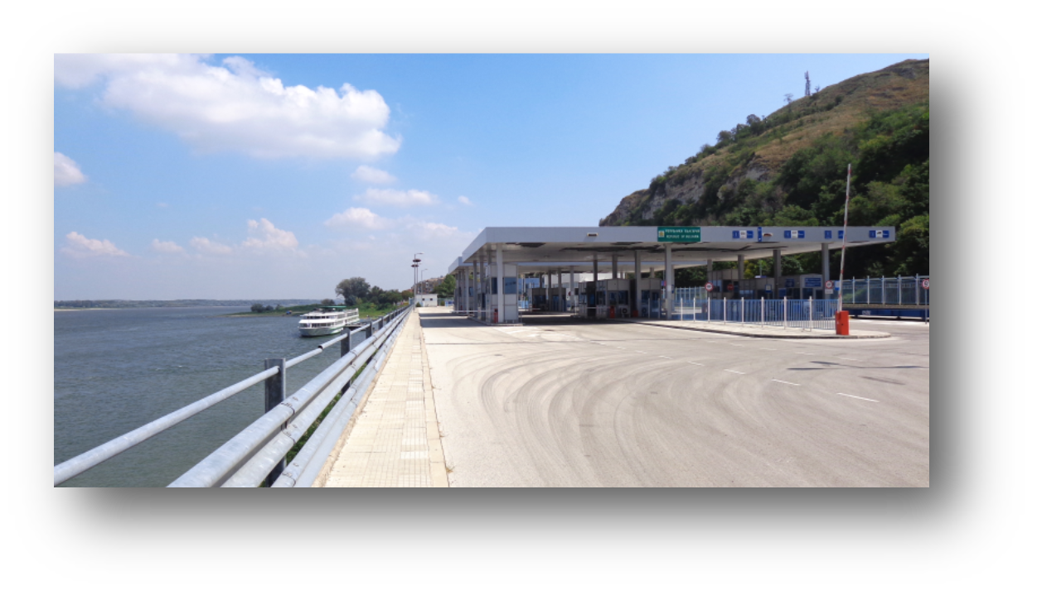
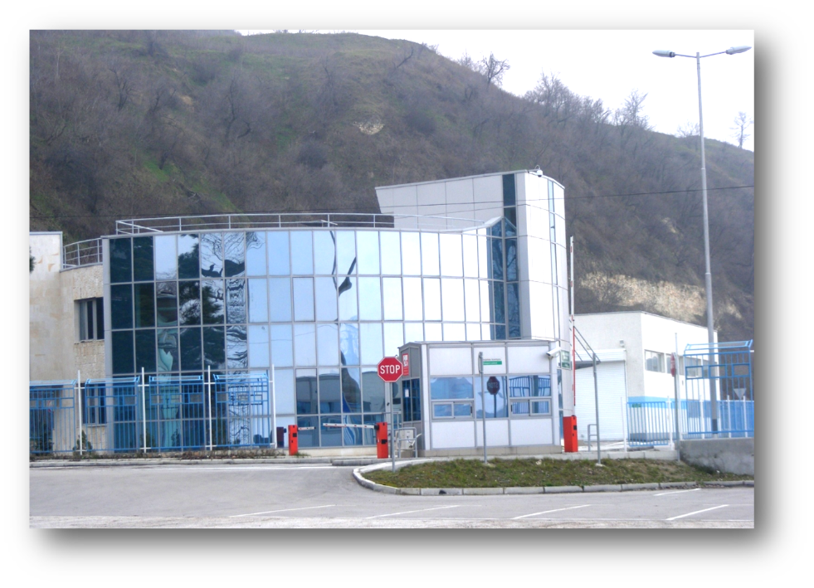
Port Terminal Nikopol, a part of Port for Public Transport of National Importance Ruse, is intended for: handling of ro-ro and ferryboat cargoes – passenger cars, light commercial and commercial vehicles, buses, agricultural and other self-propelled wheeled vehicles; handling of passengers – embarkation and disembarkation of passengers; mooring services, supplying ships with water, electricity and communication; supplying with food and other supplies.
By the end of June 2015 a second berth was put into service in Port, intended for direct loading of grains (“truck – ship”). The loading equipment there has a capacity of about 300 MT per hour, which allows round-the-clock rate per ship of min. 2 – 3000 MT grains, depending foremost on the arrival of trucks with grain. For the 2 months following the implementation of the berth more than 18 ships have been loaded with 22 000 MT grains
In the plans for development of port Nikopol is the intention one more berth for grains to be put into service, as well as there are plans for building of storages (silos) for grains with capacity 3 – 4000 MT, which will allow also indirect option for loading.

Slide 16
With the conclusion of these 4 agreements, Bulgarian River Shipping J.S.Co enriched its main activity with more services – i.e. to act as a port operator, providing transshipment operations and port services to passenger and cargo ships in several Bulgarian ports.
Since December 2006 the company is certified by the Germanischer Lloyd Certification GmbH according to ISO 9001:2000.
Nowadays Bulgarian River Shipping J.S.Co is the biggest Bulgarian river carrier on the Danube River. It’s almost impossible the company to be displaced from the leading positions in the transport of mass cargoes as coal, fertilizers, ores, coke, grains, etc.
Bulgarian River Shipping J.S.Co is in successful partnership with over small and large companies all over Bulgaria and Europe.

